Slide 1
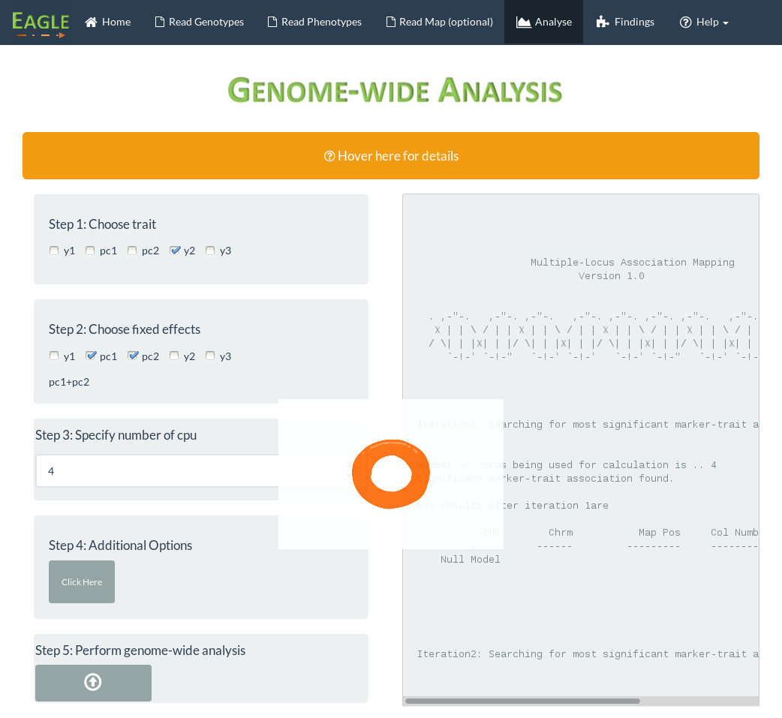
Click on findings
once analysis is
complete
Selected “y2” to
be the trait
Output from analysis appears here
Selected
fixed effects
Processing
animation
Set number of
cpu to 4
Click button to
start analysis

