Slide 1
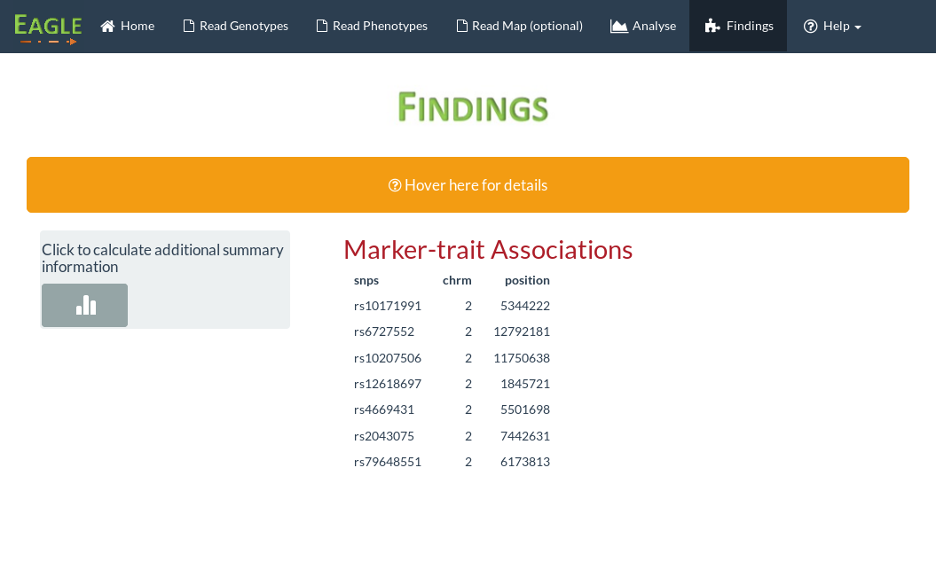
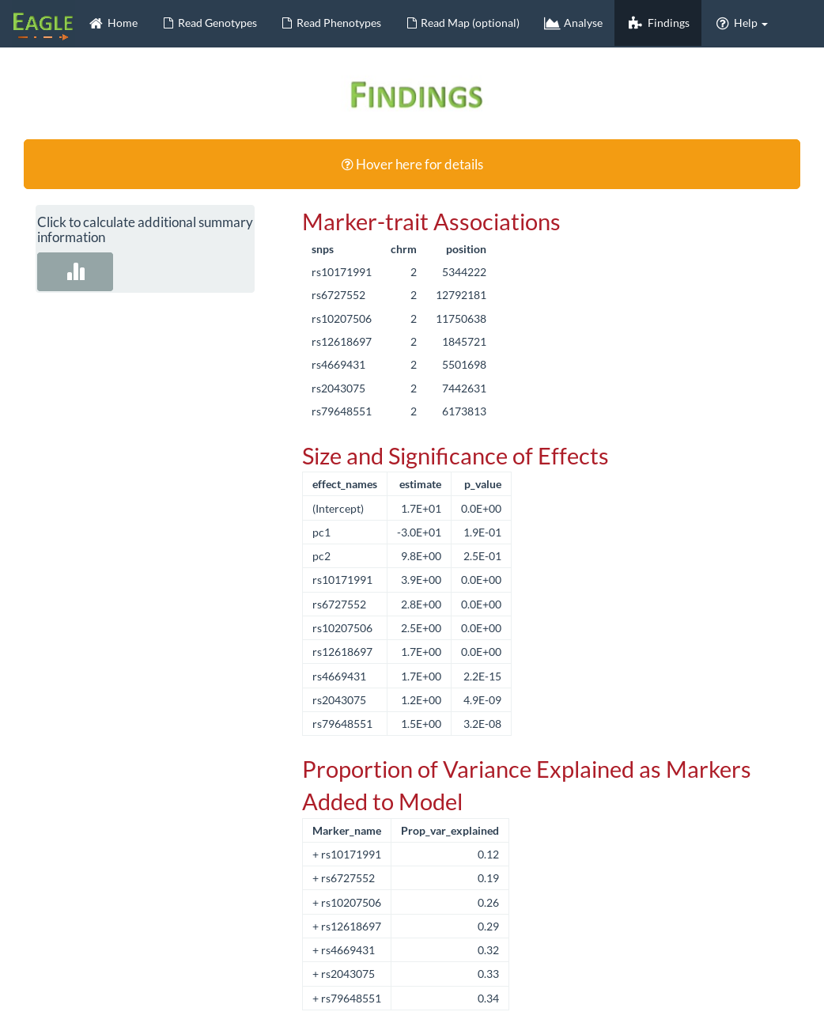
List of “best” snp found to be in strongest and significant association with the trait
By clicking here, additional summary information is calculated
Effect size and significance of “best” snp along with any other fixed effects included in the model
Gives the percentage of phenotypic variation explained by having only the first “best” snp in the model, then the first two “best” snps etc. The final line of this table is the percentage of phenotypic variance explained by a model that has all 7 “best” snp in the model.

