Slide 1
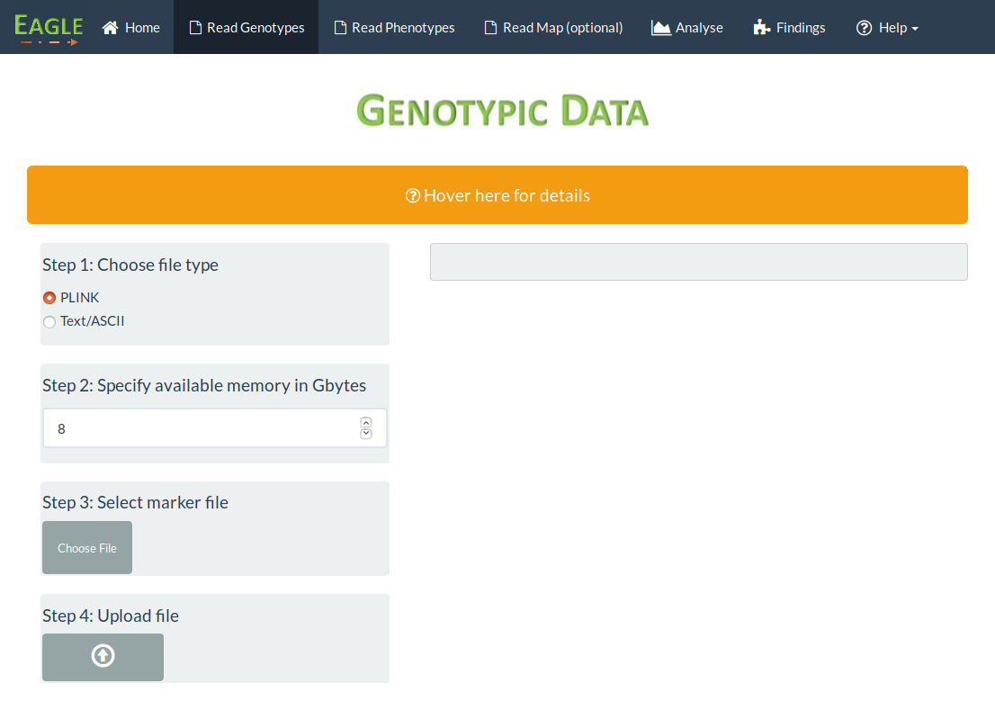
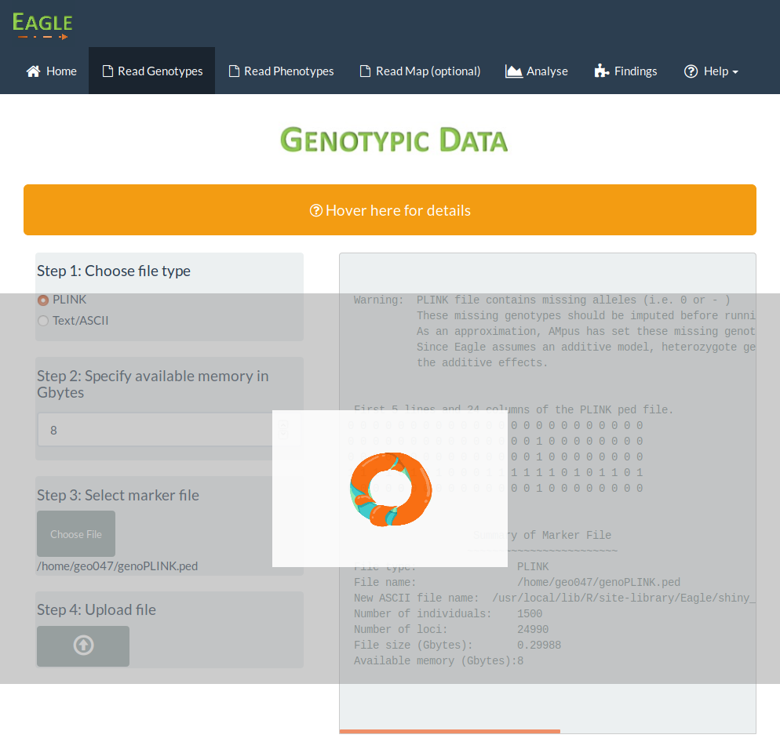
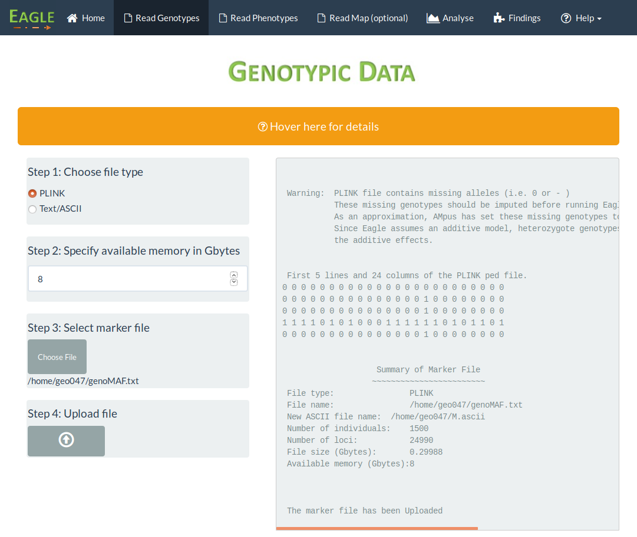
Initial page after pressing Read Genotype tab
Step1 : Leave as PLINK
Step2 : Set amount of memory
Step3 : Click here to open
file browser
Step4 : Click here to begin
reading file
As the file is being read, a loading
animation appears along with output
in the right panel
Once the file has been read,
the loading animation will disappear,
with only the output remaining

