Slide 1
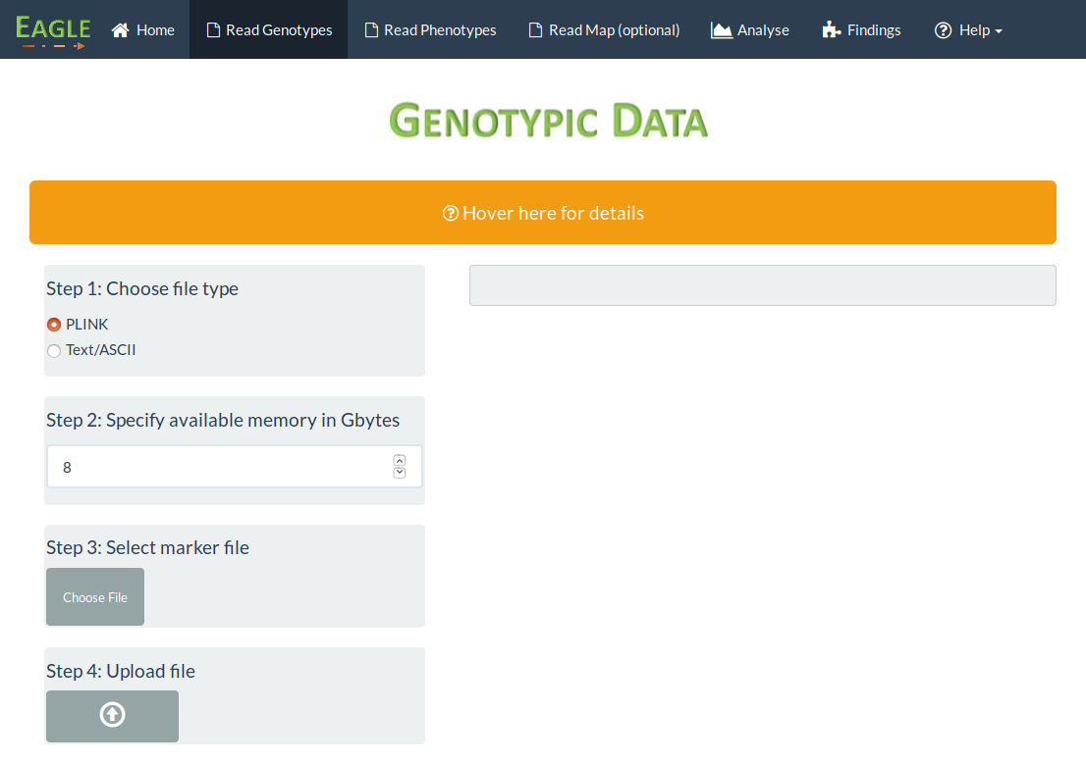
Specify the amount of available
memory in Gbytes.
Use arrow keys
or enter number manually

