Slide 1

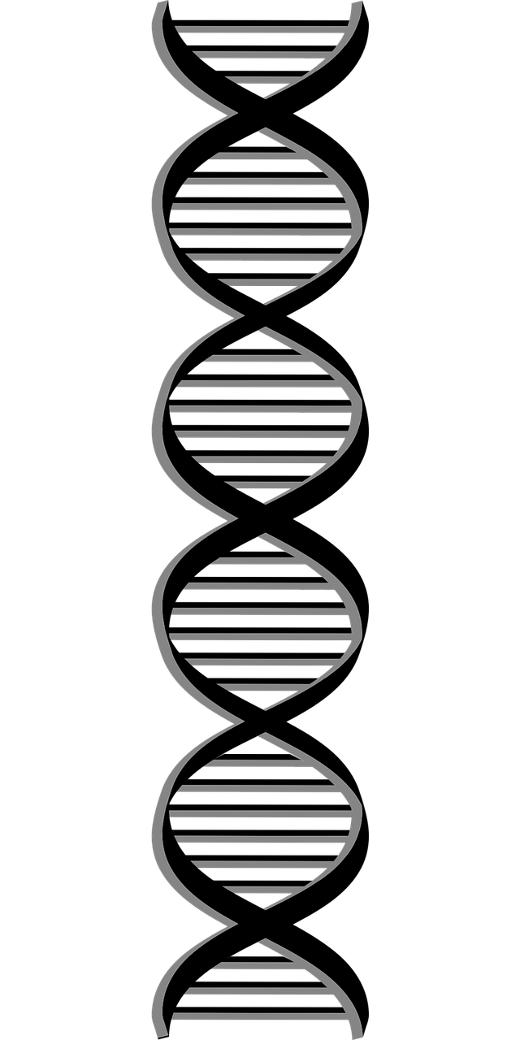
Eagle
Multiple-locus Genome-wide Association Mapping
Analysis Workflow
Read Genotypes
Read Phenotypes
Optional
Only if needed
Read Map
Read Z Matrix
Formats: PLINK ped or
plain text
Format: text file, space or
comma separated
1
Example plain text file
Format: text file, space
separated
Format: text file, space
separated
Genotypes can be
coded as any
alphanumeric value
Space
separated
Example
Example
Example
Column names
2 traits (y1 & y2) and
4 fixed effects
Column names
Matching genotype
SNPs
y1 | y2 | pc1 | pc2 | age | sex
0.1 | 100 | 0.11 | 1.4 | 10 | M
3.4 | 110 | 0.36 | 2.3 | 25 | M
-2.1 | 90 | 0.27 | 1.7 | 34 | F
-0.3 | 44 | 0.18 | 2.1 | 24 | F
SNP | Chrm | Pos
rs3454 | 1 | 0.3
rs2344 | 1 | 2.5
rs05344 | 1 | 11.4
1 | 0 | 0 | 0 | 0 | 0 | 0 | 0
0 | 0 | 1 | 0 | 0 | 0 | 0 | 0
0 | 0 | 1 | 0 | 0 | 0 | 0 | 0
0 | 1 | 0 | 0 | 0 | 0 | 0 | 0
0 | 0 | 1 | 1 | 0 | 1 | 1 | 1
0 | 0 | 1 | 1 | 0 | 1 | 1 | 1
0 | 0 | 1 | 0 | 0 | 1 | 1 | 0
0 | 2 | 1 | 1 | 0 | 1 | 1 | 1
SNP
Matching trait value
Individuals
Individuals
Findings
Analysis
”Best” set of snp and their
map location
SNP | Chrm | Pos
rs00454 | 5 | 123.2
rs112844 | 1 | 73.1
rs833208 | 12 | 15.3
Distributed
computation
Amount of phenotypic
variance explained by
SNP, cumulatively
Effect size, and significance
Multiple-locus
genome-wide
analysis
SNP | Proportion of Variance Explained
rs00454 | 0.05
+ rs112844 | 0.12
+ rs833208 | 0.16
SNP | Effect size | P-value
rs00454 | 1.2 | 1e-8
rs112844 | 0.9 | 1e-7
rs833208 | -0.8 | 1e-6
Linear mixed model
framework

