Slide 1
Known
Information
Scenario 1
Scenario 2
Penetrance model
Observed Disease Status
Unaff
Aff
Unaff
Aff
Unaff
QTL Genotype | Trait
 | Aff | Unaff
QQ | 1.0 | 0.0
Qq | 1.0 | 0.0
qq | 0.0 | 1.0
QTL Genotype | Trait
 | Aff | Unaff
QQ | 0.95 | 0.05
Qq | 1.0 | 0.0
qq | 0.0 | 1.0
Y =
Findings from QTL
Mapping study
Allowable QTL alleles
consistent With Y, G, and
penetrance model
Allowable QTL alleles
consistent With Y, G, and
penetrance model
Phased genotype data
in region of interest
Marker Haplotype | QTL allele
g1 | q
g2 | Q
g3 | q
g4 | q
Marker Haplotype | QTL allele
g1 | q
g2 | Q
g3 | q
g4 | q
g1|g1
G1|g2
G3|g4
G2|g2
G4|g4

Slide 2
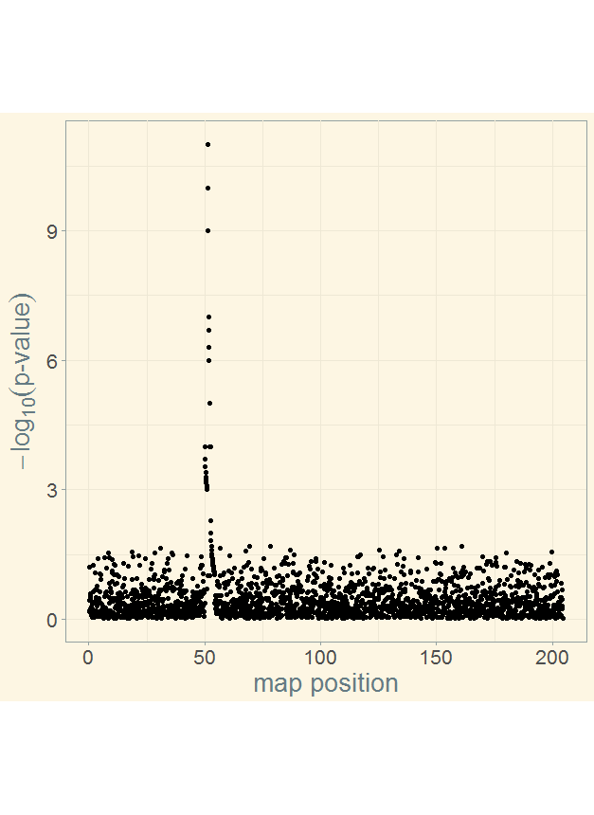
Scenario I
Scenario II
No
uncertainty
Some
uncertainty
Penetrance model - the probabilistic
relationship between trait and QTL
genotype
Penetrance model - the probabilistic
relationship between trait and QTL
genotype
Known Information
Phased genotype
data in region
of interest (G)
QTL Genotype | Trait
 | Aff | Unaff
QQ | 0.95 | 0.05
Qq | 1.0 | 0.0
qq | 0.0 | 1.0
QTL Genotype | Trait
 | Aff | Unaff
QQ | 1.0 | 0.0
Qq | 1.0 | 0.0
qq | 0.0 | 1.0
Disease
Status (Y)
Unaff
Aff
Unaff
Aff
Unaff
g₁|g₁
g₁|g₂
g₃|g₄
g₂|g₂
g₄|g₄
Allowable QTL alleles consistent with observed disease status, phased marker genotypes and penetrance model
Allowable QTL alleles consistent with observed disease status, phased marker genotypes and penetrance model
Findings from QTL Mapping Study
Marker Haplotype | QTL allele | Pr(Q|Y,G, penetrance)
g1 | q | 0.0
g2 | Q | 1.0
g3 | q | 0.0
g4 | q | 0.0
Marker Haplotype | QTL allele configurations
 | i | ii | iii | iv
g1 | Q | Q | q | q
g2 | Q | Q | Q | Q
g3 | Q | q | Q | q
g4 | Q | q | Q | q
region of interest

