Slide 1

Schema.org,
Geo and Linked Data
SDOW-Topic 4
Lieke Verhelst – Linked Data Factory

Slide 2
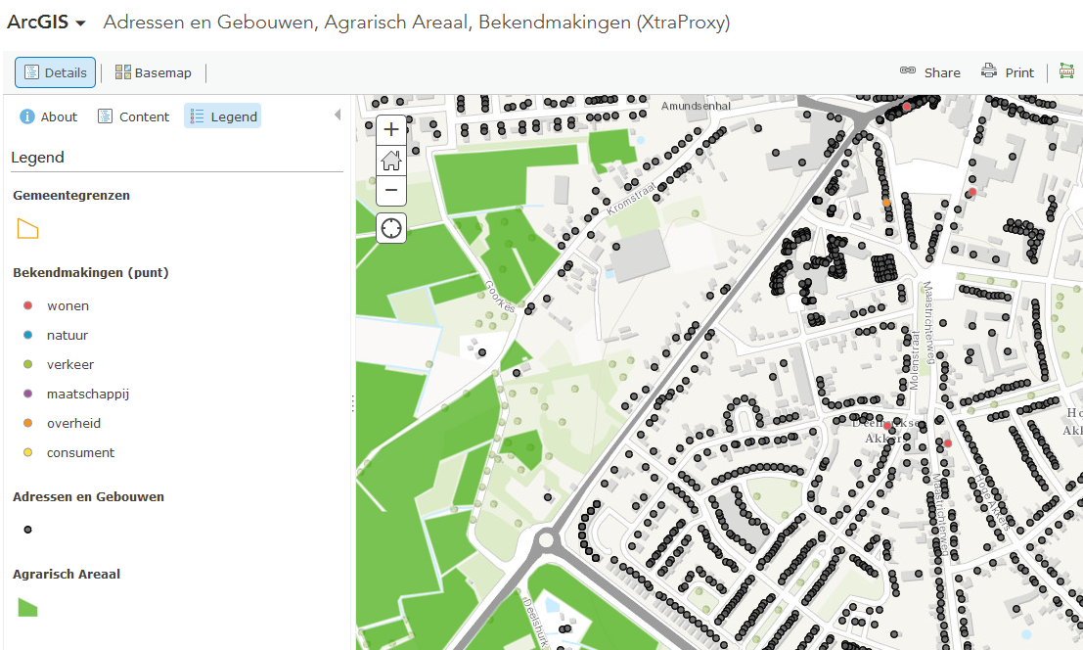

Slide 3
Research questions
How do we add schema.org to the datasets (BAG, AAN, Bekendmakingen)
How can we link them
  Semantics
  Link discovery
What will the SE do with this Linked Data JSON-LD?
How usable is Schema.org for annotating geo information?

Slide 4
Schema.org and Geo

Slide 5
elevation
value
geo
Place
GeoCoordinates
longitude
value
latitude
geo
location
contentLocation
address
value
geoMidpoint
address
CreativeWork
elevation
value
Action or
Event or
Organization
spatial
address
PostalAddress
location
Dataset
GeoShape
dataset
value
Catalog
line
………
value
rdfs:subClassOf
Action or
Event or
Organization
value
value
polygon
GeoCircle
geoRadius
value
Distance
Geospatial elements in
Schema.org Version 2.2

Slide 6
Geo in schema.org
Only Action or Event or Organization (and subclasses) can have a location
Objects of address can be of entity PostalAddress or text (common in schema.org)
Many unnecessary sub properties like jobLocation etc..

Slide 7
Place
address
PostalAddress
addressLocality
value
contentLocation
value
keywords
postalCode
value
value
value
headline
value
value
Report
genre
value
description
url
Bekendmakingen (Administrative
Version)
http://data.linkeddatafactory.nl/bekendmakingen/
value

Slide 8
Place
geo
GeoCoordinates
latitude
value
contentLocation
value
keywords
longitude
value
value
value
headline
value
value
Report
genre
value
description
url
Bekendmakingen (Spatial
Version)
http://data.linkeddatafactory.nl/bekendmakingenspatial/
value

Slide 9
Schema.org and Linking

Slide 10
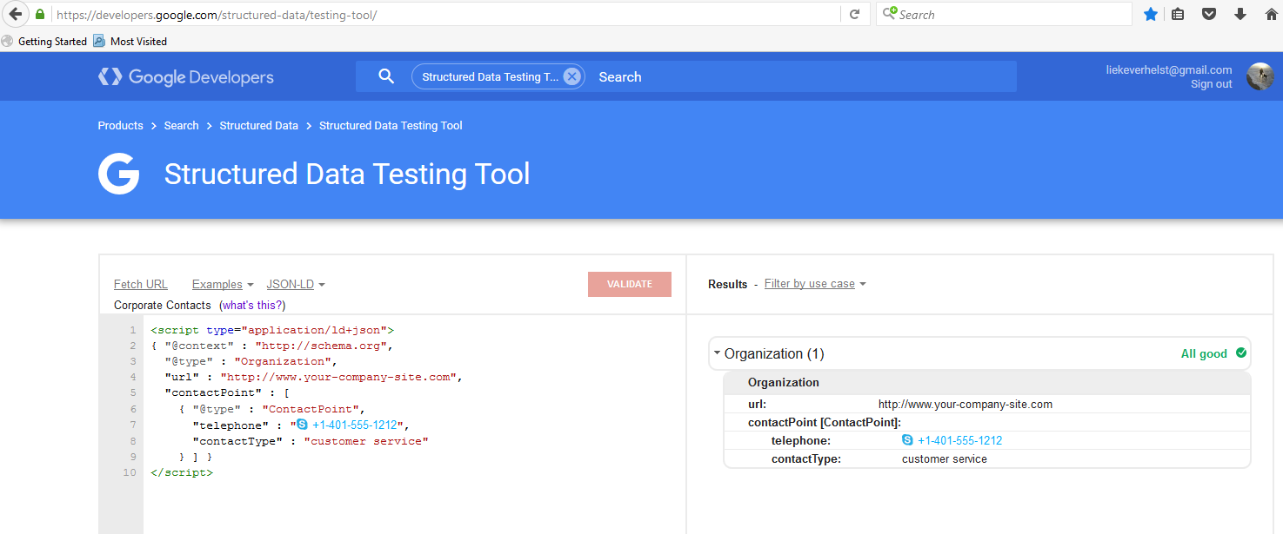
Schema.org for mark-up
NO URI-IDENTIFIER
@id tag

Slide 11
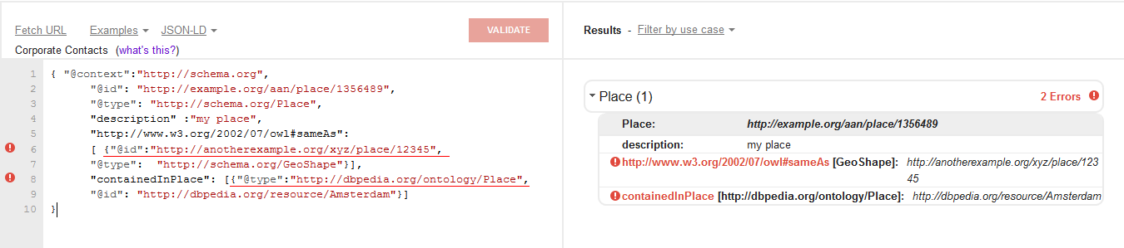


Semantics and the validator

Slide 12
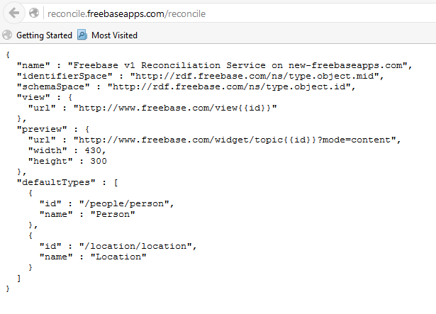
Link discovery API

Slide 13
Link nodes
GeoShape
GeoCoordinates
geo
geo
containedInPlace
Place
address
containsPlace
contentLocation
locationCreated
spatial
locationCreated
PostalAddress
contentLocation
DataCatalog
Dataset
dataset
citation
Report
mainEntityOfPage

Slide 14
Schema.org geo-extension

Slide 15
Requirements
Every Thing can have a location
Keep It Simple!

Slide 16
Towards a geo extension of schema.org
sgeo:inside
sgeo:nextTo
sgeo:coordinates
sgeo:Location
sgeo:location
value (string)
sgeo:shape
schema:Thing
value= point, line polygon

Slide 17
sgeo:coordinates
sgeo:Location
value (string)
sgeo:location
value
keywords
value
headline
value
value
Report
genre
value
description
url
Bekendmakingen spatial (geo extension
Version)
value

