Slide 1

Maak geo-informatie developervriendelijk
Wouter Beek, Triply
Rob Knapen, Alterra
Teun van Sprundel, Spotzi
Peter ter Haar, Geonovum

Slide 2
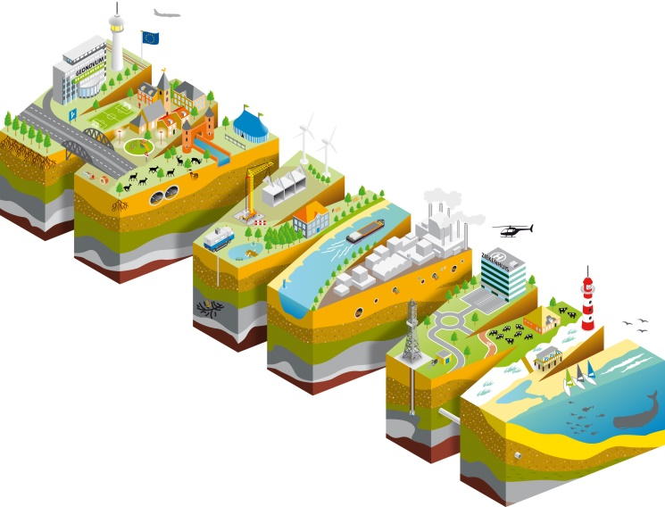
#geo4web testbed
Een experimenteel testbed van Geonovum
Om geodata onderdeel te maken van het web ecosysteem
Vindbaar door zoekmachines
Vriendelijk voor ontwikkelaars

Slide 3



Geo4Web Testbed: Sponsors
https://github.com/geo4web-testbed

Slide 4

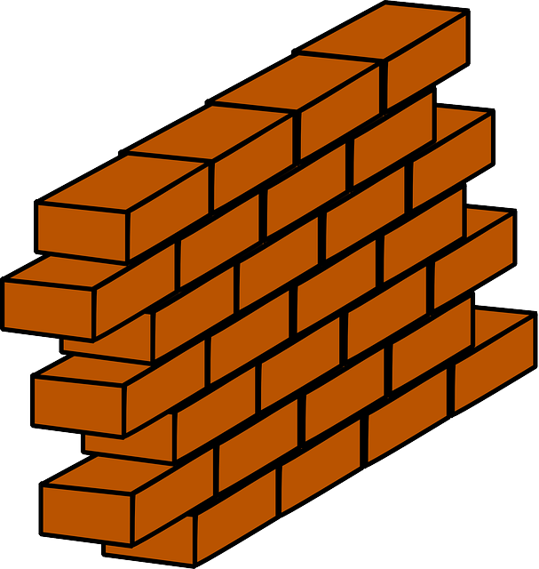
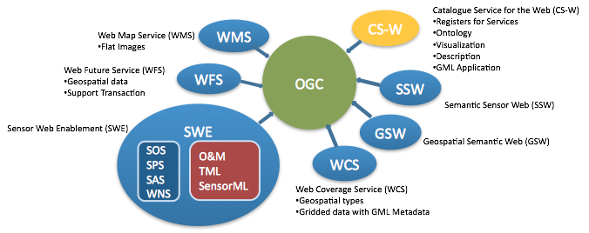




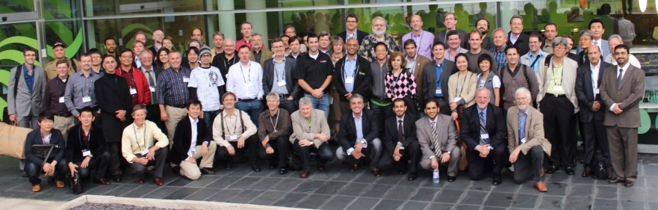



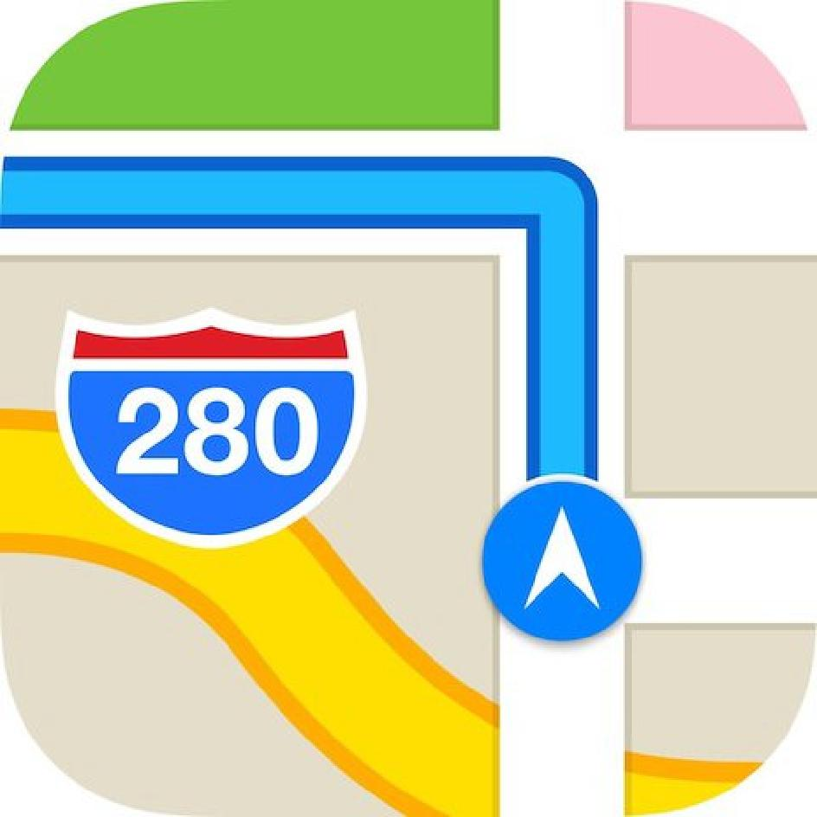


Geodata >> op het Web
Geo domein
Rest van de wereld
Linked Data
RESTful APIs
HTML

Slide 5
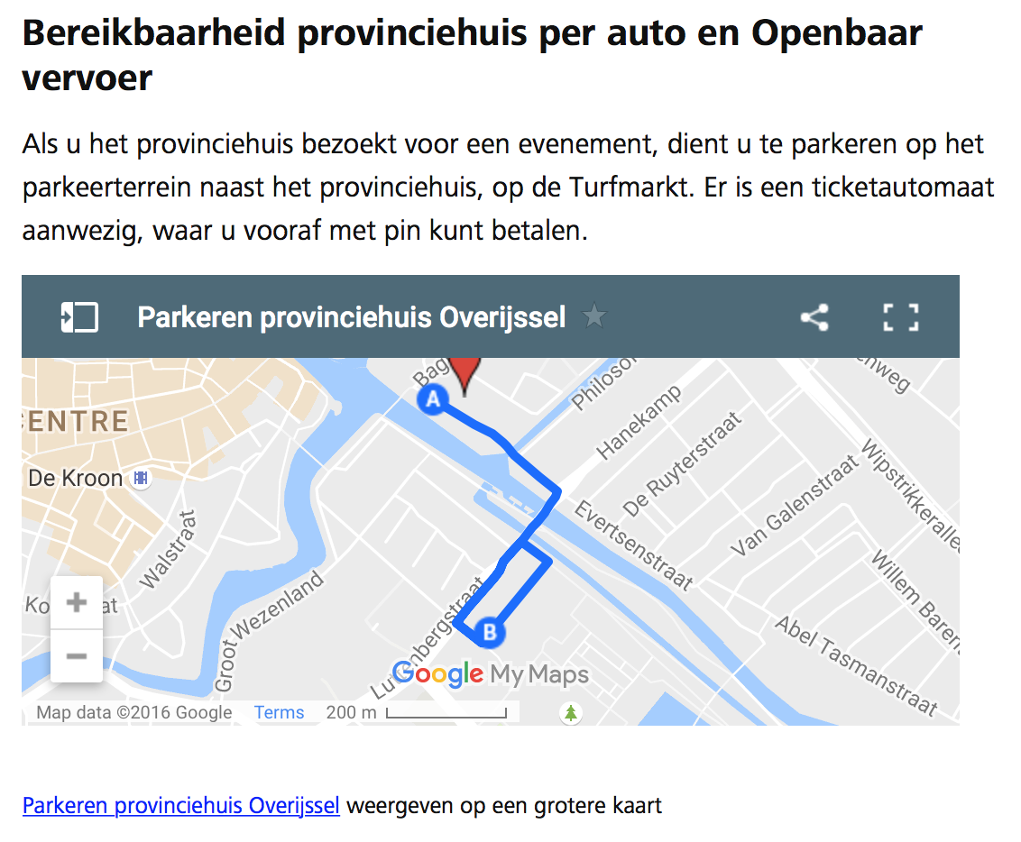

Slide 6
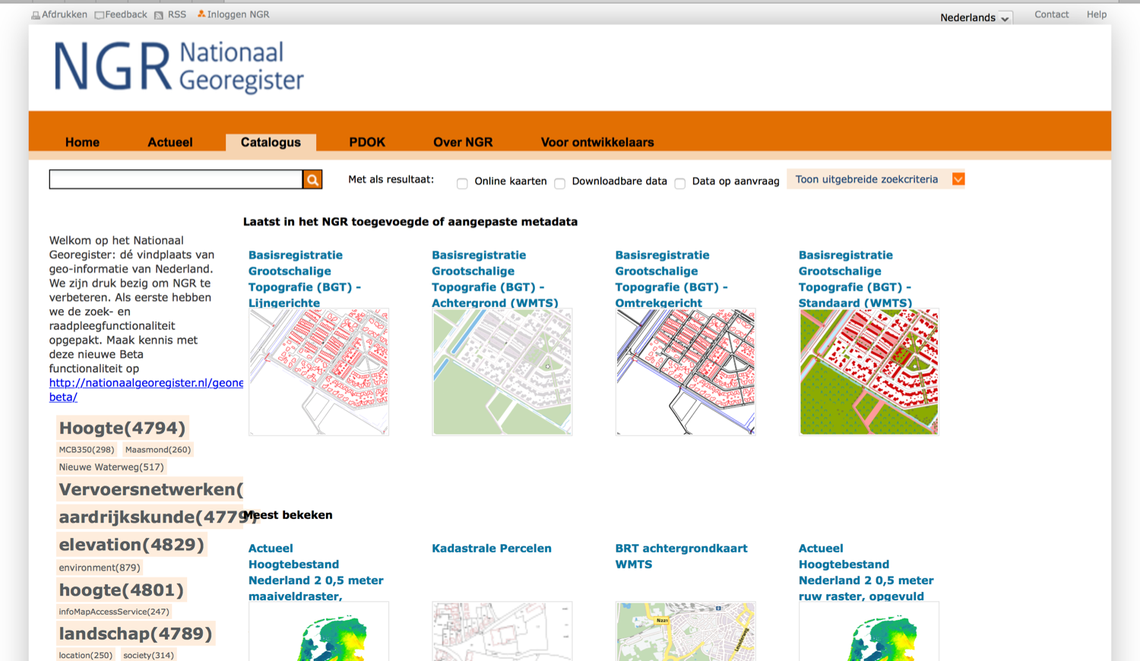

Slide 7
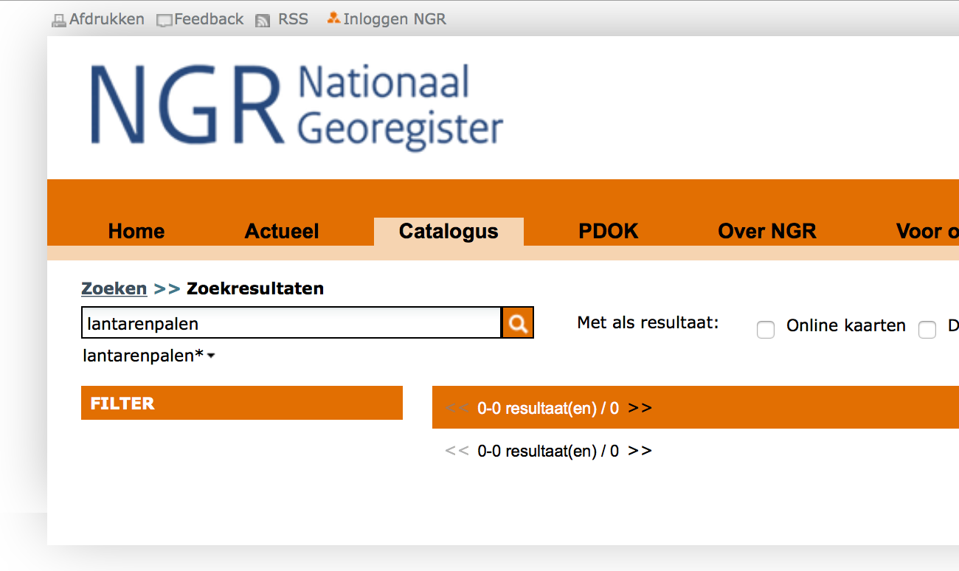

Slide 8
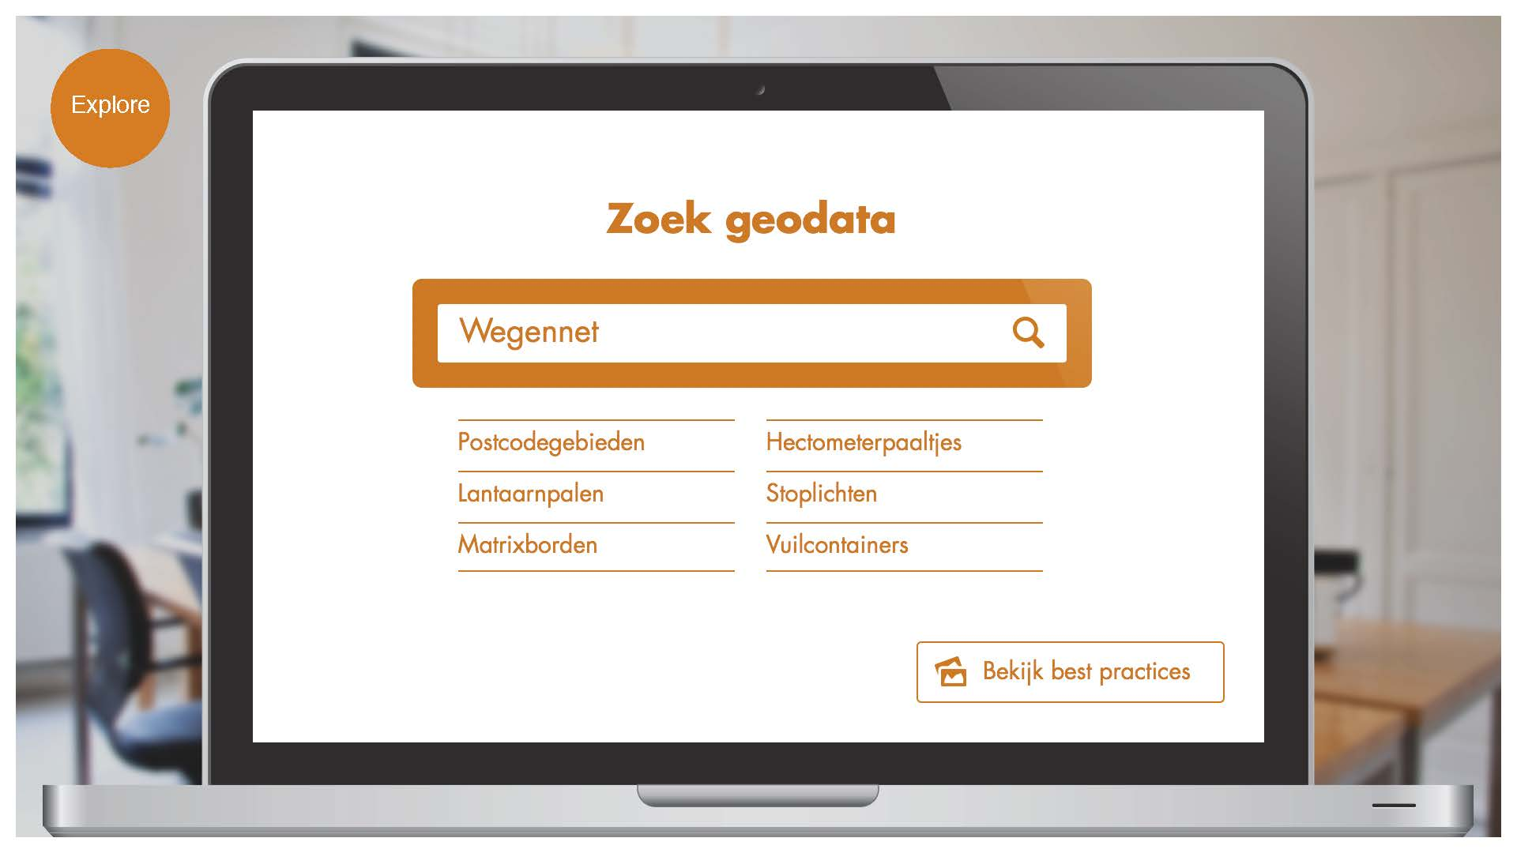

Slide 9
Vragen fase 1
#2: A usable spatial data publication platform
find out how to make spatial data easy to find and more specifically to explore the idea of ‘government as a platform’
#3: Crawlable spatial data using the ecosystem of the Web and Linked Data
find out what would be the best way to publish geospatial data not as a traditional SDI, but rather based on modern web technology, in such a way that it becomes part of the ecosystem of the web.
#4: Spatial data on the web using the current SDI
find out how to integrate traditional SDI with OGC services with the modern web of data.
https://github.com/geo4web-testbed

Slide 10
Lessons learned fase 1
Everyone in a platform or community has their own needs and capacities
Make sure the needle can be found in the haystack
Keep it simple
Think carefully about who is allowed to do what
Each speaks its own language and lives in his own world
Make search engines feel comfortable to discover you
Show a search engine the direction with an XML sitemap
Foster to link everything with everything
Think of the future, use persistent URIs
Make use of the structure, include Schema.org markup
Deal with the unknown set of developers and devices
Serve your data in many different flavours
Improve performance, reduce payload
Don't copy data, use proxies
https://github.com/geo4web-testbed/lessons-learned/wiki

Slide 11
Geo4Web, fase 2
Evaluatie van LL fase 1
Tripply implementatie lessons learned fase 1
Spotzi / Alterra: kijken of het nu makkelijker is
Data van Rijksdienst voor het Cultureel Erfgoed
https://github.com/geo4web-testbed

Slide 12



Resultaten fase 2
https://github.com/geo4web-testbed

Slide 13
Geo4Web fase 3, hoe nu verder?
Voorstel: Prototype / demo applicatie
Applicatie die gebruik maakt van resultaten van fase 1 en 2
Demonstratie / Leeromgeving / Tutorial
Ontwikkelaars kunnen onder de motorkap kijken
Documentatie van gebruikte software, code en query's
In principe open source
https://github.com/geo4web-testbed

