Slide 1

Schema.org
Geo and Linked Data
SDOW-Topic 4
Lieke Verhelst – Linked Data Factory

Slide 2
Research questions
How do we add schema.org to the datasets (BAG, AAN, Bekendmakingen)
How can we link them
  Semantics
  Link discovery
What will the SE do with this Linked Data JSON-LD?
How usable is Schema.org for annotating geo information?

Slide 3
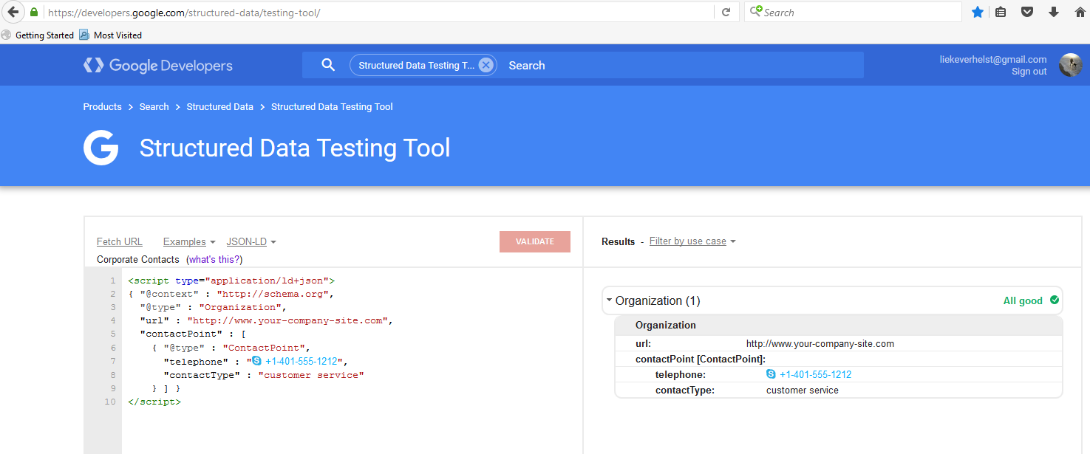
Schema.org for mark-up
NO URI-IDENTIFIER
@id tag

Slide 4
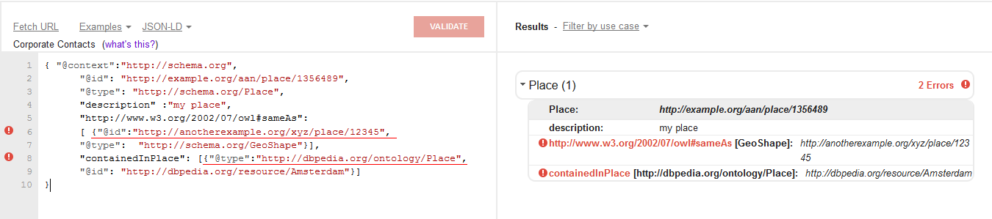


Semantics and the validator

Slide 5
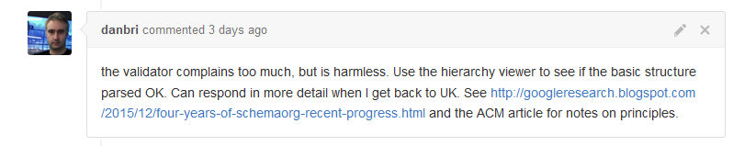
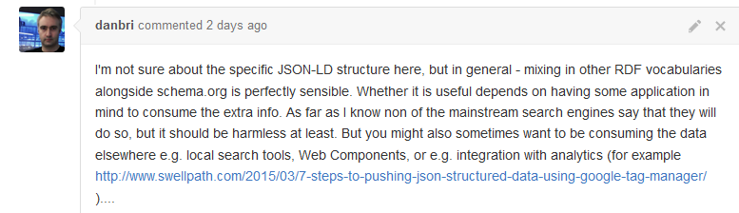
So..what now?

Slide 6
Schema.org and Geo

Slide 7
elevation
value
geo
Place
GeoCoordinates
longitude
value
latitude
geo
location
contentLocation
address
value
geoMidpoint
address
CreativeWork
elevation
value
Action or
Event or
Organization
spatial
address
PostalAddress
location
Dataset
GeoShape
dataset
value
Catalog
line
………
value
rdfs:subClassOf
Action or
Event or
Organization
value
value
polygon
GeoCircle
geoRadius
value
Distance
Geospatial elements in
Schema.org Version 2.2

Slide 8
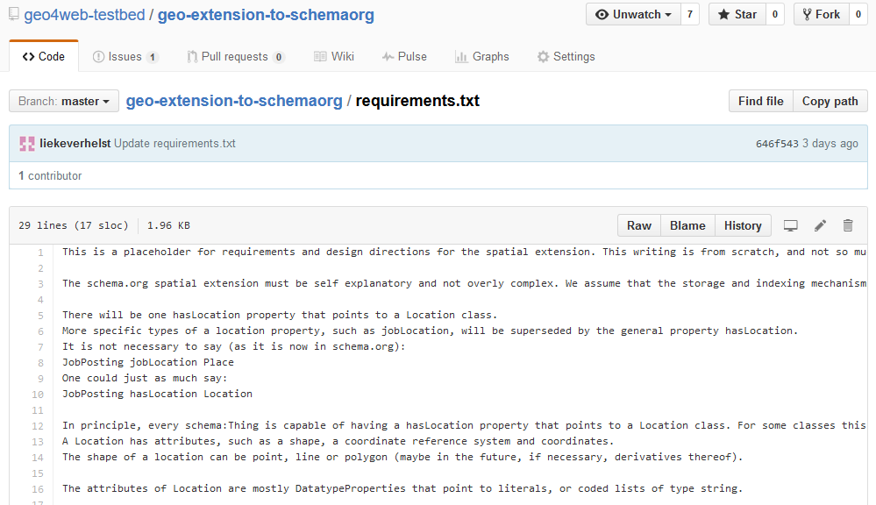
Towards a geo extension of schema.org

Slide 9
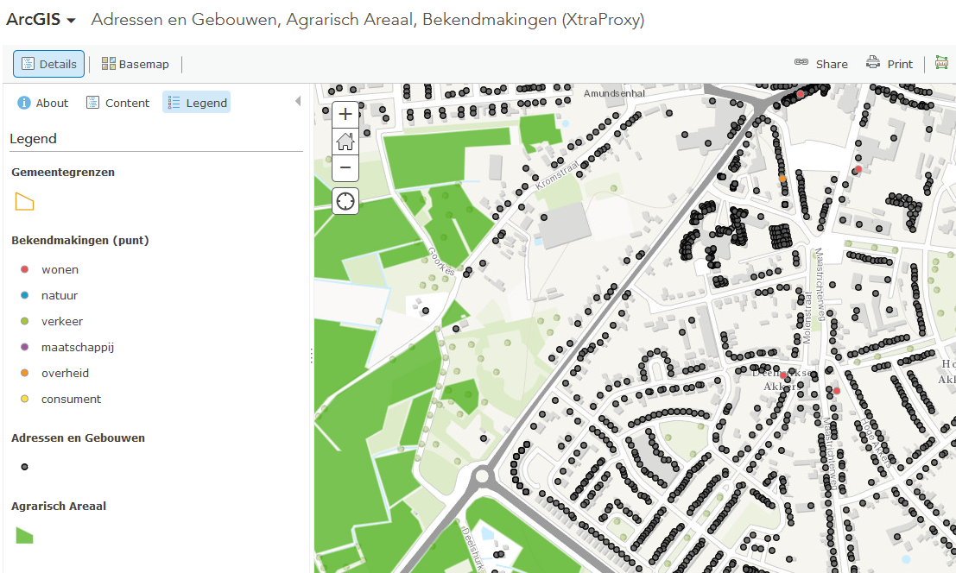

Slide 10
Place
PostalAddress
address
addressLocality
value
contentLocation
postalCode
headline
value
value
genre
value
value
CreativeWork
subClassOf
description
Article
subClassOf
subClassOf
Report
Thing
url
value
Bekendmakingen (Administrative
Version)

Slide 11
geo
GeoCoordinates
longitude
Place
latitude
value
value
contentLocation
value
value
datePublished
keywords
value
headline
genre
value
value
CreativeWork
subClassOf
description
Article
subClassOf
subClassOf
Report
Thing
url
value
Bekendmakingen (Spatial Version)

Slide 12
Link nodes
GeoShape
GeoCoordinates
geo
geo
containedInPlace
Place
address
containsPlace
contentLocation
locationCreated
spatial
locationCreated
PostalAddress
contentLocation
DataCatalog
Dataset
dataset
mainEntityOfPage *
Report
* Is the Place really the Main Entity of the Report?

Slide 13
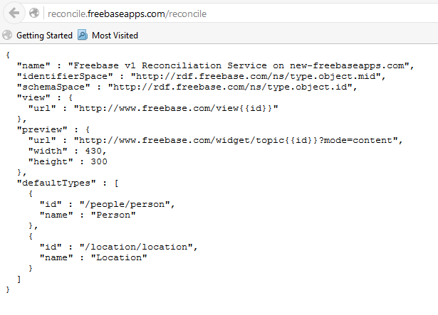
Link discovery API

