Slide 1


Final Presentation - Modern ways of spatial data publication
Building a spatial application
Teun van Sprundel
Erik Nagelkerke

Slide 2
Content of the presentation
Intro – Main question
The Application
Evaluation of lessons learned

Slide 3
Testbed topic #1:
Analyzing the lessons learned
Main question:
How do these lessons learned meet the constraints and capabilities of governmental organizations on the one hand, and of data users on the other?

Slide 4
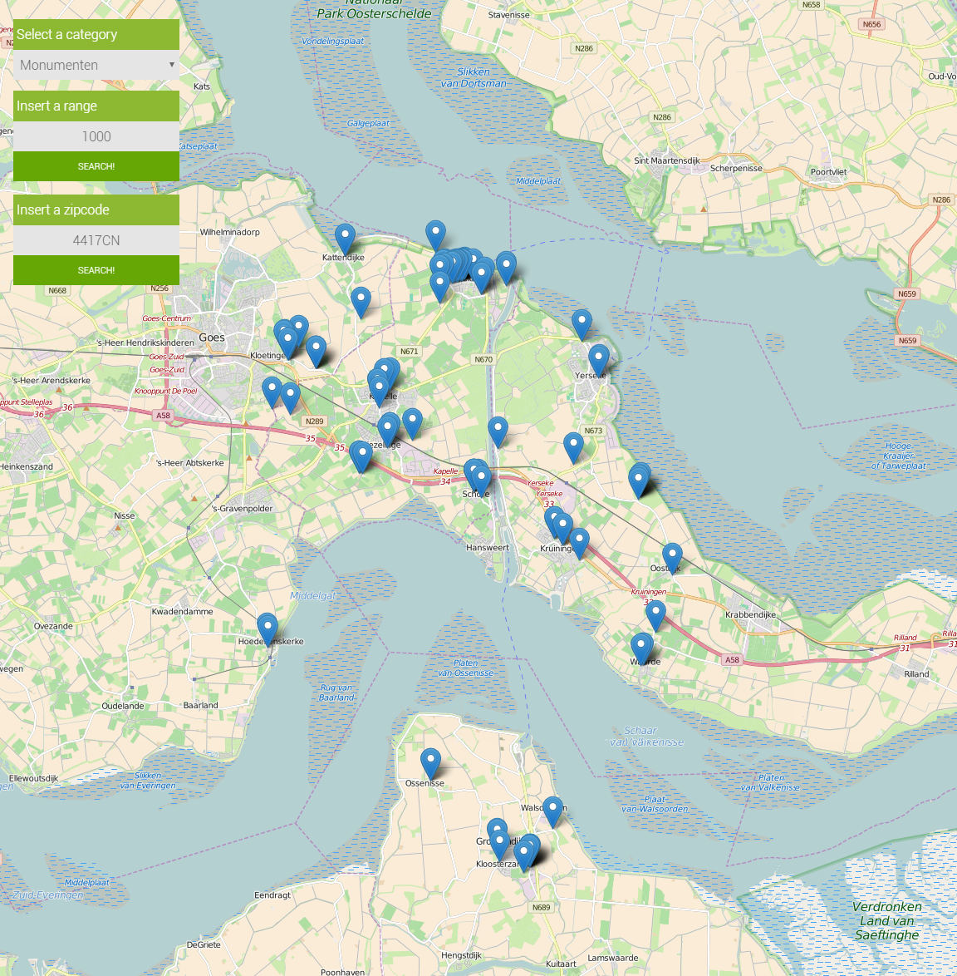
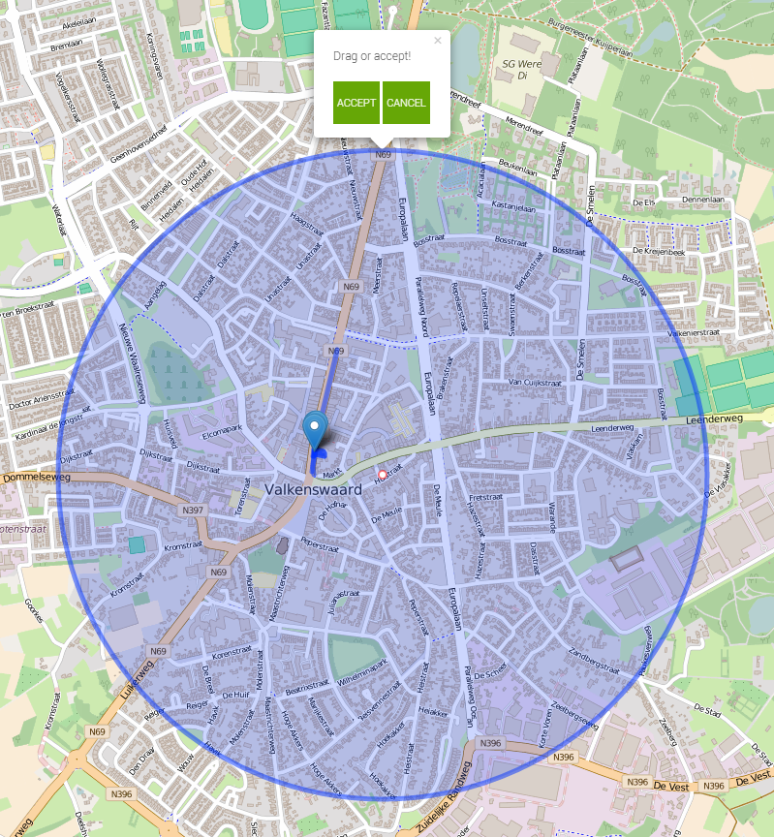
Application
http://geonovum.spotzi.com/task2

Slide 5
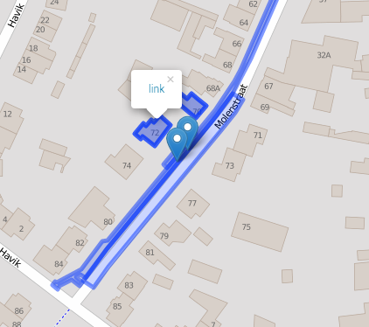
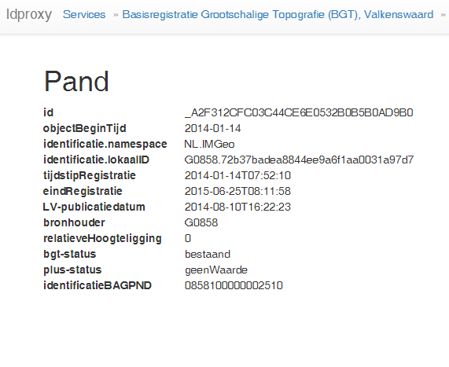
Application

Slide 6
Evaluation of lessons learned
Lesson 3A:
Serve your data in many different flavors
This lesson made things a lot easier for our developers.
The platform provided data response in many types, like GeoJSON and JSON-LD. Because Leaflet works great with GeoJSON, the base of our application was quickly showing results.

Slide 7
Evaluation of lessons learned
Lesson 1:
Everyone in a platform or community has their own needs and capacities
The lesson learned advices to keep it simple and make sure the data can be found. Besides these points it is also of great importance that the platform tells the user what the possibilities and limits of the platform are. This way the user does not have to look for limits and possibilities himself.

Slide 8
Evaluation of lessons learned
Besides the lessons learned that were realized from the last testbed, we also want to introduce some new insights.
One of the things which are really important for publishing linked data on the web is the performance and uptime.
While it is really easy to overlook these topics, no developer will use the data if this isn’t working properly. By using linked data instead of copying the data, you also make the users and their applications dependent of the data publisher.

Slide 9
ANY QUESTIONS?
http://www.spotzi.com/
teun@spotzi.com
http://github.com/geo4web-testbed/topic1-task2
erik@spotzi.com

