Slide 1
Carbon Dioxide Concentrations at Mona Loa Observatory
Bowei Zhao

Slide 2
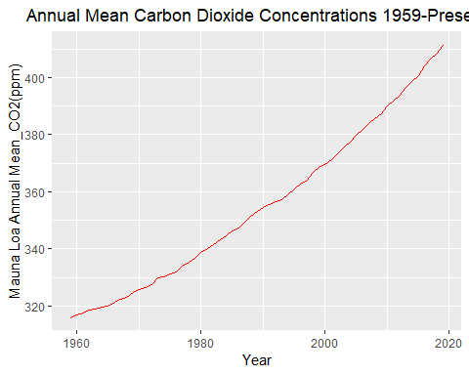
Plot the temporal trend of annual mean carbon dioxide concentrations

Slide 3
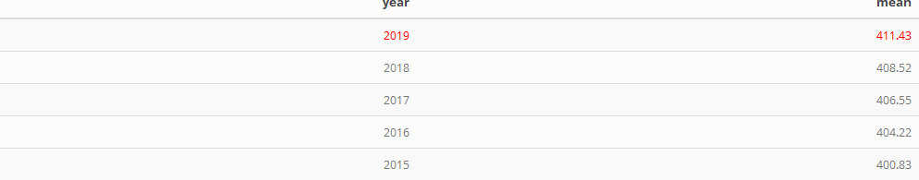
Show the annual mean carbon dioxide concentrations in the last five years

