Slide 1
Case Study 08: Annual Mean CO2
Zaque Evans

Slide 2
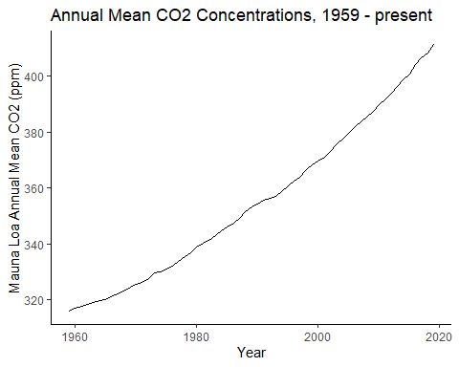

Slide 3
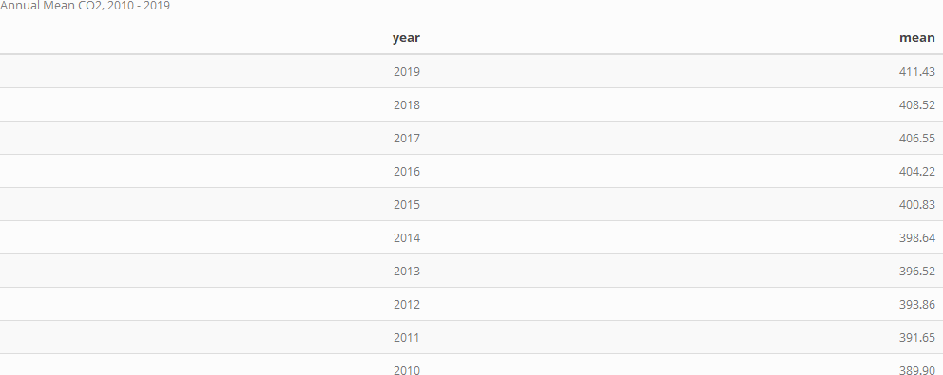
Annual Mean CO2 (ppm) 2010-2019, Muana Lao Observatory

