Slide 1
Case Study 08
Zixuan Chen

Slide 2
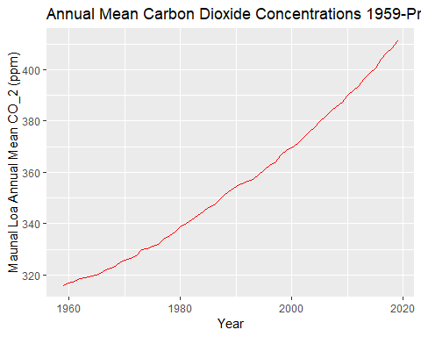

Slide 3
