Slide 1
Script8

Slide 2
Case Study #8
The goal of this case study is to download data from the web, do stuff with it, and then output a file in multiple formats.
library(data.table) data8 <- read.csv('ftp://aftp.cmdl.noaa.gov/products/trends/co2/co2_annmean_mlo.csv',skip=55,header=TRUE)

Slide 3
Our Data
Our Data is Mauna Loa CO2 data (annual means) since 1959. Let’s display this in a graph.

Slide 4
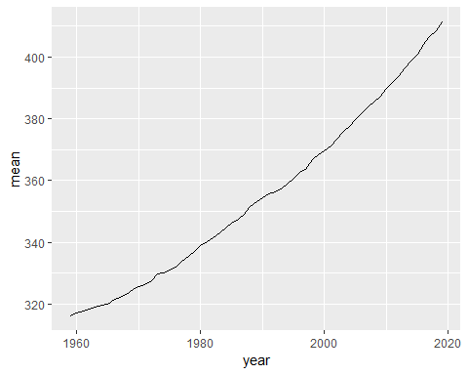

Slide 5
year | mean | unc
1959 | 315.98 | 0.12
1960 | 316.91 | 0.12
1961 | 317.64 | 0.12
1962 | 318.45 | 0.12
1963 | 318.99 | 0.12
1964 | 319.62 | 0.12

Slide 6
Let’s see if this works!

