Slide 1
Case Study 8
Brendan Kunz

Slide 2
R Markdown
This is an R Markdown document. Markdown is a simple formatting syntax for authoring HTML, PDF, and MS Word documents. For more details on using R Markdown see http://rmarkdown.rstudio.com.
When you click the Knit button a document will be generated that includes both content as well as the output of any embedded R code chunks within the document. You can embed an R code chunk like this:

Slide 3
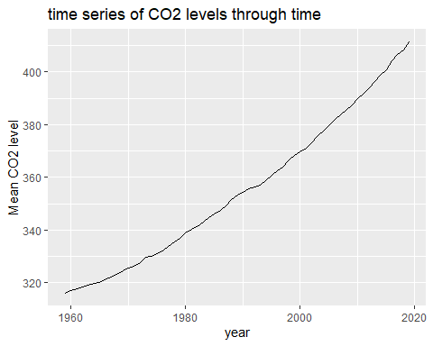

Slide 4
Including Plots
You can also embed plots, for example:
Top 5 Annual Mean Carbon Dioxide Concentrations
year
mean
2019
411.43
2018
408.52
2017
406.55
2016
404.22
2015
400.83
Note that the echo = FALSE parameter was added to the code chunk to prevent printing of the R code that generated the plot.

