Slide 1
Case Study 08
Collin O’Connor

Slide 2
library(tidyverse) library(kableExtra)

Slide 3
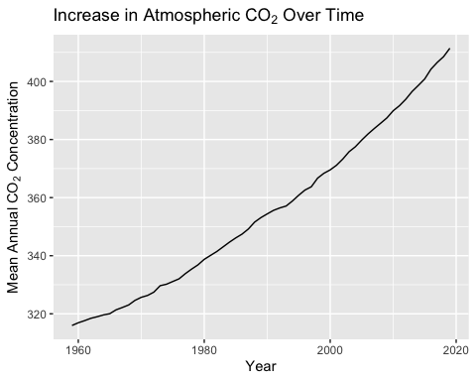
Reading in data

