Slide 1
One Script, Many Products
Erik Woyciesjes

Slide 2
Mauna Loa CO2 Annual Mean Data
## Parsed with column specification: ## cols( ## `#` = col_logical(), ## year = col_double(), ## mean = col_double(), ## unc = col_double() ## )
# Data Plotted

Slide 3
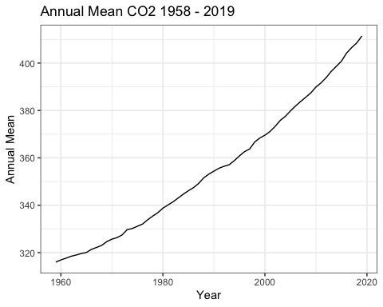

Slide 4
# Arrage Data for Table
## Selecting by unc
# Data Table

Slide 5
# | year | mean | unc
NA | 2019 | 411.43 | 0.12
NA | 2018 | 408.52 | 0.12
NA | 2017 | 406.55 | 0.12
NA | 2016 | 404.22 | 0.12
NA | 2015 | 400.83 | 0.12
NA | 2014 | 398.64 | 0.12
Annual Means for the Last Decade

