Slide 1
GEO511_CS_08
Marko Lazin

Slide 2
Setup
library(tidyverse)
Data
cs8_data<-read_table("ftp://aftp.cmdl.noaa.gov/products/trends/co2/co2_annmean_mlo.txt",skip=56) cs8_data<-cs8_data[,2:4]
Graph
ggplot(cs8_data,aes(x=year,y=mean))+ geom_line()+ labs(title="Mauna Loa CO2 Annual Mean",x="Year",y="Mean CO2 PPM")

Slide 3
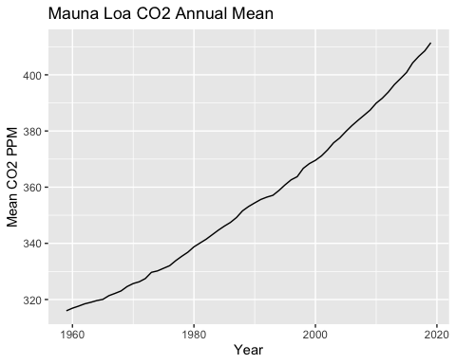

Slide 4
Table
knitr::kable(head(arrange(cs8_data,desc(mean))),format="simple",align="c",caption="Mauna Loa CO2 Top Annual Mean")

Slide 5
year | mean | unc
2019 | 411.43 | 0.12
2018 | 408.52 | 0.12
2017 | 406.55 | 0.12
2016 | 404.22 | 0.12
2015 | 400.83 | 0.12
2014 | 398.64 | 0.12
Mauna Loa CO2 Top Annual Mean

