Slide 1
Case Study 08
Kaiser Mahmood

Slide 2
library(tidyverse) library(kableExtra) library(ggplot2) library(knitr) library(magick) library(dplyr)

Slide 3
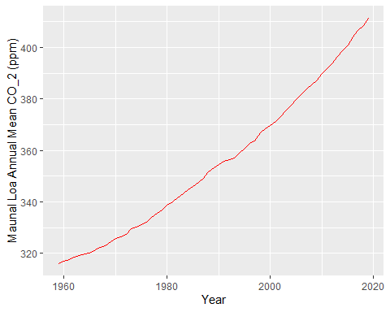

Slide 4
year | mean
2019 | 411.43
2018 | 408.52
2017 | 406.55
2016 | 404.22
2015 | 400.83

