Slide 1
Carbon Dioxide Concentrations at Mona Loa Observatory
Sandra Notaro

Slide 2
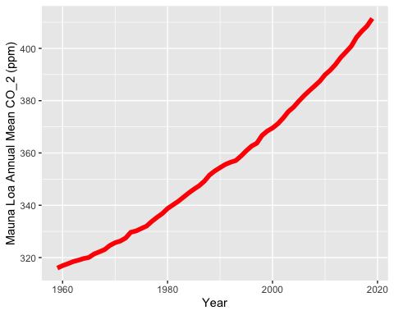
Annual Mean Carbon Dioxide Concentrations 1959-Present

Slide 3
Top Five Annual Mean Carbon Dioxide Concentrations at Mona Loa
year | mean
2019 | 411.43
2018 | 408.52
2017 | 406.55
2016 | 404.22
2015 | 400.83

Slide 4
Tina and Betsy helped me make my table look properly by combining different ideas

