Slide 1
Carbon Dioxide Concentrations at Mauna Loa
Ting Chang

Slide 2
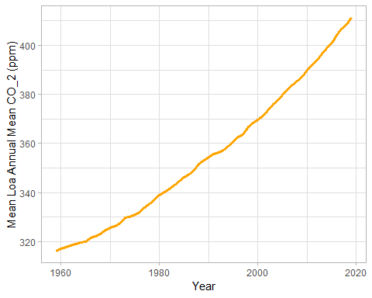
Annual Mean Carbon Dioxide Concentrations 1959-Present

Slide 3
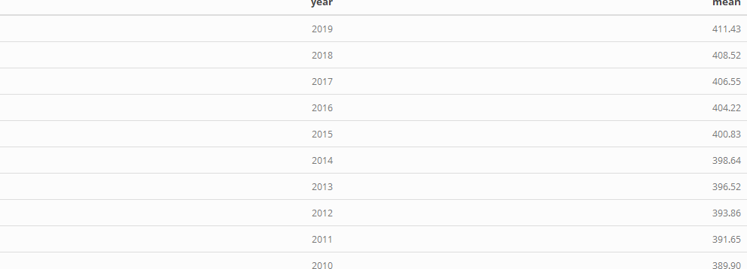
Top 10 Annual Mean Carbon Dioxide Concentrations

