Slide 1
Case Study 8
Adrian Elie

Slide 2
library(tidyverse) library(ggplot2) library(kableExtra) CO <- read_table("ftp://aftp.cmdl.noaa.gov/products/trends/co2/co2_annmean_mlo.txt", skip = 56)
## ## -- Column specification -------------------------------------------------------- ## cols( ## `#` = col_double(), ## year = col_double(), ## mean = col_double(), ## unc = col_character() ## )
## Warning: 63 parsing failures. ## row col expected actual file ## 1 -- 4 columns 3 columns 'ftp://aftp.cmdl.noaa.gov/products/trends/co2/co2_annmean_mlo.txt' ## 2 -- 4 columns 3 columns 'ftp://aftp.cmdl.noaa.gov/products/trends/co2/co2_annmean_mlo.txt' ## 3 -- 4 columns 3 columns 'ftp://aftp.cmdl.noaa.gov/products/trends/co2/co2_annmean_mlo.txt' ## 4 -- 4 columns 3 columns 'ftp://aftp.cmdl.noaa.gov/products/trends/co2/co2_annmean_mlo.txt' ## 5 -- 4 columns 3 columns 'ftp://aftp.cmdl.noaa.gov/products/trends/co2/co2_annmean_mlo.txt' ## ... ... ......... ......... .................................................................. ## See problems(...) for more details.
CO print(CO, n = 60) Workplease <- ggplot(CO, aes(x = `#`, y = year))+ geom_line()+ labs(x = "Year", y = "CO2 concentration")+ ggtitle("Rise in CO2 levels since 1959") + theme(plot.title = element_text(hjust = 0.5)) Workplease

Slide 3
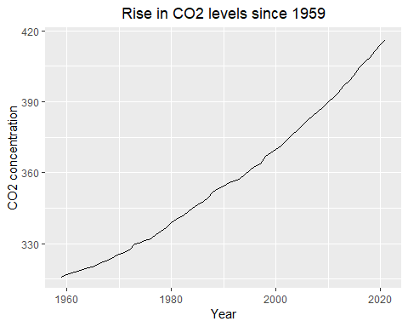

Slide 4
table <- knitr::kable(CO, formal = "pipe",) table
#
year
mean
unc
1959
315.98
0.12
NA
1960
316.91
0.12
NA
1961
317.64
0.12
NA
1962
318.45
0.12
NA
1963
318.99
0.12
NA
1964
319.62
0.12
NA
1965
320.04
0.12
NA
1966
321.37
0.12
NA
1967
322.18
0.12
NA
1968
323.05
0.12
NA
1969
324.62
0.12
NA
1970
325.68
0.12
NA
1971
326.32
0.12
NA
1972
327.46
0.12
NA
1973
329.68
0.12
NA
1974
330.19
0.12
NA
1975
331.13
0.12
NA
1976
332.03
0.12
NA
1977
333.84
0.12
NA
1978
335.41
0.12
NA
1979
336.84
0.12
NA
1980
338.76
0.12
NA
1981
340.12
0.12
NA
1982
341.48
0.12
NA
1983
343.15
0.12
NA
1984
344.87
0.12
NA
1985
346.35
0.12
NA
1986
347.61
0.12
NA
1987
349.31
0.12
NA
1988
351.69
0.12
NA
1989
353.20
0.12
NA
1990
354.45
0.12
NA
1991
355.70
0.12
NA
1992
356.54
0.12
NA
1993
357.21
0.12
NA
1994
358.96
0.12
NA
1995
360.97
0.12
NA
1996
362.74
0.12
NA
1997
363.88
0.12
NA
1998
366.84
0.12
NA
1999
368.54
0.12
NA
2000
369.71
0.12
NA
2001
371.32
0.12
NA
2002
373.45
0.12
NA
2003
375.98
0.12
NA
2004
377.70
0.12
NA
2005
379.98
0.12
NA
2006
382.09
0.12
NA
2007
384.02
0.12
NA
2008
385.83
0.12
NA
2009
387.64
0.12
NA
2010
390.10
0.12
NA
2011
391.85
0.12
NA
2012
394.06
0.12
NA
2013
396.74
0.12
NA
2014
398.81
0.12
NA
2015
401.01
0.12
NA
2016
404.41
0.12
NA
2017
406.76
0.12
NA
2018
408.72
0.12
NA
2019
411.66
0.12
NA
2020
414.24
0.12
NA
2021
416.45
0.12
NA

