Slide 1
R - Time Series Analysis
By: Haoming Tang

Slide 2
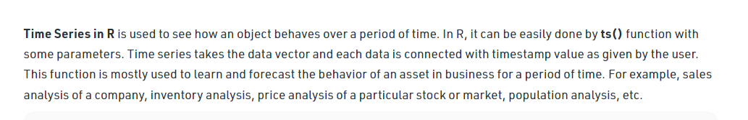
Introduction
The time series object is created by using the ts() function.

Slide 3
Creating a time series
The ts() function will convert a numeric vector into an R time series object. The format is ts(vector, start=, end=, frequency=) where start and end are the times of the first and last observation and frequency is the number of observations per unit time (1=annual, 4=quartly, 12=monthly, etc.).
# save a numeric vector containing 72 monthly observations
# from Jan 2009 to Dec 2014 as a time series object
myts <- ts(myvector, start=c(2009, 1), end=c(2014, 12), frequency=12)
# subset the time series (June 2014 to December 2014)
myts2 <- window(myts, start=c(2014, 6), end=c(2014, 12))
# plot series
plot(myts)

Slide 4
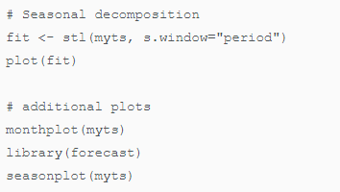
Seasonal Decomposition
A time series with additive trend, seasonal, and irregular components can be decomposed using the stl() function. Note that a series with multiplicative effects can often by transformed into series with additive effects through a log transformation (i.e., newts <- log(myts)).

Slide 5
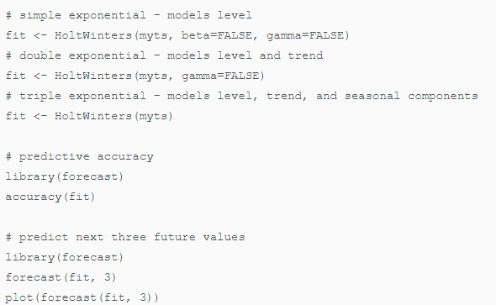
Exponential Models
Both the HoltWinters() function in the base installation, and the ets() function in the forecast package, can be used to fit exponential models.

Slide 6
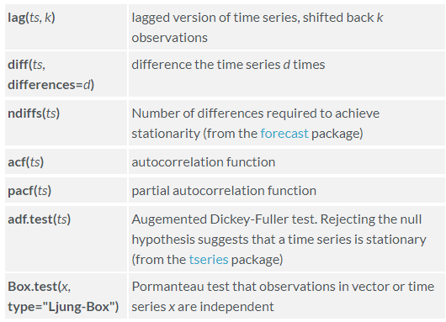
ARIMA Models
The arima() function can be used to fit an autoregressive integrated moving averages model. Other useful functions include

Slide 7
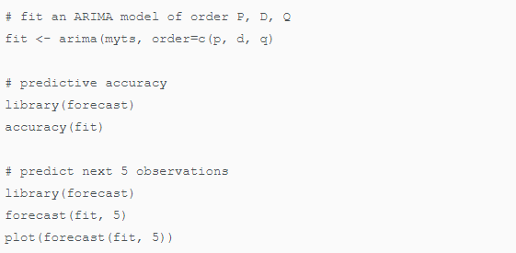
Note that the forecast package has somewhat nicer versions of acf() and pacf() called Acf() and Pacf() respectively.

