Slide 1
CS_08
Yue Ma

Slide 2
Data collection
read the txt data from the website

Slide 3
draw the figures
Make the line plot of CO2 emission

Slide 4
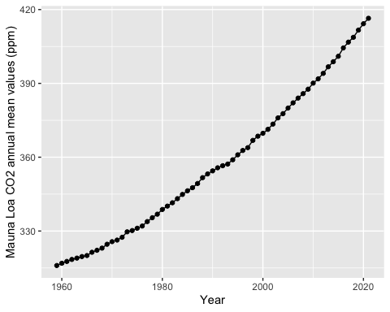

Slide 5
get the top five years for CO2 emission
draw the table

Slide 6
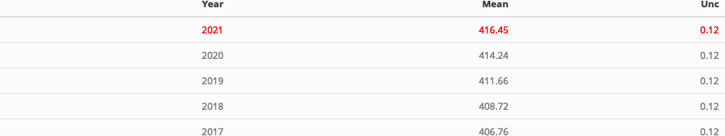

Slide 7
Note that the echo = FALSE parameter was added to the code chunk to prevent printing of the R code that generated the plot.

