Slide 1
GEO511_case_study_8

Slide 2
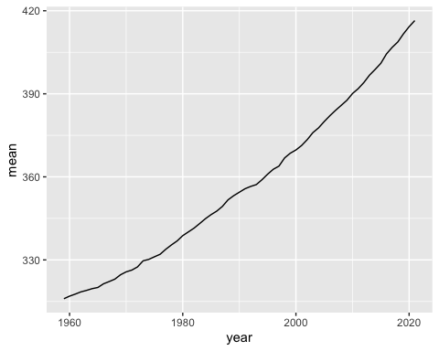
Manua Loa Trends in Atmospheric Carbon Dioxide
This is updated data from the Global Monitoring Laboratory (Earth System Research Laboratories) on trends in atmospheric carbon dioxide from Manua Loa, Hawaii. Reference: Dr. Pieter Tans, NOAA/GML Dr. Ralph Keeling, Scripps Institution of Oceanography.

