Slide 1
Case Study 08
Ehsan Ul Hoque Tanim

Slide 2
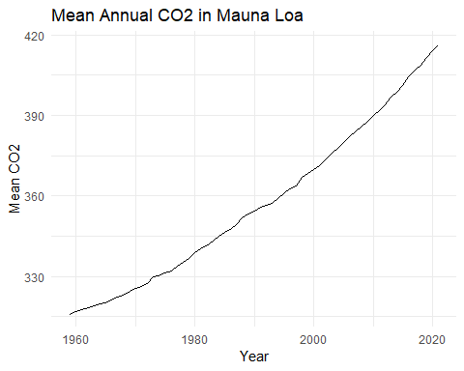
## ## ── Column specification ────────────────────────────── ## cols( ## year = col_double(), ## mean = col_double(), ## uncertainty = col_double() ## )

Slide 3
year
mean
uncertainty
2021
416.45
0.12
2020
414.24
0.12
2019
411.66
0.12
2018
408.72
0.12
2017
406.76
0.12

