Slide 1
Case Study 08
Hang Tian

Slide 2
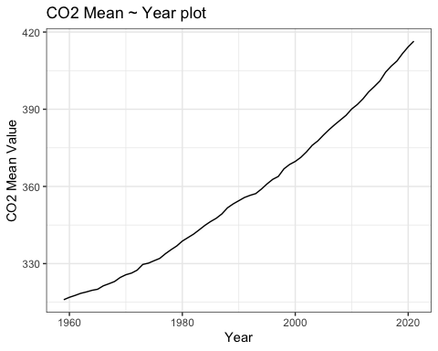
library(ggplot2) suppressPackageStartupMessages(library(tidyverse)) dataurl="ftp://aftp.cmdl.noaa.gov/products/trends/co2/co2_annmean_mlo.txt" temp=read_table(dataurl, skip=57,col_names = c('year','mean','unc'))
## ## ── Column specification ──────────────────────────────────────────────────────────────────────────── ## cols( ## year = col_double(), ## mean = col_double(), ## unc = col_double() ## )
ggplot(temp,aes(year,mean))+ geom_line()+ theme_bw()+ xlab('Year')+ ylab('CO2 Mean Value')+ ggtitle('CO2 Mean ~ Year plot')

Slide 3
year | mean
2021 | 416.45
2020 | 414.24
2019 | 411.66
2018 | 408.72
2017 | 406.76
library(dplyr) processed=temp%>%arrange(desc(mean))%>%select(year,mean)%>%slice(1:5) knitr::kable(processed,'simple')

Slide 4
# rmarkdown::render("week_08/case_study_08.Rmd",output_format = "all")

