Slide 1
Case Study 08
Bobby Decker

Slide 2
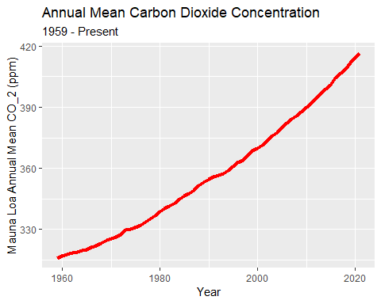
#install.packages(“kableExtra”) #install.packages(“magick”)
##
## -- Column specification -------------------------------------------------------------------------------------------------------
## cols(
## year = col_double(),
## mean = col_double(),
## unc = col_double()
## )
ggplot(mauna_mean, aes(year, mean))+
geom_line(color="red", size=1.75)+
labs(
title="Annual Mean Carbon Dioxide Concentration",
subtitle = "1959 - Present",
)+
xlab("Year")+
ylab("Mauna Loa Annual Mean CO_2 (ppm)")

Slide 3

top5_table<-arrange(mauna_mean, desc(mean))[1:5, ]
knitr::kable(top5_table, caption = 'Top Five Annual Mean Carbon Dioxide Concentrations at Mona Loa',
col.names = c("year", "mean", "unc")) %>%
as_image(width = 10,file = "table.png")

Slide 4
#rmarkdown::render(“path/to/file.Rmd”,output_format = “all”)

