Slide 1
Case Study 08
Willow Flood

Slide 2
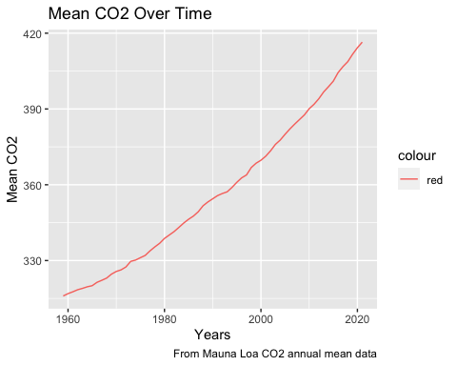
library(tidyverse) co2_data = read_table(file = ('ftp://aftp.cmdl.noaa.gov/products/trends/co2/co2_annmean_mlo.txt'), skip = 57, col_names = c("year", "mean", "unc"), comment = "#")
## ## ── Column specification ──────────────────────────────────────────────────────── ## cols( ## year = col_double(), ## mean = col_double(), ## unc = col_double() ## )
library(ggplot2) ggplot(co2_data, aes(x=year, y=mean)) + geom_line(aes(color = "red")) + labs(title = "Mean CO2 Over Time", y = "Mean CO2", x = "Years", caption = "From Mauna Loa CO2 annual mean data")

Slide 3
Year | Mean | UNC
2021 | 416.45 | 0.12
2020 | 414.24 | 0.12
2019 | 411.66 | 0.12
2018 | 408.72 | 0.12
2017 | 406.76 | 0.12
2016 | 404.41 | 0.12
knitr::kable(head(arrange(co2_data[,1:3], desc(year))), format = "simple", col.names = c("Year", "Mean", "UNC"), caption = "Mauna Loa CO2 Annual Mean")
Mauna Loa CO2 Annual Mean

