Slide 1

CS_08
People in T4

Slide 2

S.1

Slide 3
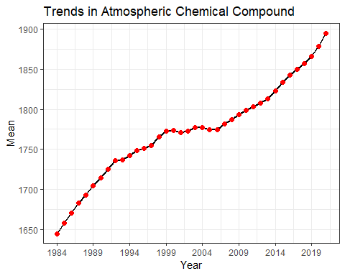
S.2
min_year = df$year %>% min() max_year = df$year %>% max() df %>% mutate(sd = sd(mean)) %>% as_tibble() %>% ggplot(., aes(x = year, y = mean)) + geom_line(color = "black", lwd = 1) + geom_point(size = 2, color = "red") + scale_x_continuous(breaks = seq(min_year, max_year, 5)) + theme_bw() + labs(x = "Year", y = "Mean", title= "Trends in Atmospheric Chemical Compound")

Slide 4
Years | Mean | S.D. | Min | Max
1980 - 1989 | 1681.548 | 18.597033 | 1657.29 | 1704.54
1990 - 1999 | 1744.591 | 17.728495 | 1714.42 | 1772.39
2000 - 2009 | 1778.246 | 7.115024 | 1771.20 | 1793.52
2010 - 2019 | 1829.700 | 23.950969 | 1798.90 | 1866.59
2020 - | 1887.125 | 11.589480 | 1878.93 | 1895.32
S.3
summ = df %>% slice(-1) %>% mutate(Years = case_when( year %in% seq(1960, 1969) ~ "1960 - 1969", year %in% seq(1970, 1979) ~ "1970 - 1979", year %in% seq(1980, 1989) ~ "1980 - 1989", year %in% seq(1990, 1999) ~ "1990 - 1999", year %in% seq(2000, 2009) ~ "2000 - 2009", year %in% seq(2010, 2019) ~ "2010 - 2019", year %in% seq(2020, 2029) ~ "2020 - " )) %>% group_by(Years) %>% dplyr::summarise(Mean = mean(mean), S.D. = sd(mean), Min = min(mean), Max = max(mean)) knitr::kable(summ,'simple')

