Slide 1
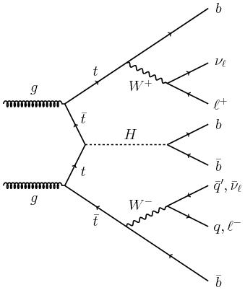
Truth Studies in pp→ttH channel
Georgios Billis
Supervisor: Prof. Niki Saoulidou – National and Kapodistrian University of Athens

Slide 2
Outline
Description of the main method
Results of the main method
Goal of the study
Truth level study of various kinematic and topological distributions
TMVA invastigation
Summary – On going work

Slide 3
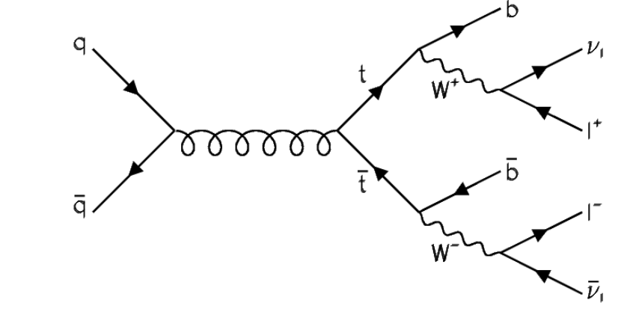
Description of the main method
The work revolves around the pp→ ttH channel in LHC accelerator (CMS)
Investigation of the dilepton tt decay

Slide 4
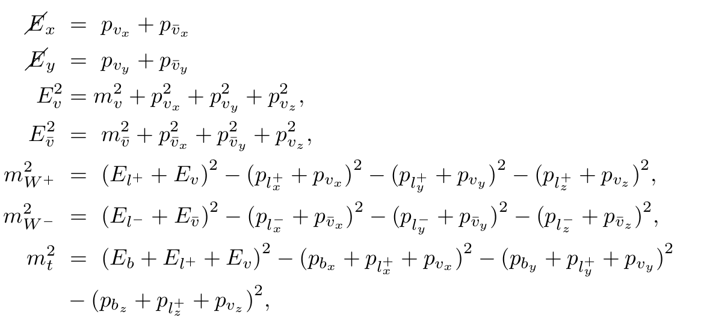
Description of the main method
Main method solves analyticaly the kinematic equations that dictate the former topology.
Obtain 0,2,4 solutions for the neutrino momenta given the masses of top and W boson.

Slide 5
Description of the main method
Exploiting that the dilepton channel can be completely solved analytically, a model independent method is employed for the reconstruction of the top and W mass.
Scan the 2D mass plane of t-W and set them as inputs in the kinematic equations.
Having all the kinematic variables of the topology, the (product) PDF weight can be calculated.
After the the 2D mass plane scan, the solution with the greatest PDF weight is chosen→ obtain the mass of top and W.

Slide 6
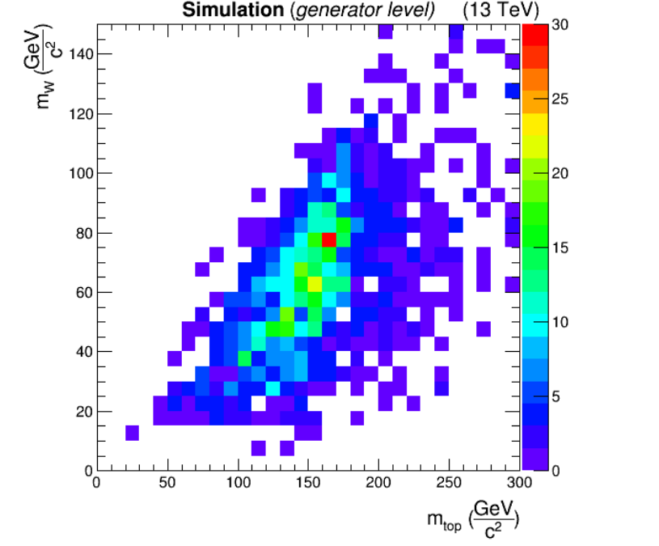
Description of the main method
C.K.Koraka – University of Athens

Slide 7
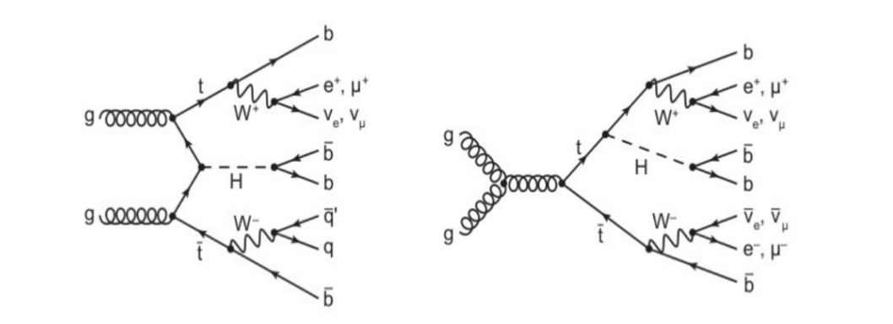
Description of the main method
Extrapolation in the case that a Higgs is also produced.
Does not affect the method – but increases the combinatorics (4 b jets).

Slide 8
Description of the main method
The inputs of the method are now:
4 bjets
2 leptons
Missing transverse energy
Mass of top & W

Slide 9
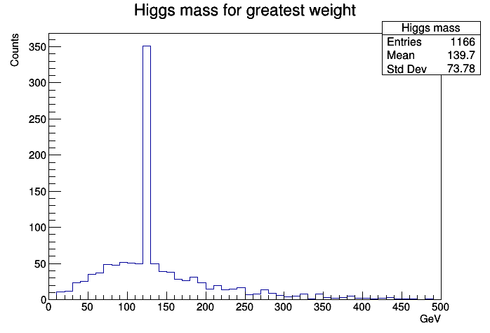
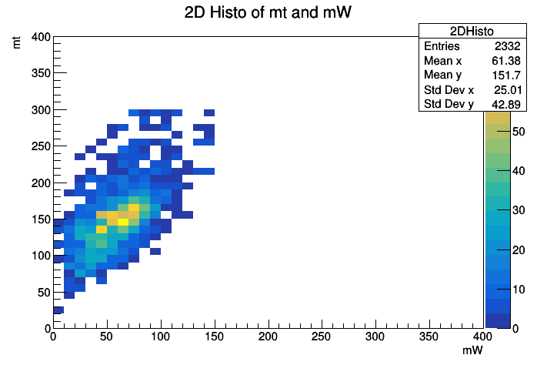
Results of the main method

Slide 10
Goal of truth study
Under certain optimization the maximum PDF weight yields the correct Higgs mass at ~43% of the events.
Goal is to find a possibly better estimator of the correct tt solution → TMVA
Several kinematic and topological distributions show discriminating power between the correct and wrong solution.

Slide 11
Technical Details
In what follows only truth events have been studied:
1) As “correct” are defined those events that satisfy Δpx=Δpy=Δpz=0 for the neutrino momenta. (Δp_i=generated mom. - solved by method mom.).
2)As “wrong” are defined those that do not satisfy condition (1).

Slide 12
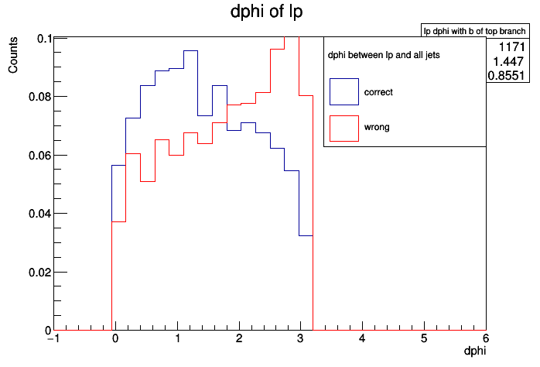
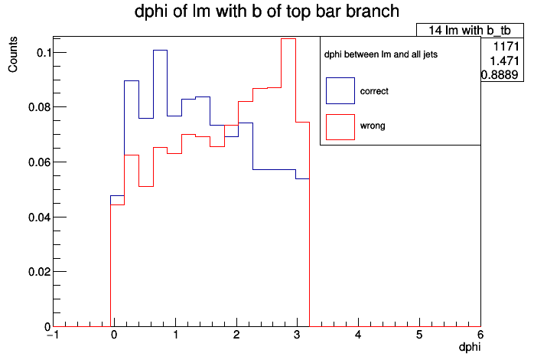
Δφ between lepton and all b jets
Positive lepton
Negative lepton
The Δφ distributions show significant discriminating power between the correct and wrong solutions.

Slide 13
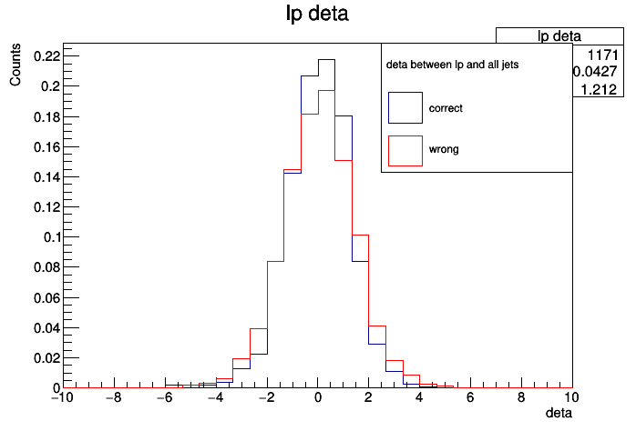

Δη between lepton and all b jets
Positive lepton
Negative lepton

Slide 14
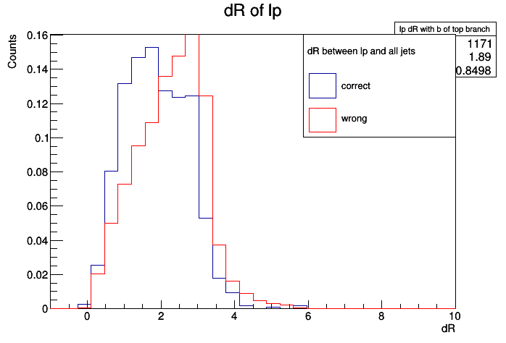
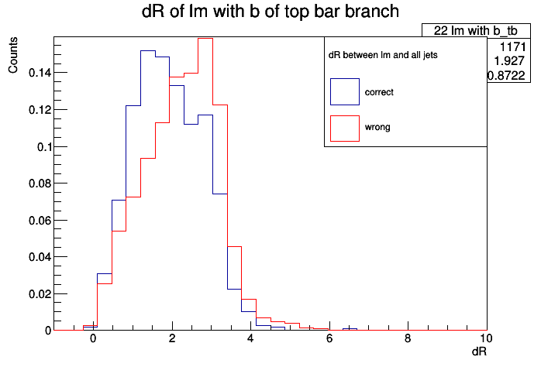
ΔR between lepton and all b jets
Positive lepton
Negative lepton

Slide 15
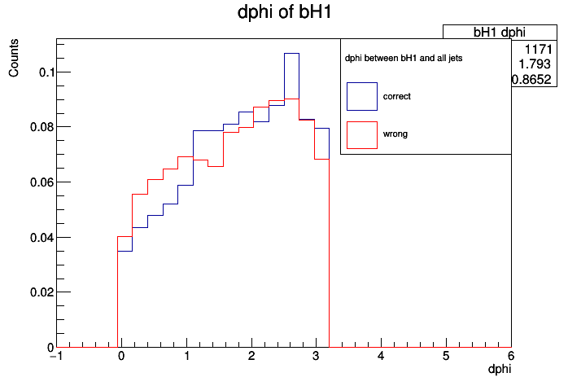

Δφ between 1st and 2nd bjet of Higgs with the rest of b jets
1st b-jet of Higgs
2nd b-jet of Higgs

Slide 16
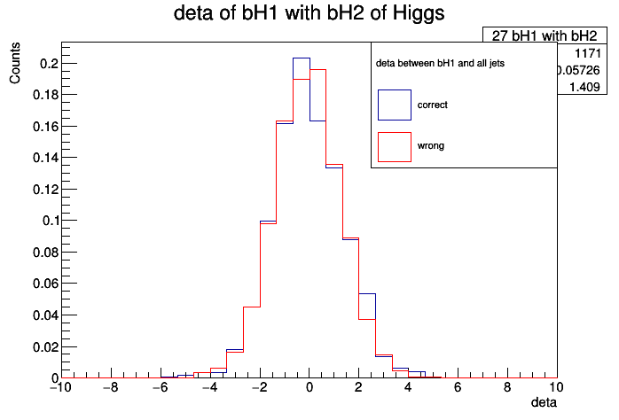
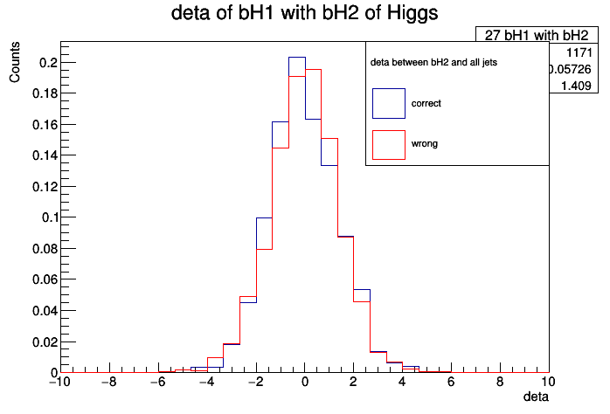
Δη between 1st and 2nd bjet of Higgs with the rest of b jets
1st b-jet of Higgs
2nd b-jet of Higgs

Slide 17
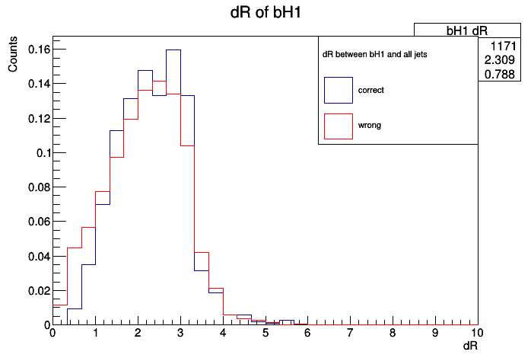

ΔR between 1st and 2nd bjet of Higgs with the rest of b jets
1st b-jet of Higgs
2nd b-jet of Higgs

Slide 18
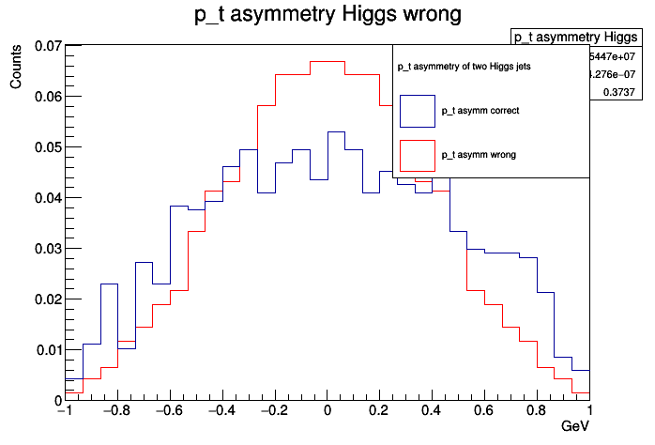
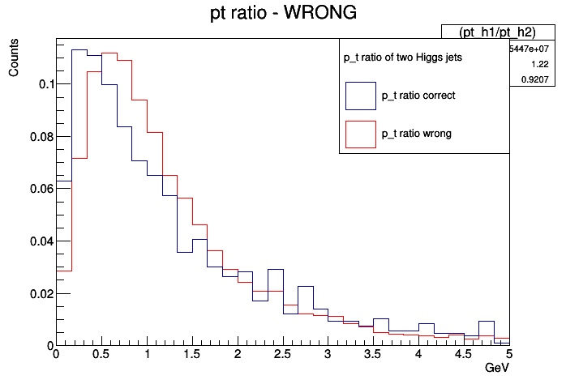
Pt asymmetry and Ratio of Higgs jets
(PT1-pT2)/(PT1+pT2)
(pT1/pT2)

Slide 19
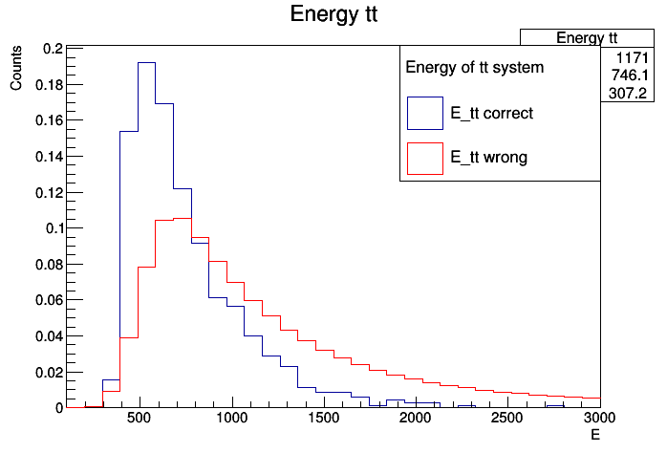
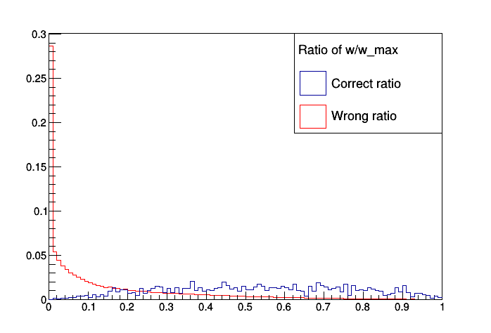
Energy of the tt system and PDF weights ratio
Energy of the tt system
Ratio = w/w_max
Good discriminative power.

