Slide 1
MVA Investigation

Slide 2
1st “Raw” approximation of MV method
No cuts applied (e.g. in ratio of w’s)
Boosted Decision Trees
Variables
Ratio of w: w/w_max
w1,w2,x1,x2
Ett
Deta,dphi,dR of lm-bt_/lp-b_tb/H1-H2
Higgs pt ratio
Higgs pt asymmetry
Higgs mass→ Spectator
400 trees
Maximum depth 3
Boost type: AdaBoost
Half of given sig&Bg were used for train and other half for testing

Slide 3
Kolmogorov – Smirnov Test
Bg→ Overtrained

Slide 4
BDT output

Slide 5
BDT output
Chose to set the BDT output as the value that maximise: S/sqrt(S+B)
BDT output value: -0.27
Not absolute→ we can fiddle around that value and look for a better cut.

Slide 6
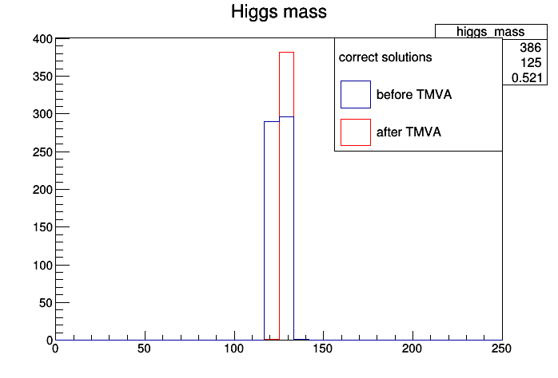
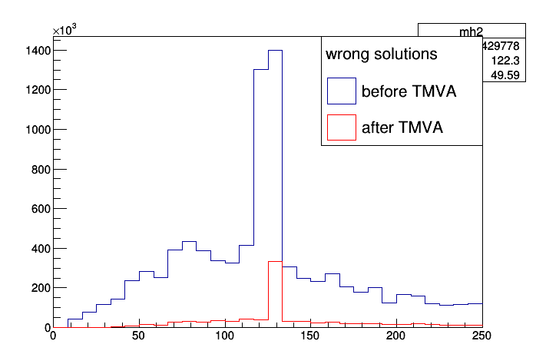
Impact on the Higgs mass
Before TMVA→ 589 events
After TMVA→ 386 events
Before TMVA→ 9.429.778 events
After TMVA→ 955.698 events

Slide 7
Background rejection vs Signal efficiency

Slide 8
2nd Approximation of MV method
Cuts added: ratio of sig >0.1 & ratio of bg<0.1
Reduced events of Bg so that we avoid overtraining→Numb of events: 826.721
Signal sample→ the same
Again half of sig and bg used for training and half for testing

Slide 9
K-S test
It can be seen that even with fewer events there is still overtraining in the Bg

Slide 10
BDT Output
It can be seen that signal and background have almost perfect separation. This can be attributed to the cut that we made in ratio.

Slide 11
Variables
As required by the cut that we made, ratio has a perfect separation and thus a “perfect variable” was made. The impact of it can be seen in the next slide:

Slide 12
Bg rejection vs Signal eff.

Slide 13
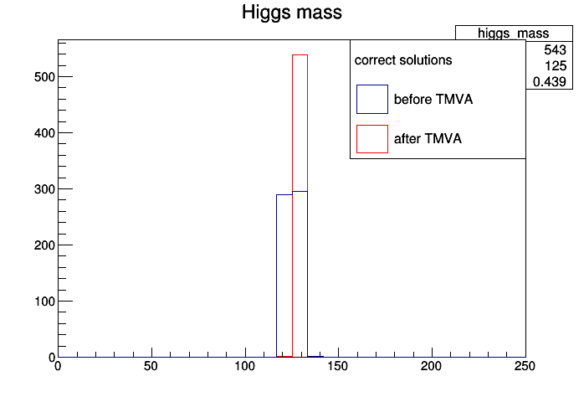
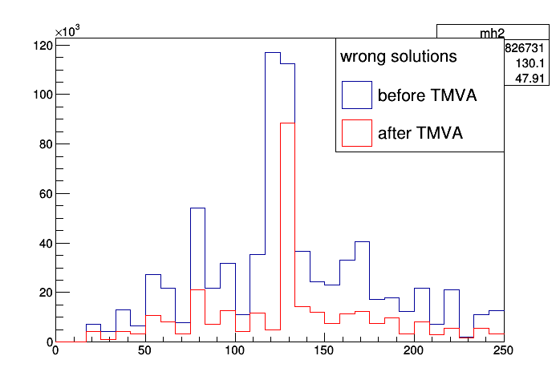
Higgs mass with the BDT cut set to be (not based in significance): -0.2
Events before TMVA→589
Events after TMVA→543
Events before TMVA→826.731
Events after TMVA→311.838

Slide 14
3rd Approach
Kept the same configuration for the BDT method
Did not apply any preselection cuts (before: ratio)
Trained the BDT with less events (so that we avoid overtraining)
But applied the weights to a much larger sample (same number of events as the 1st approach)

Slide 15
Variables

Slide 16
BDT output

Slide 17
Overtraining?

Slide 18
Bg rejection vs Sig efficiency

Slide 19
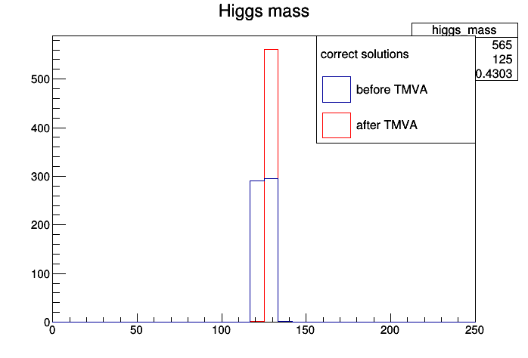
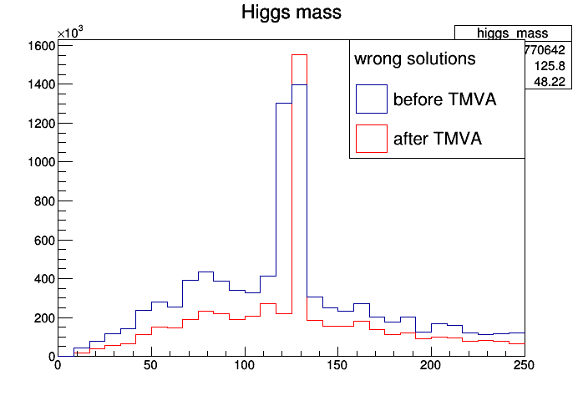
Higgs mass
Before TMVA→ 9.429.668 events
After TMVA → 770.642
Before TMVA→589 events
After TMVA →565 events

Slide 20
NN Method
I cannot get from GUI the proposed best cut (possibly bug→Reported), I look for it with the eye. In this case sig and bg overlap.

