Slide 1


Programming for Digital Humanities (4ME501)
Fall Term, August 30th 2017
Introduction Meeting
Marcelo Milrad, Koraljka Golub, Dan Kohen & Ilir Jusufi
marcelo.milrad@lnu.se, koraljka.golub@lnu.se,
dan.kohen@lnu.se & ilir.jusufi@lnu.se

Slide 2

Outline
Aims and content of the course
General information
Expected learning outcomes
Pedagogical Approach
Assumptions & Obligations
About the students & the lecturers
Materials
Assignments and final project
Additional information

Slide 3
Course Aims
The aim of this course is to introduce and discuss fundamental
concepts and techniques related to programming in the field
of Digital Humanities (DH). In this course, you will acquire
knowledge and practical experience that will allow you to
use programming (Python) as a powerful means of expression
in the humanities and the arts. The knowledge and skills
gained in this course will enable you how to apply and utilize
different programming techniques to analyze and interpret
subject matter in the field of humanities in novel ways.

Slide 4
Syllabus: Content
General programming
  Basic programming concepts
  Programming language structure: theoretical and practical aspects
  Algorithms and problem solving
Data
  Managing different data types
  Text processing, Interaction and Visualization
Application
  Application of different programming techniques for solving relevant problems within the field of humanities
http://kursplan.lnu.se/kursplaner/syllabus-4ME501-1.pdf

Slide 5
General Information
15 ECTS
Period: August 28th 2017 – January 14th 2018
50% pace
English language
Distance mode with 6 obligatory meetings
  Presence on-line real time preferred (sessions will be made available on Moodle afterwards)
https://lnu.se/en/course/programming-for-digital-humanities/vaxjo-distance-part-time-autumn/

Slide 6
Expected Learning Outcomes
Demonstrate a good understanding of the different
methods associated with basic programming
Be able to explain the concepts and methods that
allow programming to be used a powerful tool of
expression in the humanities and the arts
Be able to explain how different programming
techniques can be used to analyze and interpret
subject matter in new ways

Slide 7
Pedagogical Approach
Experiential learning: real cases and hands-on activities
We learn together trough a dialogic process and collaboration
Type of activities: meetings, video recordings (flipped-classroom), forum discussions, hands on, assignments and a final project

Slide 8
Instruction Methods
6 mandatory real-time on-line meetings
  They are recorded for later use
Video Lectures
Assignments
Final project

Slide 9
Assumptions and Obligations
You have at least a bachelor degree in the field of humanities or the like
You are open minded, responsible and are ready to make an effort
You like intellectual challenges and are willing to learn new things
Deadlines are important → you should respect them

Slide 10
Students attending the course
Heterogeneous group
  International: more than 40 accepted students from 9 countries: Denmark, France, Germany, Italy, Moldova, United Kingdom, Sweden and Switzerland
  Disciplinary diversity
    On the forum mentioned: cognitive science, linguistics, archeology, human resource management, library and information science…
  Education level
    From recent BA graduated to full professors

Slide 11

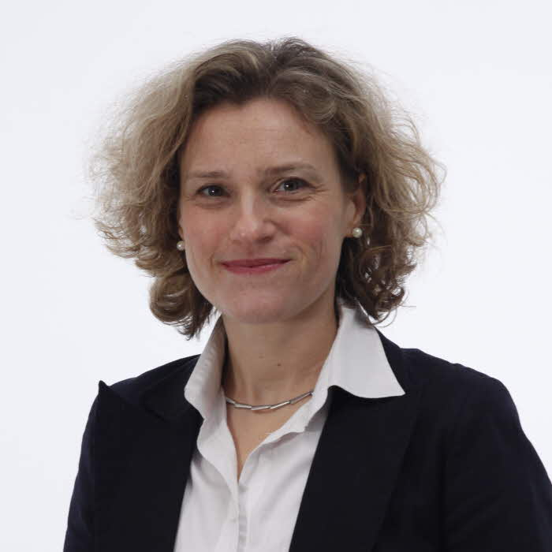

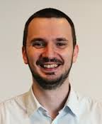

Teachers
Professor Marcelo Milrad – course responsible
Dr Koraljka Golub, Docent –
(collaboration on the course conception from
the digital humanities persepctive)
Dr Dan Kohen – Python Programming
Dr Ilir Jusufi – Interactive Visualisation
PhD Candidate, Max Müller, course assistant

Slide 12
Course Web Site, resources & more
4ME501 in Moodle
http://mediatech.lnu.se/moodle/course/view.php?id=85
4ME501 in Adobe Connect
https://connect.sunet.se/lnu-4me501/
4ME501 Vimeo Channel https://vimeo.com/channels/1283957/
Consultations: based on predefined appointments utilizing one of the channels used in the course

Slide 13
Required readings
Montfort, Nick. (Latest edition). Exploratory programming for the arts and humanities.
Cambridge, MA: MIT Press. 328 pages https://mitpress.mit.edu/exploratory
Web­ based materials
Tutorials by Linnaeus University

Slide 14
Examination: 4ME501 HT17
No. | Activity | Amount of credits
1. | Assignment 1 (Individual work) | 1,5
2. | Assignment 2 (Individual work) | 1,5
3. | Assignment 3 (Individual work) | 2
4. | Assignment 4 (Individual work) | 2,5
5 | Assignment 5 (Individual work) | 1,5
6 | Assignment 6 (Individual work) | 1,5
7 | Final Project | 4,5
Total |  | 15

Slide 15
Grades 4ME501 HT17
Percentage | ECTS Grade
0 – 59% | F (Fail)
60%- 67% | E
68%- 76% | D
77%- 85% | C
86%- 94% | B
95%- 100% | A

Slide 16
Course Evaluation
Anonymous, handled centrally by LNU (not teachers on the course)
Within several weeks after the end of the course period, each student will receive an email link to course evaluation
The compiled report will be filed at the Faculty of Technology, LNU
The report is to be communicated to the students who have taken the course and to the students who are to participate in the course the next time it is offered

Slide 17
Three major content blocks
  1: Foundations of programming with Python for DH
  and text processing
  August – Beginning of October
  2: More on text processing and Interactive Visualization
  Beginning of October – Beginning of November
  3: Advanced Text Processing & Rich Media (images, audio and
  animation*)
  Mid November – Beginning of January
* These topics will be discussed and presented in details later in November

Slide 18
1. Foundations of Programming with Python for DH
  Content:
  Installation and setup
  Programming fundamentals (data types, functions, iteration…)
  Basics of text processing
  Literature:
  Book chapters: Introduction and chapters 1, 2, 3, 4, 5, 6

Slide 19
Assignment 1:
  Simple text manipulation and processing
  Presentation of this assignment: September 14th
  Deadline: 24 September

Slide 20
Assignment 2: Text manipulation
Comparison of two e-books based on word recognition, frequency counts, and named entities recognition
Presentation of this assignment: Sep 14th
Deadline: October 7th

Slide 21
1I. Text processing and visualisation
  Content:
  More on text processing techniques
  Basics of visualization
  Overview of visualisation techniques for DH
  Literature:
  Book chapters: chapters 7,10, 11 and additional resources available online

Slide 22
Assignment 3
Simple statistics and visualizations techniques connected to the two previous assignments
Presentation of this assignment: Sep 28th
Deadline: October 24th

Slide 23
Assignment 4-6
Three assignments connected to the topics of block three of the course
Presentation of this assignments: November/December
Deadline: TBC

Slide 24
Final project
Define your own topic of interest for the final project
The work could be carried out in pairs
The assignment should be defined by you and posted to Moodle. Detailed information and dates will be confirmed later.

Slide 25
Relevant suggestions

Slide 26
Great Python tutorial!
http://programminghistorian.org
We strongly suggest to look through this URL for examples and use cases like:
Transliterating non-ASCII characters with Python http://programminghistorian.org/lessons/transliterating
Generating an Ordered Data Set from a Text File http://programminghistorian.org/lessons/generating-an-ordered-data-set-from-an-OCR-text-file
Text Mining in Python through the HTRC Feature Reader
http://programminghistorian.org/lessons/text-mining-with-extracted-features
The Sound of Data (a gentle introduction to sonification for historians) http://programminghistorian.org/lessons/sonification

Slide 27
Five reasons why you should learn Python
https://fossbytes.com/why-should-one-learn-python-programming-language/

Slide 28
Other relevant links
Introduction to DH: online videos with different views on DH: http://dariah.eu/teach
About transforming text to data:
https://oldnews.peterkrantz.se/about-the-experiment

Slide 29
Contact Information
Dr. Marcelo Milrad, Professor
Coordinator and Examiner for the 4ME501course
Department of Media Technology
Linnaeus University,
351 95, Campus Växjö, SWEDEN
E-mail: marcelo.milrad@lnu.se

