Slide 1
Web Engineering
By
Adnan Amin
IMSciences|Peshawar

Slide 3
HTTP and HTML (Created By Tim Berners-Lee)
HTTP, Stands for HyperText Transfer Protocol.
HTTP is a communication standard governing the requests and responses that take place between the browser running on the end user’s computer and the web server.
HTML, Stands for Hypertext Markup Language.

Slide 4
Job of Server and Web Server?
The server’s job is to accept a request from the client and attempt to reply to it in a meaningful way. i.e. serving up a requested web page.
A web server can usually handle and listening multiple simultaneous connections. When an incoming request arrives, the server sends back a response to the client to confirm its receipt.

Slide 5
Request and Response
Web server is spends its time listening for an incoming connection, when one arrives it is known as request.
The request connection usually sends from the Client using web browser to a web server.
When the server sends back a response to the client that confirm its receipt is known as server response.

Slide 6
The Request/Response Procedure
The request/response process consists of a web browser asking the web server to send it a web page and the server sending back the page.
The browser then takes place to display the page.

Slide 7
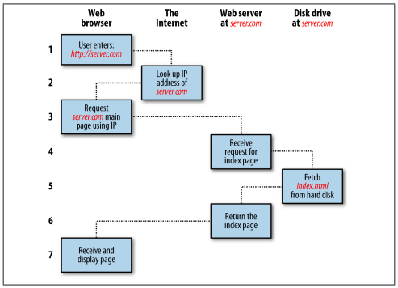
The basic client/server request/response sequence

Slide 8
Steps involved in request/response sequence
Type http://imsciences.edu.pk into web browser’s address bar.
Web browser looks up the IP Address for imsceinces.edu.pk
Web Browser issues a request for the home page at imsciences.edu.pk at web server on server machine.
The web serverreceived the request and looks for the web page on its storage device.
The web page is retrieved by the server and returned to the browser.
The client’s browser will display the web page.

Slide 9
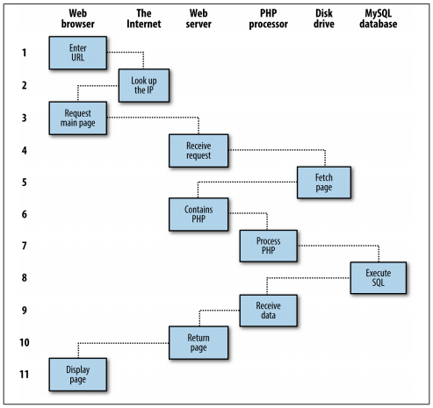
Steps involved in Dynamic Web Pages Procedure

Slide 10
Steps client/server request/response sequence
Type http://imsciences.edu.pk into your browser’s address bar.
Web browser looks up the IP Address for imsciences.edu.pk
Web browser issues a request to that address for the web server’s home page.
The web server will received the request, fetches the home page from its storage device.
The home page now passes through PHP interpreter because page containing PHP scripting.
The PHP interpreter executes the PHP code, if page contains MySQL statements, then PHP interpreter will passes to the MySQL database engine.
MySQL database returns the results of the statements back to the PHP interpreter.
The PHP interpreter returns the results of the executed PHP Code along with the results from MySQL database to the web server.
The web server returns the page to the requesting client, which displays it.

Slide 11
PHP
Hypertext preprocessor
A tool for writing and executing server-side scripting.
A simple way to embed dynamic activity in web pages.
Its extension is *.php and always placed inside the web server default director i.e. www
A flexible scripting language to connect with database. i.e. MySQL
Sample code
<?php
echo “Hello Students”;
?>

Slide 12
MySQL
The highest level of MySQL structure is a database, within which you can have one or more tables that contain your data.
It is a relational database with structured query that uses English-like commands.
Free to use and installed on vast numbers of web servers.
Its based on SQL (structured query language), designed in the early 1970s.
For example:
Select name, class, gender from students;
Where students is table name and name,class gender are attributes inside the students table. this mysql query will return the list of all students’ name, class and gender from table students.

Slide 13
JavaScript
It provides a means for dynamic user interaction.
Combined with CSS (Casecadding Style Sheet), JavaScript is the power behind dynic web pages that change in front of eyes rather then when than when a new page is returned by the server. (No request/response procedure).
For example: checking email address validity in input form, if wrong format so immediately displaying “Enter email address in correct format”.
Sample code:
<script type=“text/javascript”>
document.write(“Hello today is “ + Date());
</script>

Slide 14
CSS
Latest CSS3 is now offers multiple dynamic interactivity previously only supported by JavaScript.
You can format the style of any HTML element such as colors, borders, spacing, background, fonts, animation etc..
You can also add animated transitions and transformations to your web page.
Sample code:
<style>
P {
text-align:justify;
font-family:Arial;
}
</style>

Slide 15
Apache Web Server
Apart from PHP, MySQL, JavaScript, CSS and HTML, there is another hero in dynamic web that is Web Server.
Apache is a web server.
Web server handle and manage a wide range of server activity of various modules such as databases (MySQL), PHP (Programming), security, ports etc.
PHP, MySQL and Apache are three most commonly used open source tools

Slide 16
Setting up a web server/Environment
WAMP
Windows, Apache, MySQL and PHP
MAMP
Mac, Apache, MySQL and PHP
LAMP
Linux, Apache, MySQL and PHP
Install any one from WAMP, MAMP, LAMP can fully functioning setup used for developing dynamic web page.
All these comes into one package that binds the bundled programs pre-configured together.

Slide 17
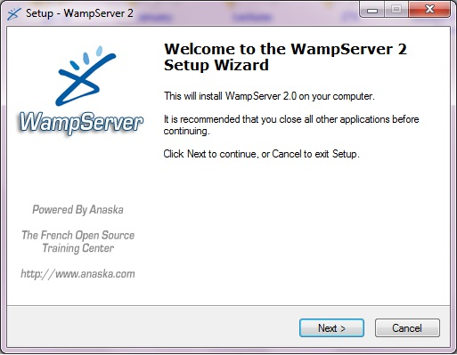
WAMP Installation
Download From
www.wampserver.com

Slide 18
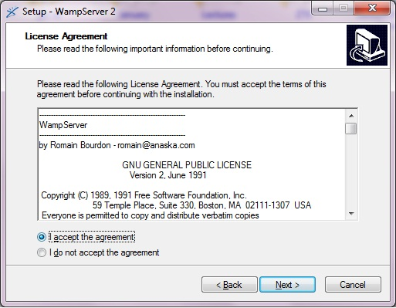

Slide 19
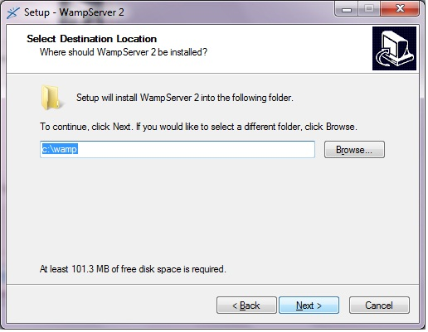

Slide 20
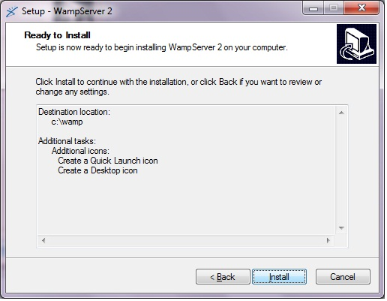

Slide 21
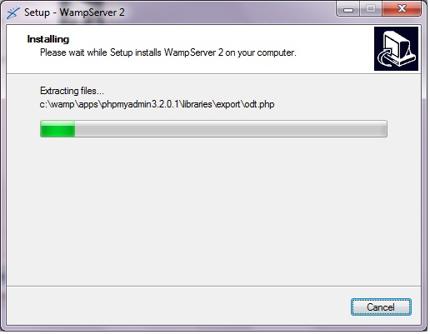

Slide 22
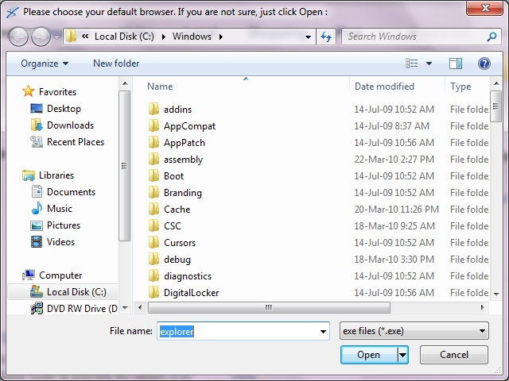

Slide 23
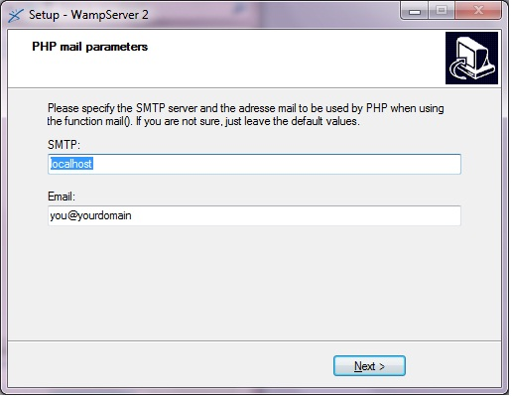

Slide 24
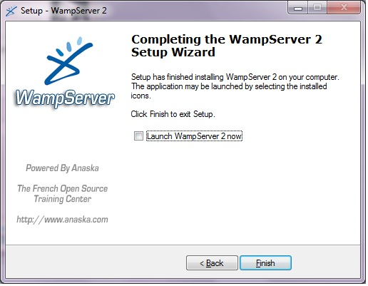

Slide 25
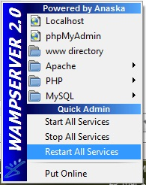

Slide 26

Testing the Installation
Create a PHP file
<?php
echo “Hello”;
?>
Save it into www folder of web server with anyname.php
Open web browser and type http://localhost/anyname.php

Slide 27
IDE
Integrated Development Environment
Rapid programming productivity
Offer many additional features such as coding editor, debugging, testing and formatting.
For examples
Dreamweaver, phpDesigner

Slide 28
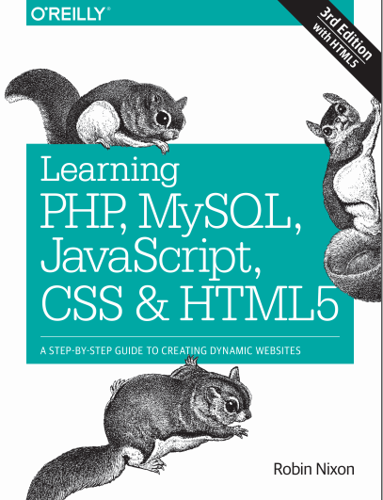
Thanks
Source:

