Slide 1
Web Engineering
BY
Adnan Amin
IMSciences|Peshawar

Slide 2
Outlines
What is PHP and What can PHP do?
Hello World!
PHP Basics
Variable naming rules
Arithmetic Operators in PHP
Assignment Operators
Comparison Operators
Logical Operators
String concatenation

Slide 3
What is PHP and What can PHP do?
PHP: Hypertext Preprocessor
Widely used open-source general purpose scripting language
Designed especially for web development
Easily embedded into HTML
PHP can do;
Collect form data
Generate dynamic page content
Send and receive cookies
Working with session
Working with file & folders

Slide 4
Hello World!
<?php
echo “Hello world”;
?>
The entire php code should be placed inside <?php ….. ?> tags.
<?php is starting of php section
?> is ending of php section
Multiple php code can be placed into a single HTML document
Extension of php file should be *.php

Slide 5
PHP Basics
//This is single line comment
/* this is multiline comments */
Semicolons ( ; ) should always be placed in the end of each statement
E.g. $x=111;
The $ symbol: always be placed in front of all variables in php.

Slide 6
Variable naming rules
When creating PHP variable, must follow these three rules:
Variable names must start with a letter of the alphabet or the underscore character.
Variable names may not contain spaces. If a variable must comprise more than one word, it should be separated with underscore character e.g. $first_name etc.
Variable names are case-sensitive. The variable $first_name is not the same as the variable $First_Name.

Slide 7
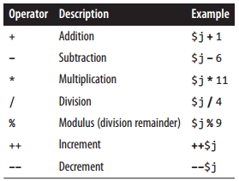
Arithmetic Operators in PHP

Slide 8
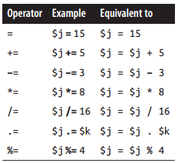
Assignment Operators

Slide 9
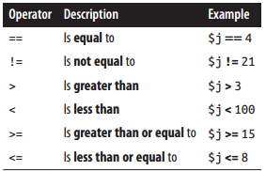
Comparison Operators

Slide 10
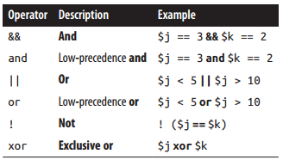
Logical Operators

Slide 11
String concatenation
Period (.) is used to append one string of characters to another.
E.g. echo “Hello Dear “ . $user_name . “ Thanks”;

Slide 12
Conditional Statements
It alter the program normal.
It enable you to ask questions about certain things and respond to the answers you get in different ways.
allow your program to choose different paths of execution based upon the outcome of an expression or the state of a variable.
These statements allow you to control the flow of your program’s
execution based upon conditions known only during run time.
If statement

Slide 13
Non-Looping (Selection) and Looping (iteration) Conditional Statements
Conditionals can be in the form of looping or non-looping.
Non-looping conditional statements are;
The actions initiated by the statement take place and program flow then moves on.
If statement
Switch statement
? Operator
Looping conditional statements are;
It execute code over and over until a condition has been met.
For loop
While loop
Foreach loop

Slide 14
If Statement
It evaluate the condition (i.e. expression).
The actions to take when an if condition is TRUE are generally placed inside curly braces, { }.
There is no need of braces if the true statement body contains single line of code.
if(condition)
{
Body for True case
}

Slide 15


IF-Else Statement
When a condition is true then body of if-part will be executed but when a condition is false then body of else-part will be executed.
Sometimes when a conditional is not TRUE, you may not want to continue on to the main program code immediately but might wish to do something else instead. This is where the else statement comes in.
if(Condition)
{
Body of If-Part
}
else
{
Body of else-part
}

Slide 16
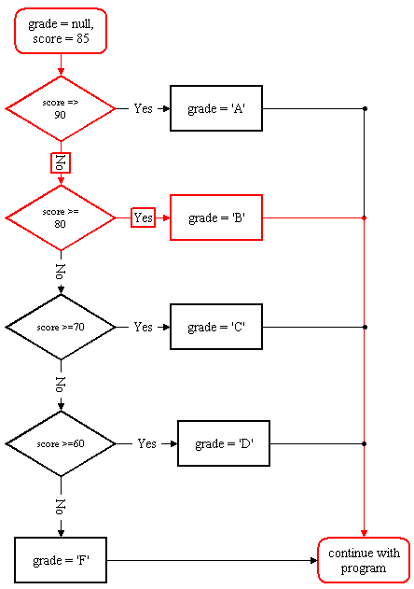
If-Else Statement
$grade;
$score = 85;
if ($score >= 90)
$grade = 'A';
else if ($score >= 80)
$grade = 'B';
else if ($score >= 70)
$grade = 'C';
else if ($score >= 60)
$grade = 'D';
else
$grade = 'F';

Slide 17
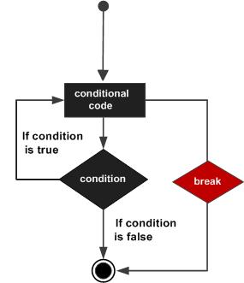
The switch Statement
The switch statement is useful in cases in which one variable or the result of an expression can have multiple values, which should each trigger a different function.
It is Java’s multiway branch statement.
It works like this;
The value of the expression is compared with each of the values in the case statements.
If a match is found, the code sequence following that case Statement is executed.
If none of the constants matches the value of the expression, then the Default statement (optional) is executed.
If no case matches and no default is present, then no further action is taken.
The break statement is used inside the switch to terminate a Statement sequence.

Slide 18
A multiple-line if ... elseif ... statement
<?php
if ($page == "Home") echo "You selected Home";
elseif ($page == "About") echo "You selected About";
elseif ($page == "News") echo "You selected News";
elseif ($page == "Login") echo "You selected Login";
elseif ($page == "Links") echo "You selected Links";
?>

Slide 19





A switch statement
<?php
switch ($page)
{
case "Home":
echo "You selected Home"; break;
case "About":
echo "You selected About"; break;
case "News":
echo "You selected News"; break;
case "Login":
echo "You selected Login"; break;
case "Links":
echo "You selected Links"; break;
}
?>

Slide 20








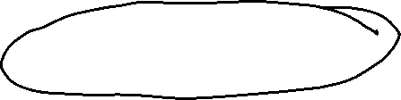


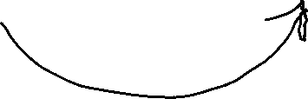




The ? Operator
The ? operator is passed an expression that it must evaluate, along with two statements to execute:
One for when the expression evaluates to TRUE, the other for when it is FALSE.
<?php
echo $fuel <= 1 ? "Fill tank now" : "There's enough fuel";
?>

Slide 21






Assigning a ? conditional result to a variable
Here $enough will be assigned the value TRUE only when there is more than a gallon of fuel; otherwise, it is assigned the value FALSE.
<?php
$enough = $fuel <= 1 ? FALSE : TRUE;
?>

Slide 22
Thanks!

