Slide 1
Web Engineering-1 Topic: MySQL
By
Adnan Amin
IMSciences, Peshawar

Slide 2
Overview
Do changes in PHP.INI file for enabling MySql.
Testing Your Installation.
To start the MySQL server.
To stop the server from running.
To shut down the MySQL service.
Login into mysql.
Display all existing databases.
Show tables of currently use database.
Show all columns of table.
Show all users of mysql database.
Delete the user from user table of mysql.
Creating New User/ Grant Privileges.

Slide 3
About PHP.INI
PHP's initialization file, generally called php.ini, is responsible for configuring many of the aspects of PHP's behavior.
PHP attempts to find and load this configuration from a number of locations.

Slide 4
Do changes in PHP.INI file for enabling MySql
Open php.ini file.
Remove semi-colon to enable your specific databases.
Statement | Description
extension=php_mysql.dll | MySQL 4.0
extension=php_mysqli.dll | MySQL 4.1 or later
extension=php_mssql.dll | MS SQLServer
extension=php_oci8.dll | Use with Oracle 10gR2 Instant Client
extension=php_oci8_11g.dll | Use with Oracle 11g Instant Client

Slide 5
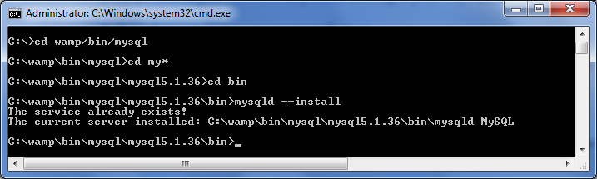
Testing Your Installation
By installing WAMP or LAMP server, there is no need to follow hard steps and manually configure MySql.
These steps to test your installation:
C:\wamp\bin\mysql\mysql5.1.36\bin>mysqld --install

Slide 6
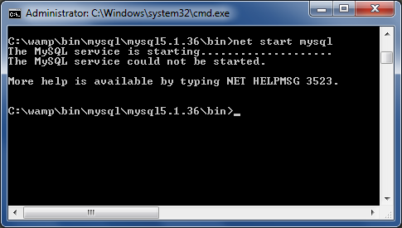
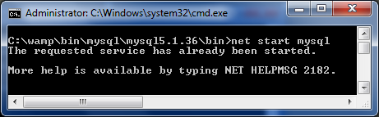
To start the MySQL server
To start the MySQL server, type the following:

Slide 7
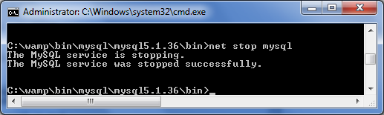
To stop the server from running
To stop the server from running, type the following steps.
C:\wamp\bin\mysql\mysql5.0.1\bin> net stop mysql;

Slide 8
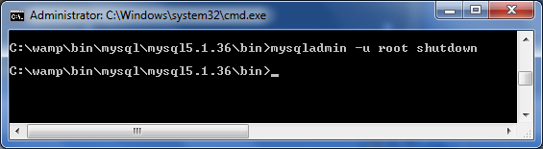
To shut down the MySQL service
To shut down the MySQL service, type the following steps.

Slide 9
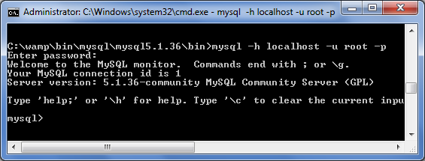
Login into mysql
Root user is default mysql administrator account with blank password.
Syntax
path: \ > mysql –h server_name –u user –p
password: your_password;
Explanation:
-h : Host name
-u : user_name
-p : user’s_password

Slide 10
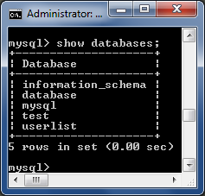
Display all existing databases.
Path:\> show databases ;
By default, there you will see just two databases.
Mysql
Test .

Slide 11
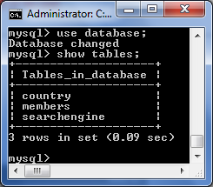
Show tables of currently use database.
Path:\> use database;
Here database might
Be any name of DB.
“Use” command is
use to change the
Currently in use DB
Into a new DB.
Show table will display
All tables of the currently in used database.

Slide 12
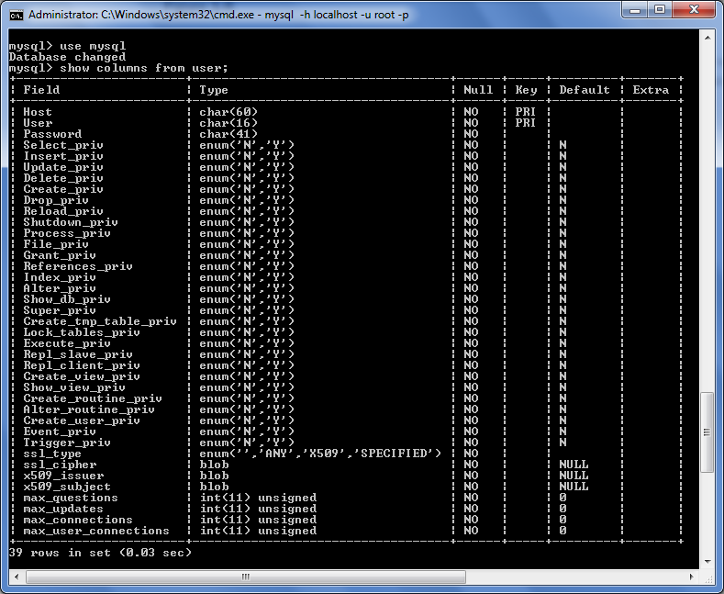
Show all columns of table.

Slide 13
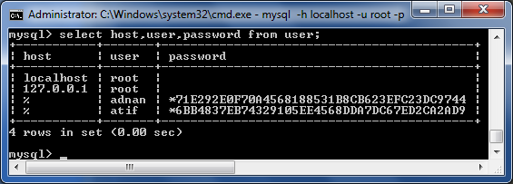
Show all users of mysql database.
Path:\> SELECT field_name, field_name2 FROM user;

Slide 14
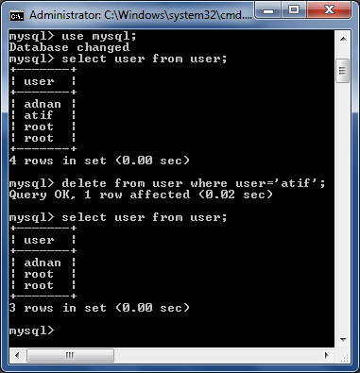
Delete the user from user table of mysql.
The below query will delete the user “ATIF” from “user” table where host name is localhost.
Before applying delete query
After applying delete query

Slide 15
Creating New User/ Grant Privileges
First login to mysql as root user.
Creating new user
Granting privileges to user atif.
mysql> CREATE USER 'atif'@'%' IDENTIFIED BY ‘123456‘;
mysql> GRANT SELECT,INSERT,UPDATE
> ON *.*
> TO ‘atif’@’%’
> IDENTIFIED BY ‘123456’;

Slide 16
Thank You!

