Slide 1
How to achieve Continuous Delivery
Best practices on how to architect for faster and better delivery in the Enterprise

Slide 2
Continous Delivery Definition
“Continuous Delivery is the ability to get changes into production safely and quickly in a sustainable way”
Notes:
Continuous delivery is the ability to get changes into production safely and quickly in a sustainable way.
It’s not only about deploying code in production but it’s about bringing all type of changes that helps to deliver value faster.
This includes also all type of IT infrastructure changes, software configuration changes, deploying data and schema migrations, …

Slide 3

Notes:
Continuous Delivery is a capability an enterprise need to develop and learn and because it’s based on new paradigms that demands deep organizational changes. It’s not something an enterprise can acquire in a box but it need to develop it through a change journey. It took Amazon or Facebook years to change their organization and architecture so that they could be sustainable by delivering faster. It can demand tremendous efforts and changes to the culture and architecture.
Like any big change in an organization it’s not linear, how you will achieve the goal is largely unpredictable. Therefore like any change in the enterprise, it need to be carefully managed to ensure that current operations are not adversely affected.
Continuous Delivery is also never done, it’s a continuum that can always be improved.

Slide 4
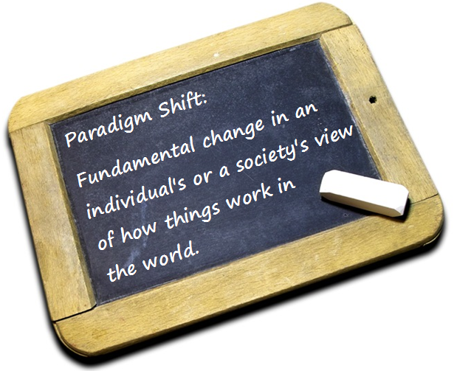
Notes:
In the classical view of software delivery, you need to make a trade-off between quality and speed. The traditional IT delivery process paradigm postulate that building quality software will demand longer to deliver. You trade quality with getting things done rapidly. Now, studies on teams that have adopted Continuous Delivery (CD) demonstrate exactly the opposite. Teams able to deploy by the push of a button not only deliver faster but they deliver better quality in a more reliable way.

Slide 5
Why Continous Delivery
Increased Availibility & Manageabiity
  Smaller = More releases = downtime = stress = Productive time
  Change fast = Remediate fast = No Rollback = Simplify Process = Investment
  Automation = Quality = Incidents
  Constant Flow = Work Force utilization
  Detect Bugs Sooner = cost of bug fixes
Improved Testability
  Decouple = Test in isolation = environments = Feedback
Improved intrinsic product quality
  Time to market = PO experimentation = Improvement
Improved satisfaction (Customer & Work force)
  Constant delivery & decouple Release = confidence & transparence
Notes:
Being able to push changes fast and reliably to production changes the rule of the game and transforms many aspects of the IT delivery process. It reflects on aspects like:
Increased Availability & Manageability
Because you can push changes a lot faster you can make smaller changes with less downtime you don’t need to come in the middle of the night or weekends to deploy the system. This means less overwork and stress for the team’s members. It also frees up a considerable amount of time as teams don’t need to participate at long lasting release planning's sessions to coordinate huge deployments.
Because you know you can push a change fast you’re also able to remediate faster and you don’t need to take account of being able to reverse a giant change. In place, you can adopt release strategies where you always advance forwards. In place of reverting a change you can be confident that you can fix any problem fast. This simplify the release process and lower the investment needed in process, infrastructure and tools to be able to revert back a giant change.
Reports also demonstrates that teams practicing CD sees their number of big incidents diminishing drastically. Apart from the better intrinsic quality that CD brings this is also due to the automation that CD demands. The automated deployment pipeline eliminates errors that might result from manual configuration and error-prone practices.
Increased efficiency and cycle time
Because you make smaller changes your tester and analyst can work in a constant flow of work. They don’t need to test everything in a great batch at the end of the release but can continuously work in at constant pace together with the developers.
Because bugs are also detected sooner they are cheaper to fix. When practicing continuous delivery automated tests are run immediately after each check-in what detects many bugs immediately. The developer can get immediate feedback even before he starts working on another task and so he knows where to search for the bug. It’s proved by many studies that bugs found before or immediately after the check-in are orders in magnitude cheaper to fix (sometimes more than 100 times). *https://www.researchgate.net/publication/255965523_Integrating_Software_Assurance_into_the_Software_Development_Life_Cycle_SDLC
Improved testability
To be able to deploy small changes independently the systems needs to be decoupled. This decoupling enables also to test the system more easily in isolation. Most of the changes can be tested without deploying to an integration environment. This lowers the number of environment needed and allows for a more rapid feedback.
Improved intrinsic product quality
Because the tremendous acceleration of time to market of a change, from once every 3 months to many times a day, product owners can experiment a lot faster enabling new product evolution strategies based on experimentation and continuous improvement. The book Lean Enterprises describes in detail how modern software companies takes advantages of continuous delivery to design products based on experimentation.
Improved Customer Satisfaction
CD brings confidence to the customers and other stakeholders on the delivery of their new features. CD enables to deliver new features at a constant and predictable pace and increase the visibility of the delivery process. By practicing feature toggles and decoupling the deployment from the actual release of the feature it enables to deploy a part or a complete new capability to early adopters.
Because organizations are more effective they can spend more time on value adding activities. This creates a virtuous circle of continuous improvements that brings a decisive competitive advantage. Continuous Delivery is becoming the norm in the enterprise. IT organization that still stick to the old delivery model will be forced to change or will simply disappear. Following the 2015 State of DevOps practices study, the companies who their IT team’s practices continuous delivery has 50 % higher market capitalization growth over the 3 last years than the other and Gartner predicts that by 2020 50% of CIO’s that have not transformed their capabilities will be displaced.

Slide 6
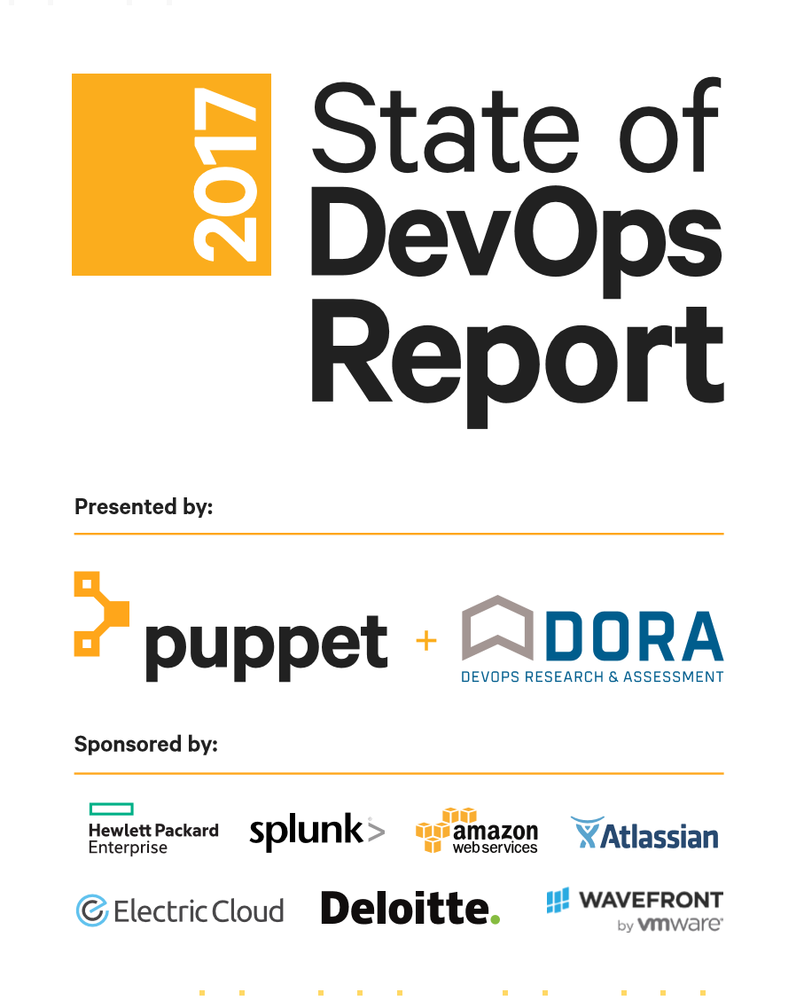
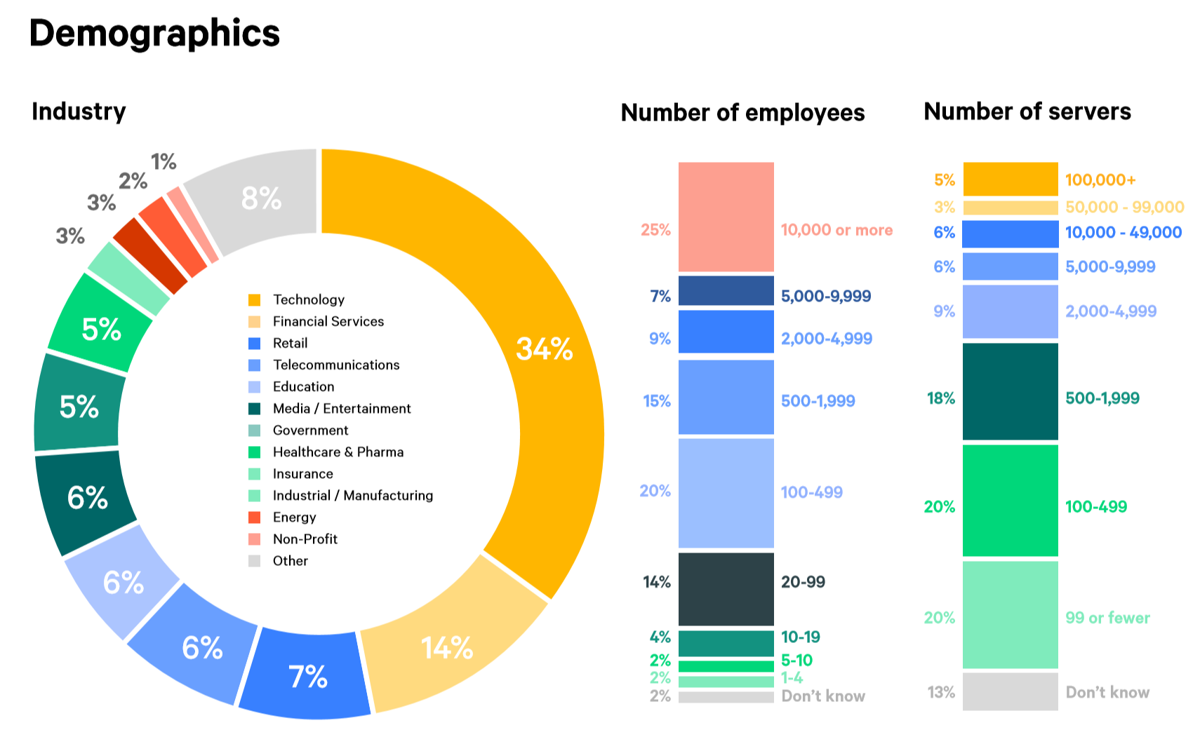
2700 Respondents
Notes:
The State of DevOps Report is a study based on an annual survey done by Puppet Labs (CI software vendor) and DORA a recherche group on DevOps practices . It’s funded by a consortium of IT companies like HP, Amazon, Deloitte, ….
In the past years the survey interrogated more than 2700 respondents from many countries working for small startups to big enterprises.

Slide 7
Methodology
Divide population in Low, medium and High performers
  Throughput Measures
    Deployment frequency. How frequently the organization deploys code.
    Deployment lead time. Time required for changes to go from “code committed” to code successfully running in production.
  Stability Measures
    Mean time to recover (MTTR). Time required to restore service when a service incident occurs (e.g., unplanned outage, service impairment, etc.).
Notes:
The state of DevOps comes with a quantitative definition of IT performance. Based on the assessment respondents the study used a statistical approach to divide the population in High, medium and low performers.
The criteria's of performance used are:
Throughput Measures
• Deployment frequency. How frequently the organization deploys code.
• Deployment lead time. Time required for changes to go from “code committed” to code successfully running in production.
Stability Measures
• Mean time to recover (MTTR). Time required to restore service when a service incident occurs (e.g., unplanned outage, service impairment, etc.).
The High performers are in doing multiple deploys a day contra medium & low performers between once a week and once a month.
The time for a code change to be pushed to production is for high performers less than an hour contra one week and one month for medium & low performers.
The change failure rate

Slide 8
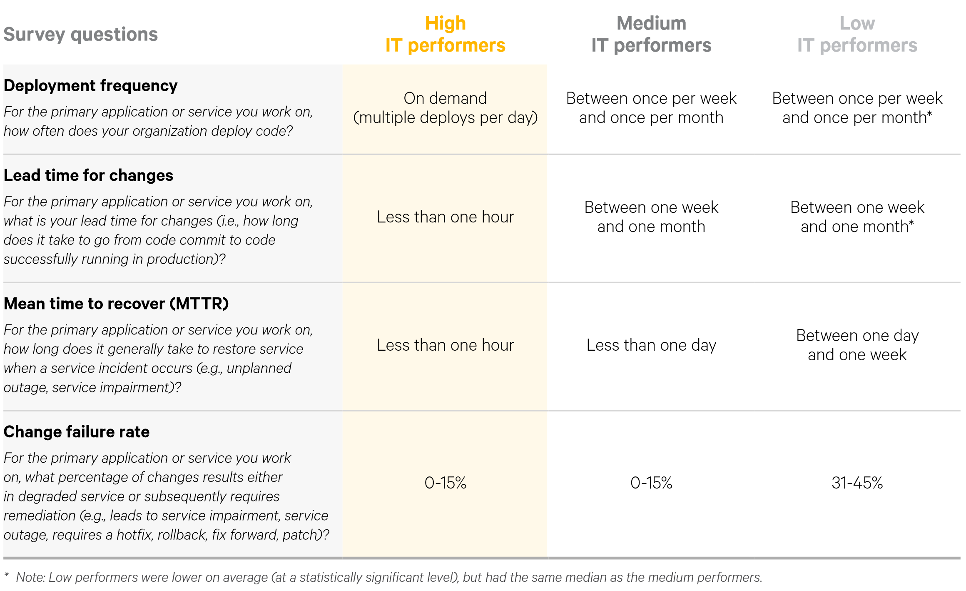

Slide 9
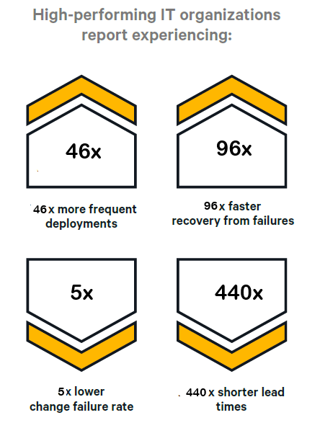
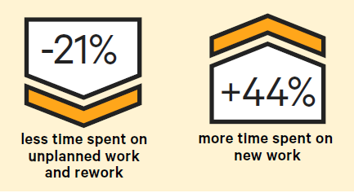
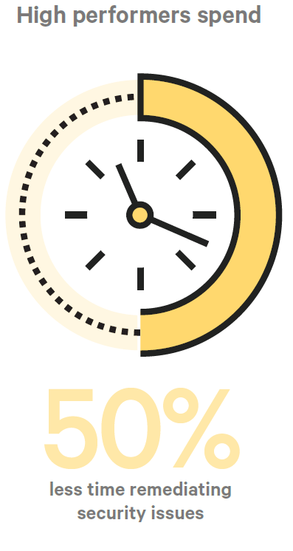
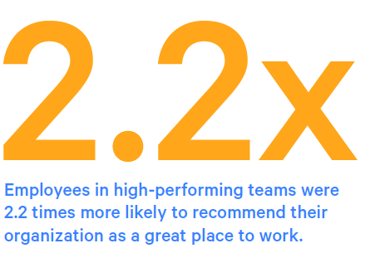

Slide 10
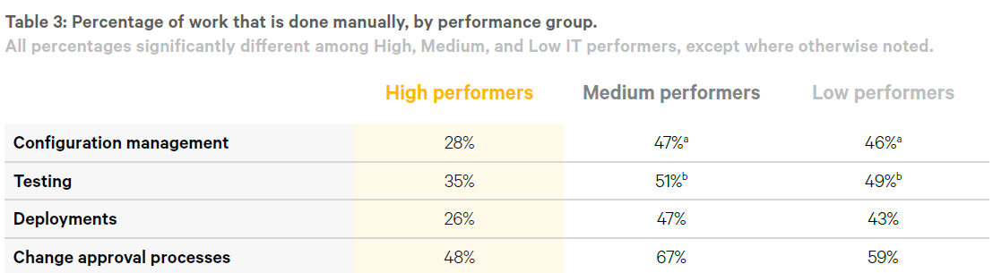
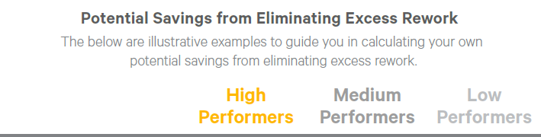
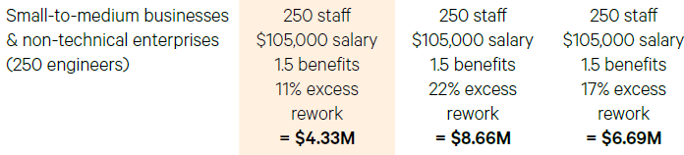
ROI

Slide 11
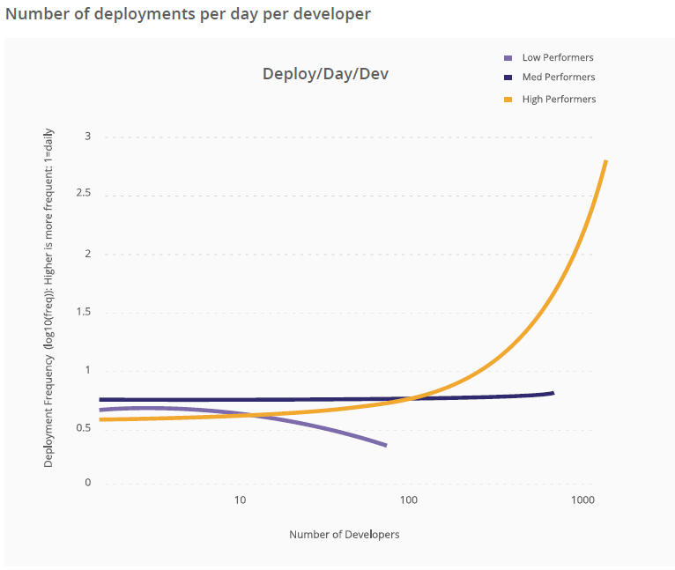
Notes:
It’s a well understood fact that when projects are late adding developers to a project can decrease the overall productivity of the team. In the classical organization it’s a common view that when growing software development teams you decrease the individual productivity of each developer. This is due to communication and integration overheads.
The DevOps study found that for the high performers, those who continuously integrate and deploy code to production this rule does not apply.
The study demonstrates that organizations that do not practice continuous delivery deploy with decreasing frequency but that those that have adopt these practices deploy significantly increasing frequency.
Conclusion: By adopting practices of continuous delivery we can increase the productivity of teams especially when working on big projects that demand many developers.

Slide 12
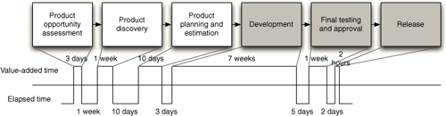
Key concept: “the value stream”
“from concept to cash”
Notes:
The entire process of software development from concept to put the application in the hand of the customers —can be modeled as a value stream map.
The value stream depict all the process steps, as well as the average amount of time that step takes. At the bottom of the map, you draw a timeline that shows how much time the request spends in value-adding activities and how much in waiting states and non-value-adding activities.

Slide 13
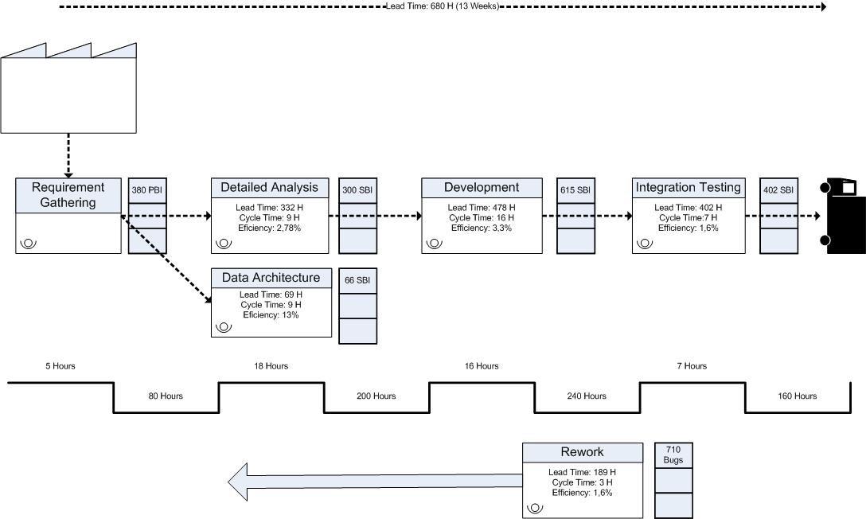

Slide 14
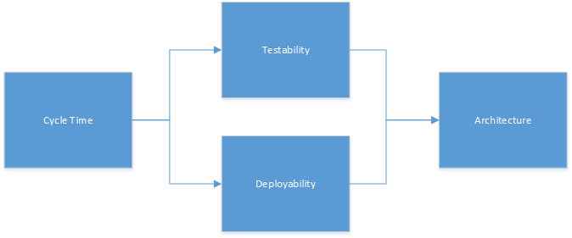
The Deployment Pipeline
As fast as possible
As simple as possible
Notes:
The complexity of the deployment pipeline and the time it takes to get something in production is directly related to the type of architecture of the system.
So before automating testing or integration you first need to work on an architecture for your application that enable that otherwise you’ll get nowhere.

Slide 15

Bottlenecks linked with Big Systems
Dependencies
  Complexity = slow development & many regressions
  Difficult to be productive = many wait time & re-work
  Large code base = Many branches = Merging hell
  Can’t deploy in isolation = Big Bang Releases = Deployment hell
Manual Tests
  Large Database = No (managed) test data = No E2E automated tests
Notes:
Large monolithical applications or applications that are composed of strongly coupled parts are charatierized by big bottlenecks that slows down the entire process.
The dependencies have significant overhead on your deployment throughput. Cycle times are longer because of the slower builds and automated and manual tests required to validate the entire app. This creates a lot of friction in the pipeline. Dependencies brings complexity what increases the development time. Complex code bases have more opportunities for bugs what causes many waste. The dependencies also lead to less opportunities for parallelizing the work. To be able to work in group, developers need to create branches so that developers can work in isolation but this demand also to merge more often what also demand a considerable effort.
An important botleneck are manual test cases ! Therfore many teams adopt test automation but before you can do test automation you first need to manage test data.
Only when teams have adequate test data they can run automated tests, and can create that data on demand, they see better IT performance, lower change failure rates, and lower levels of deployment pain and rework.
The problem whith large monolitical applications is that they also have generally large databases. Now the problem with test data is that how bigger the database how more difficult it is to manage. When the test data is difficult to setup or reason about then it become difficult to do any meaningfull test automation.

Slide 16

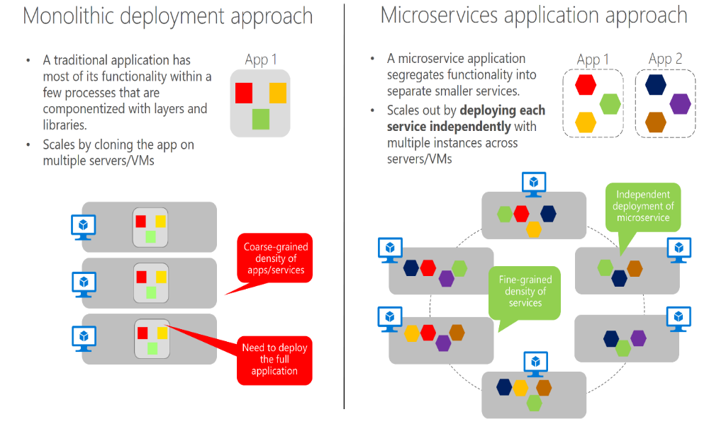
Microservice Architecture
Application is composed out of many services
Isolated
Specific business capability
Specific domain
Deployed independently
Notes:
Microservices are the emerging application platform: It is the architecture that will serve as the basis for many applications over the next 10 years. There's good reason for this: The advantages associated with microservices, such as their allowance for agile development and artifacts and an architecture that enables businesses to develop and roll out new digital offerings faster, make it the obvious choice.

Slide 17
Characteristics of a Microservice Architecture
Componentization via Services
Organized around Business Capabilities
Products not Projects
Smart endpoints and dumb pipes
Decentralized Governance
Decentralized Data Management
Infrastructure Automation
Design for failure
Evolutionary Design
https://martinfowler.com/articles/microservices.html
Notes:
Characteristics of a Microservice Architecture
We cannot say there is a formal definition of the microservices architectural style, but we can attempt to describe what we see as common characteristics for architectures that fit the label. As with any definition that outlines common characteristics, not all microservice architectures have all the characteristics, but we do expect that most microservice architectures exhibit most characteristics. While we authors have been active members of this rather loose community, our intention is to attempt a description of what we see in our own work and in similar efforts by teams we know of. In particular we are not laying down some definition to conform to.
Componentization via Services
For as long as we've been involved in the software industry, there's been a desire to build systems by plugging together components, much in the way we see things are made in the physical world. During the last couple of decades we've seen considerable progress with large compendiums of common libraries that are part of most language platforms.
When talking about components we run into the difficult definition of what makes a component. Our definition is that a component is a unit of software that is independently replaceable and upgradeable.
Microservice architectures will use libraries, but their primary way of componentizing their own software is by breaking down into services. We define libraries as components that are linked into a program and called using in-memory function calls, while servicesare out-of-process components who communicate with a mechanism such as a web service request, or remote procedure call. (This is a different concept to that of a service object in many OO programs [3].)
One main reason for using services as components (rather than libraries) is that services are independently deployable. If you have an application [4] that consists of a multiple libraries in a single process, a change to any single component results in having to redeploy the entire application. But if that application is decomposed into multiple services, you can expect many single service changes to only require that service to be redeployed. That's not an absolute, some changes will change service interfaces resulting in some coordination, but the aim of a good microservice architecture is to minimize these through cohesive service boundaries and evolution mechanisms in the service contracts.
Another consequence of using services as components is a more explicit component interface. Most languages do not have a good mechanism for defining an explicit Published Interface. Often it's only documentation and discipline that prevents clients breaking a component's encapsulation, leading to overly-tight coupling between components. Services make it easier to avoid this by using explicit remote call mechanisms.
Using services like this does have downsides. Remote calls are more expensive than in-process calls, and thus remote APIs need to be coarser-grained, which is often more awkward to use. If you need to change the allocation of responsibilities between components, such movements of behavior are harder to do when you're crossing process boundaries.
At a first approximation, we can observe that services map to runtime processes, but that is only a first approximation. A service may consist of multiple processes that will always be developed and deployed together, such as an application process and a database that's only used by that service.
Organized around Business Capabilities
When looking to split a large application into parts, often management focuses on the technology layer, leading to UI teams, server-side logic teams, and database teams. When teams are separated along these lines, even simple changes can lead to a cross-team project taking time and budgetary approval. A smart team will optimise around this and plump for the lesser of two evils - just force the logic into whichever application they have access to. Logic everywhere in other words. This is an example of Conway's Law[5] in action.
Any organization that designs a system (defined broadly) will produce a design whose structure is a copy of the organization's communication structure.
The microservice approach to division is different, splitting up into services organized around business capability. Such services take a broad-stack implementation of software for that business area, including user-interface, persistant storage, and any external collaborations. Consequently the teams are cross-functional, including the full range of skills required for the development: user-experience, database, and project management.
Products not Projects
Most application development efforts that we see use a project model: where the aim is to deliver some piece of software which is then considered to be completed. On completion the software is handed over to a maintenance organization and the project team that built it is disbanded.
Microservice proponents tend to avoid this model, preferring instead the notion that a team should own a product over its full lifetime. A common inspiration for this is Amazon's notion of "you build, you run it" where a development team takes full responsibility for the software in production. This brings developers into day-to-day contact with how their software behaves in production and increases contact with their users, as they have to take on at least some of the support burden.
The product mentality, ties in with the linkage to business capabilities. Rather than looking at the software as a set of functionality to be completed, there is an on-going relationship where the question is how can software assist its users to enhance the business capability.
There's no reason why this same approach can't be taken with monolithic applications, but the smaller granularity of services can make it easier to create the personal relationships between service developers and their users.

Slide 18

Conways law
“Any organization that designs a system (defined broadly) will produce a design whose structure is a copy of the organization's communication structure.”
Notes:
Conway's law was not intended as a joke or a Zen koan, but as a valid sociological observation. It is a consequence of the fact that two software modules A and B cannot interface correctly with each other unless the designer and implementer of A communicates with the designer and implementer of B. Thus the interface structure of a software system necessarily will show a congruence with the social structure of the organization that produced it.
An important observation for CTO’s is that because the design that occurs first is almost never the best possible, the prevailing system concept may need to change. Therefore, an important value to convey in an organization is flexibility. An organization that value flexibility will also produce more flexible design that can adapt and so survive longer.

Slide 19
Characteristics of a Microservice Organization
Componentization owned by Teams
Organized around Business Capabilities
Product not Project teams
Smart teams and dumb communication
Decentralized Governance => teams are autonomous
Decentralized Data Management => database is owned by the teams
Teams can count on Infrastructure Automation
Design for failure
Evolutionary mindset => continous improvement

Slide 20
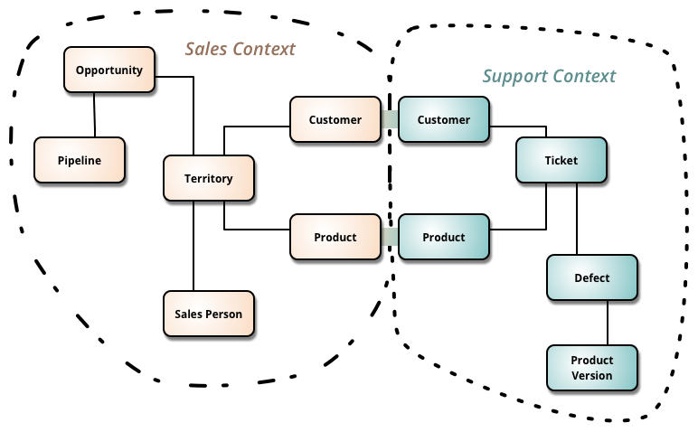
Relationship with DDD Bounded Context
Break a large domain into smaller domains
  Polysemy
  Divided in multi canonical models
  Unrelated & Related Concepts
  Context Map
1 Bounded Context >= 1 Microservice
  Add physical boundaries => No Sharing
    Process
    Database
Notes:
As you try to model a larger domain, it gets progressively harder to build a single unified model. Different groups of people will use subtly different vocabularies in different parts of a large organization. The precision of modeling rapidly runs into this, often leading to a lot of confusion. Typically this confusion focuses on the central concepts of the domain. Early in my career I worked with a electricity utility - here the word "meter" meant subtly different things to different parts of the organization: was it the connection between the grid and a location, the grid and a customer, the physical meter itself (which could be replaced if faulty). These subtle polysemes could be smoothed over in conversation but not in the precise world of computers. Time and time again I see this confusion recur with polysemes like "Customer" and "Product".
In those younger days we were advised to build a unified model of the entire business, but DDD recognizes that we've learned that "total unification of the domain model for a large system will not be feasible or cost-effective" [1]. So instead DDD divides up a large system into Bounded Contexts, each of which can have a unified model - essentially a way of structuring MultipleCanonicalModels.
Bounded Contexts have both unrelated concepts (such as a support ticket only existing in a customer support context) but also share concepts (such as products and customers). Different contexts may have completely different models of common concepts with mechanisms to map between these polysemic concepts for integration. Several DDD patterns explore alternative relationships between contexts.
DDD's strategic design goes on to describe a variety of ways that you have relationships between Bounded Contexts. It's usually worthwhile to depict these using a context map.
A microservice is therefore like a Bounded Context, but it also specifies that it is a distributed service. It is built as a separate process for each Bounded Context, and it must use the distributed protocols noted earlier, like HTTP/HTTPS, WebSockets, or AMQP. The Bounded Context pattern, however, does not specify whether the Bounded Context is a distributed service or if it is simply a logical boundary (such as a generic subsystem) within a monolithic-deployment application.
It is important to highlight that defining a service for each Bounded Context is a good place to start. But you do not have to constrain your design to it. Sometimes you must design a Bounded Context or business microservice composed of several physical services. But ultimately, both patterns—Bounded Context and microservice—are closely related.
DDD benefits from microservices by getting real boundaries in the form of distributed microservices. But ideas like not sharing the model between microservices are what you also want in a Bounded Context.

Slide 21
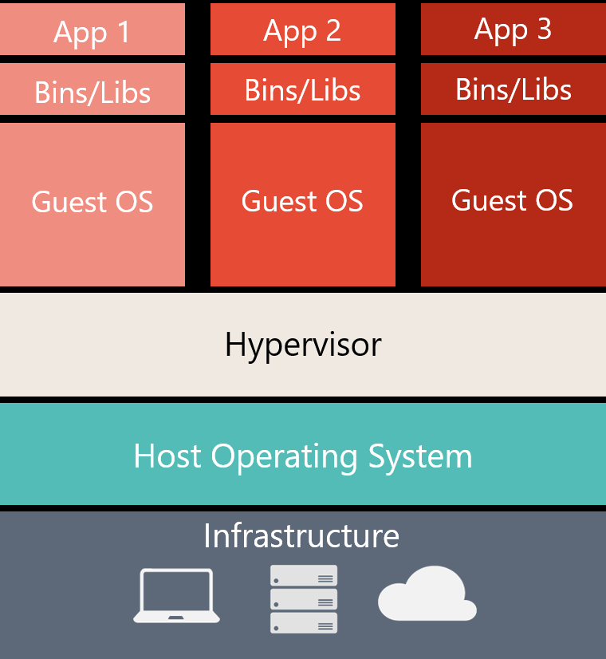
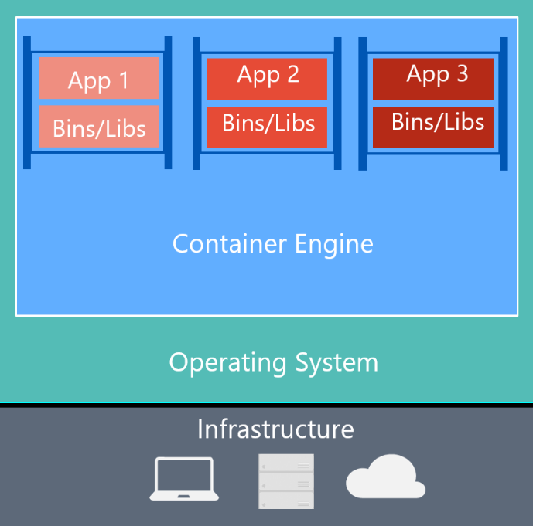
The link with Containers
Virtual Machine
Container
Notes:
What is Docker?
Docker is an open-source project for automating the deployment of applications as portable, self-sufficient containers that can run on the cloud or on-premises. Docker is also a company that promotes and evolves this technology, working in collaboration with cloud, Linux, and Windows vendors, including Microsoft.

Slide 22
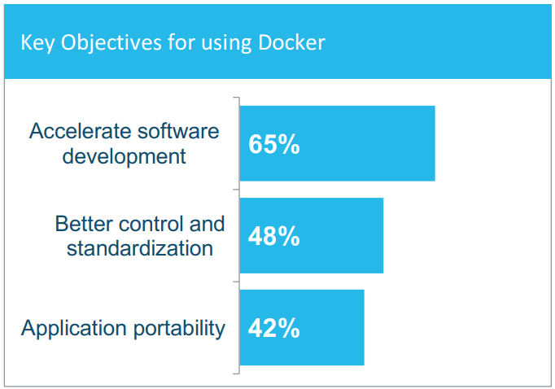
The Link with Containers
Benefits
  Decoupling from environment
    Consistent environment (staging)
    Run everywhere => vendor decoupling
  Runtime Options
  Better ressource utilization & cohabitation
  Finer-grained execution environments
  Better Manageability
    Deployment
    Os, patching
    Monitoring
    Docker Compose
    Clustering
    Orchestrator
    Registries
    Layered & indempotent
Notes:
From that point forward, every deployment runs in the same environment. Every container uses the same OS version, has the same version of dependencies installed, uses the same framework, and is built using the same process.
In addition, developers can all run the application in this consistent environment. Issues that only appear with certain versions will appear immediately for developers rather than surfacing in a staging or production environment. Differences between the development environments among the development team matter less once applications run in containers.
Finally, containerized applications translates to better ressource utilizations, you can put more apps on a VM and still have isolations between these apps.
Developers can use development environments on Windows, Linux, or macOS. On the development computer, the developer runs a Docker host where Docker images are deployed, including the app and its dependencies.
Because containers require far fewer resources (for example, they do not need a full OS), they are easy to deploy and they start fast. This allows you to have higher density, meaning that it allows you to run more services on the same hardware unit, thereby reducing costs.
As a side effect of running on the same kernel, you get less isolation than VMs.
The main goal of an image is that it makes the environment (dependencies) the same across different deployments. This means that you can debug it on your machine and then deploy it to another machine with the same environment guaranteed.
A container image is a way to package an app or service and deploy it in a reliable and reproducible way. You could say that Docker is not only a technology, but also a philosophy and a process.
When using Docker, you will not hear developers say, “It works on my machine, why not in production?” They can simply say, “It runs on Docker,” because the packaged Docker application can be executed on any supported Docker environment, and it will run the way it was intended to on all deployment targets (Dev, QA, staging, production, etc.).
Finer-grained execution environments
Containers, by contrast, perform execution isolation at the operating system level. Here, a single operating system instance can support multiple containers, each running within its own, separate execution environment. By running multiple components on a single operating system you reduce overhead, freeing up processing power for your application components.
Compose: A command-line tool and YAML file format with metadata for defining and running multi-container applications. You define a single application based on multiple images with one or more .yml files that can override values depending on the environment. After you have created the definitions, you can deploy the whole multi-container application with a single command (docker-compose up) that creates a container per image on the Docker host.
Cluster: A collection of Docker hosts exposed as if it were a single virtual Docker host, so that the application can scale to multiple instances of the services spread across multiple hosts within the cluster. Docker clusters can be created with Docker Swarm, Mesosphere DC/OS, Kubernetes, and Azure Service Fabric. (If you use Docker Swarm for managing a cluster, you typically refer to the cluster as a swarm instead of a cluster.)
Orchestrator: A tool that simplifies management of clusters and Docker hosts. Orchestrators enable you to manage their images, containers, and hosts through a command line interface (CLI) or a graphical UI. You can manage container networking, configurations, load balancing, service discovery, high availability, Docker host configuration, and more. An orchestrator is responsible for running, distributing, scaling, and healing workloads across a collection of nodes. Typically, orchestrator products are the same products that provide cluster infrastructure, like Mesosphere DC/OS, Kubernetes, Docker Swarm, and Azure Service Fabric.

Slide 23
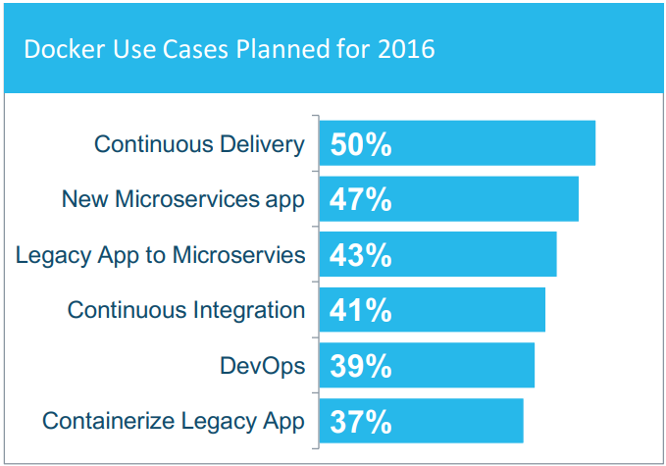

The link with containers
Microservice & Containers

Slide 24
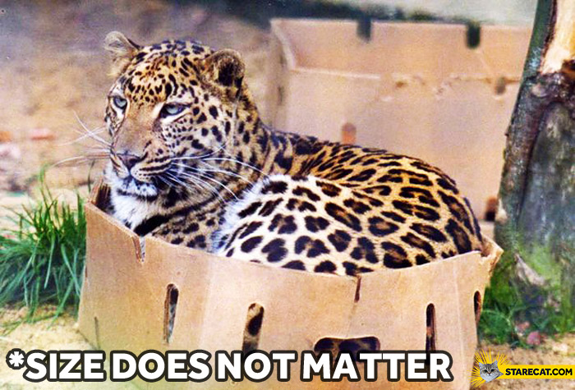
Notes:
The term micro in microservice suggest that services should be decomposed in very small units. Martin Fowler recommend a size range that varies between a service-per-person and a service-per-dozen-people meaning that a microservice should not be maintained by a team of more than a dozen people. This follows the notion of the Two Pizza Team organizations used at Amazon. Following my own experience, micro services are maintained by small multidisciplinary teams varying between two to six people. More important is the domain surface the micro service covers. DDD advise to divide a unified model in smaller units named bounded context. Defining a service as covering no more than one bounded context is a comfortable way to constraint the size of your services.
So, cohesion is certainly a good way to define the service boundaries but in my opinion, this does not matter that much. A factor that is far more concrete is the speed and comfort with which developers can work on the service. Developers that can get rapid feedback on their work by building rapidly, debug easily and test their code continuously on their own pc are in a far better position that those that have to deploy the system to an integration environment and wait for other devs to deploy their code before they can test their own work.
Therefore, I think that size of the service does not matter that much. What’s really important is that the architecture of the system should account for autonomy.
Rather than emphasizing one rigid size for microservices, I prefer to make sure my services adheres to different forms of autonomy:
Runtime autonomy: The system should survive during a certain amount of time to a failure of one of its parts.
Testing autonomy: One should be able to test the parts of a system in isolation.
Change autonomy: One should be able to do modification without impacting other parts of the system.
Platform autonomy: The system should be able to run on platforms with different kind of hosting infrastructure.

Slide 25
Different kinds of autonomy
Runtime autonomy: the system should survive during a certain amount of time to a failure of one of it’s parts.
Testing autonomy: be able to test the parts in isolation.
Autonomy of change: be able to do modification without impacting other parts of the system.
Platform autonomy: System should be able to run on platforms with different kind of hosting infrastructure.

Slide 26
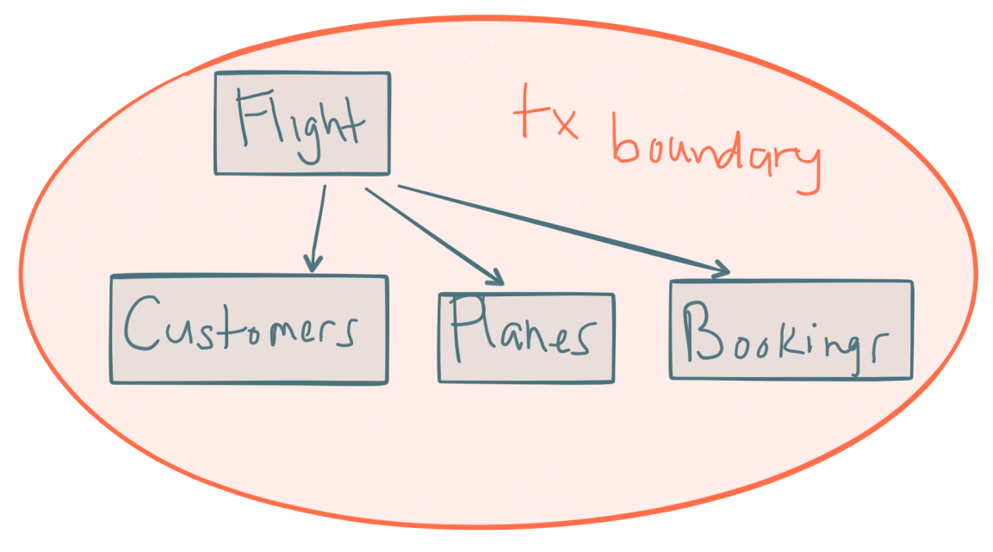
How to achieve autonomy?
Componentization (Application Architecture)
  Focus on functional decomposition (not on technical layers)
  Design for localized changes
    Design so that use case change is localized inside 1 component
  Conway's Law
    Design so that feature change is localized inside 1 team
Notes:
In order for a software module to function, multiple authors must communicate frequently with each other. Therefore, the software interface structure of a system will reflect the social boundaries of the organization(s) that produced it, across which communication is more difficult. Conway's law was intended as a valid sociological observation, although sometimes it's taken in a humorous context.
Defining microservice boundaries is probably the first challenge anyone encounters. Each microservice has to be a piece of your application and each microservice should be autonomous with all the benefits and challenges that it conveys. But how do you identify those boundaries?
First, you need to focus on the application’s logical domain models and related data. You must try to identify decoupled islands of data and different contexts within the same application. Each context could have a different business language (different business terms). The contexts should be defined and managed independently. The terms and entities used in those different contexts might sound similar, but you might discover that in a particular context, a business concept with one is used for a different purpose in another context, and might even have a different name. For instance, a user can be referred as a user in the identity or membership context, as a customer in a CRM context, as a buyer in an ordering context, and so forth.
The way you identify boundaries between multiple application contexts with a different domain for each context is exactly how you can identify the boundaries for each business microservice and its related domain model and data. You always attempt to minimize the coupling between those microservices. This guide goes into more detail about this identification and domain model design in the section Identifying domain-model boundaries for each microservice later.

Slide 27
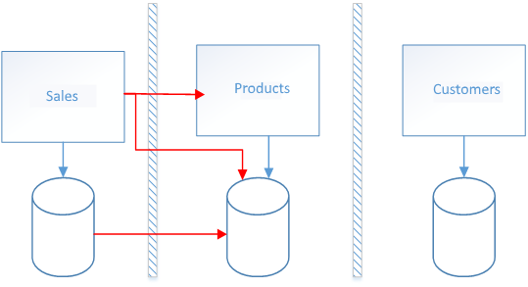
How to achieve autonomy?
Data sovereignty
  Each Microservice must own his data
  Conceptual model will differ between microservices.
Process sovereignty
  Each process should be autonomous
    No synchronous communication between applications
    No querying of other applications (synchronous or asynchronous)

Slide 28
Event Notification
Products
Sales
Notes:
Event driven notification cfr. Gui based development

Slide 29
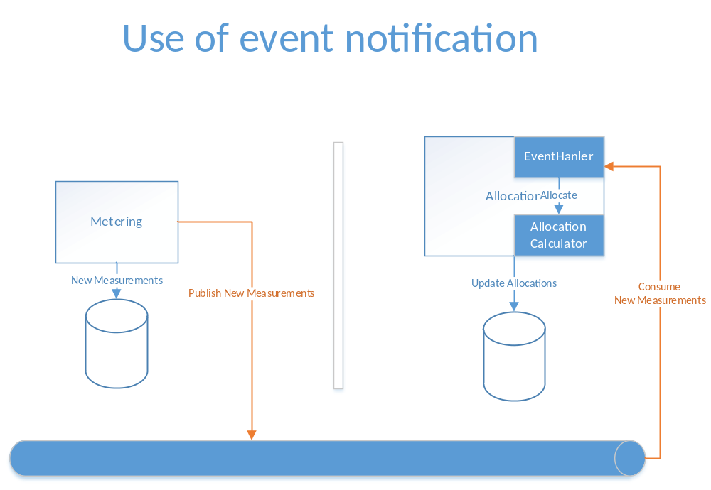
How to send commands to other applications?
Notes:
Don’t call other systems directly, even not with asynchronous messaging. A more flexible approach is to use a publish/subscribe so that your communication from the sender will be available to additional subscriber microservices or to external applications. Thus, it helps you to follow the open/closed principle in the sending service. That way, additional subscribers can be added in the future without the need to modify the sender service.
When you use a publish/subscribe communication, you might be using an event bus interface to publish events to any subscriber.
When using asynchronous event-driven communication, a microservice publishes an integration event when something happens within its domain and another microservice needs to be aware of it, like a price change in a product catalog microservice. Additional microservices subscribe to the events so they can receive them asynchronously. When that happens, the receivers might update their own domain entities, which can cause more integration events to be published. This publish/subscribe system is usually performed by using an implementation of an event bus. The event bus can be designed as an abstraction or interface, with the API that is needed to subscribe or unsubscribe to events and to publish events. The event bus can also have one or more implementations based on any inter-process and messaging broker, like a messaging queue or service bus that supports asynchronous communication and a publish/subscribe model.

Slide 30
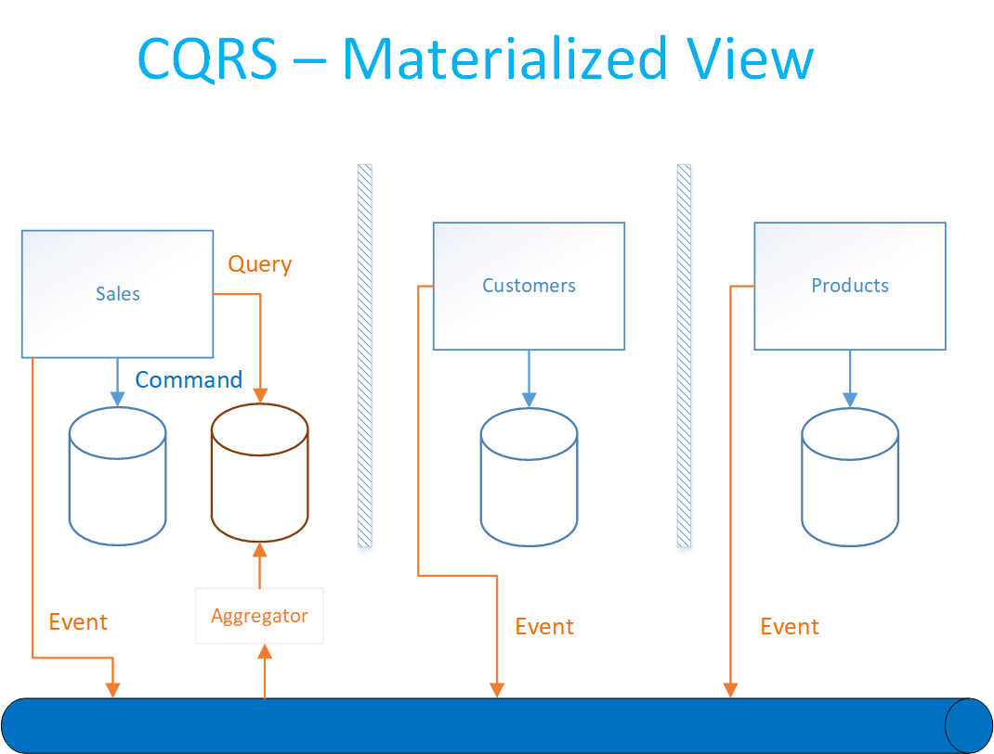
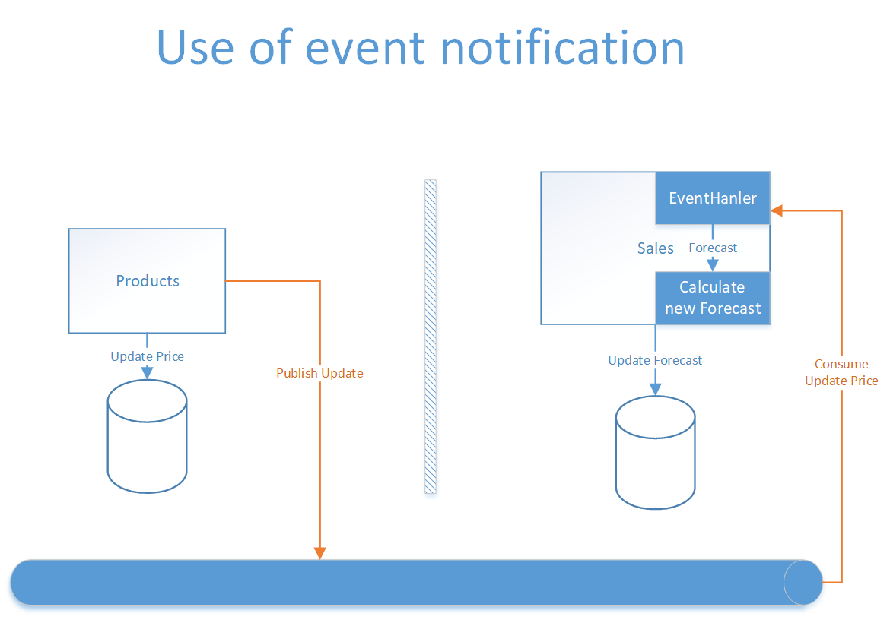
How to query data from other components?
Notes:
CQRS with query/reads tables. Another solution for aggregating data from multiple microservices is the Materialized View pattern. In this approach, you generate, in advance (prepare denormalized data before the actual queries happen), a read-only table with the data that is owned by multiple microservices. The table has a format suited to the client app’s needs.
Consider something like the screen for a mobile app. If you have a single database, you might pull together the data for that screen using a SQL query that performs a complex join involving multiple tables. However, when you have multiple databases, and each database is owned by a different microservice, you cannot query those databases and create a SQL join. Your complex query becomes a challenge. You can address the requirement using a CQRS approach—you create a deformalized table in a different database that is used just for queries. The table can be designed specifically for the data you need for the complex query, with a one-to-one relationship between fields needed by your application’s screen and the columns in the query table. It could also serve for reporting purposes.
This approach not only solves the original problem (how to query and join across microservices); it also improves performance considerably when compared with a complex join, because you already have the data that the application needs in the query table. Of course, using Command and Query Responsibility Segregation (CQRS) with query/reads tables means additional development work, and you will need to embrace eventual consistency. Nonetheless, requirements on performance and high scalability in collaborative scenarios (or competitive scenarios, depending on the point of view) is where you should apply CQRS with multiple databases.
“
It’s important to note that CQRS comes with a cost and it shouldn't be used everywhere. Duplicating your domains in a read and write model is in many cases more complex than using one domain. Don’t create two separate models. When you can satisfy most of the requirements and especially the performance requirement with only one model, don’t split it up. Here you could simply duplicate entities coming from other models in your own database and use a publish/subscribe mechanism two propagate the data.
So for simpler use cases you don’t need to use CQRS but can stick to what’s called event-carried State Transfer => All data is carried by the event, no communication is done to the other system to get the changed data.

Slide 31
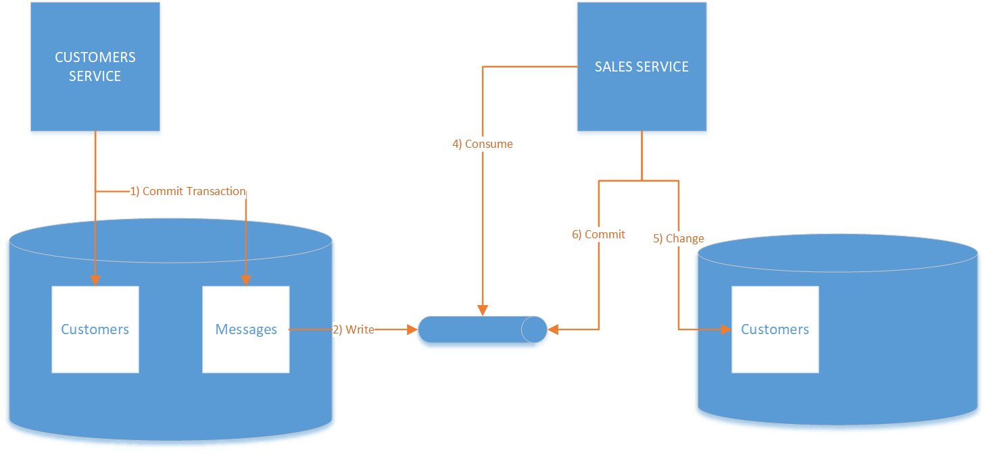
How to guarantee consistency?
Notes:
With these patterns our applications become self sufficient. As they do not depend directly and immediately on other systems they can survive a outage of one of his providers during some time. In software development everything.
One price to pay is data duplication and increased storage space but storage space is relatively cheap and is here traded against team agility what has a much greater cost. What is more problematic is that following the CAP theorem you will loose immediate consistency if you increase the availability. This should not be a drama as the immediate consistency can be trade with eventual Consistency. The real world is already deep dependent on this form of consistency, think about for example of your bank account.
Some techniques exist that guarantees that eventually data will be consistent over time.
One of these techniques is based on DB transactions

Slide 32
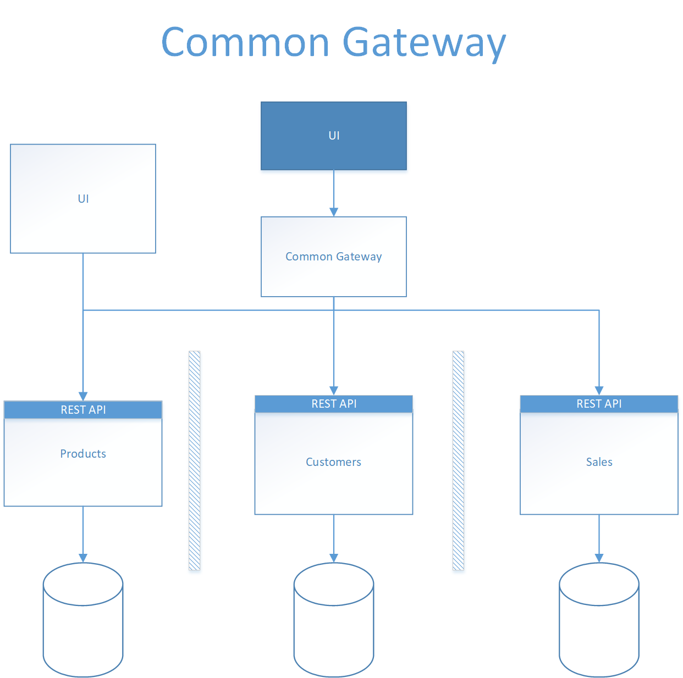
How to show data from other components?

Slide 33
How to deploy changes?
Always guarantee backward compatibility (At least for version n-1)
  Additive changes
    Database
    API (Synchronous & Asynchronous)
  Version the API’s
Only deploy from Main branch
Use feature flags

Slide 34
What will we gain?
“Continuous Delivery is the ability to get changes into production safely and quickly in a sustainable way”
But also:
Increased Tenant Scalability
Improved Testability
Increased Availibility & Manageabiity
Improved intrinsic product quality
Improved satisfaction (Customer & Work force)
Ability to adopt a modern Infrastructure Architecture (Cloud)

Slide 35
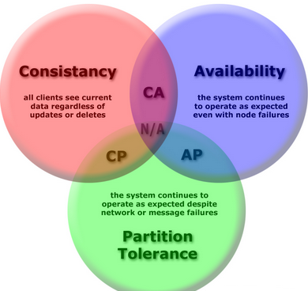
What do we give up?
Overall Immediate Consistency
Easily debug the command chain between two services
One big database that can be used as a backdoor

Slide 36


How to move forward
Notes:
Inspired by two metphores, the strangler and piggyback.
Strangler
This pattern is used when important changes need to be made to an application.
Instead of starting a big project to rewrite a new application that does just what the old one did you do it gradually.
You gradually create a new system around the edges of the old, letting it grow slowly over several years until the old system is strangled. Doing this is more easy that it sounds.
To transform an existing architecture into a microservice you start with creating new autonomous components.
Then you move existing feature to the new components or add the new ones. A strategy that is often used is to use events to duplicate information and behavior.
First let the duplicated feature work in parallel and gradually use them as the master.
PiggyBack, here the

