Slide 1


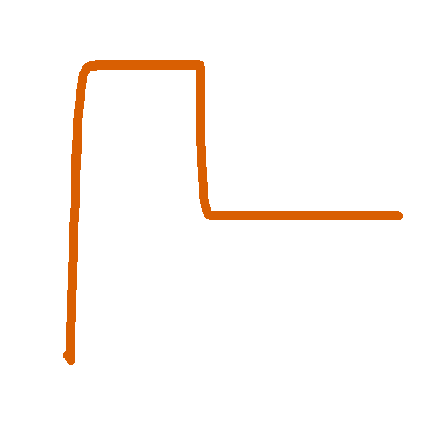



Baseline steady state
Adult harvest steady state

Slide 2


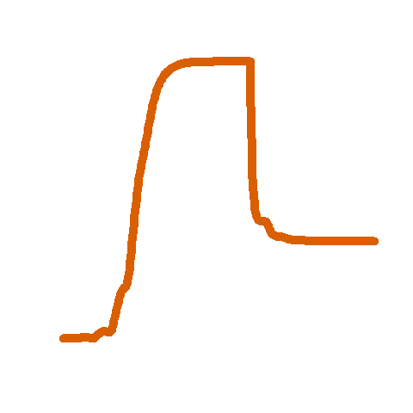
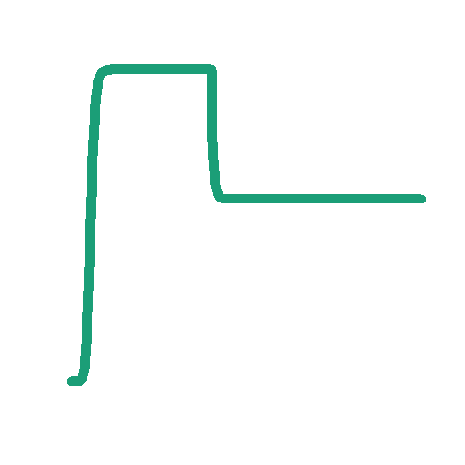



Slide 3

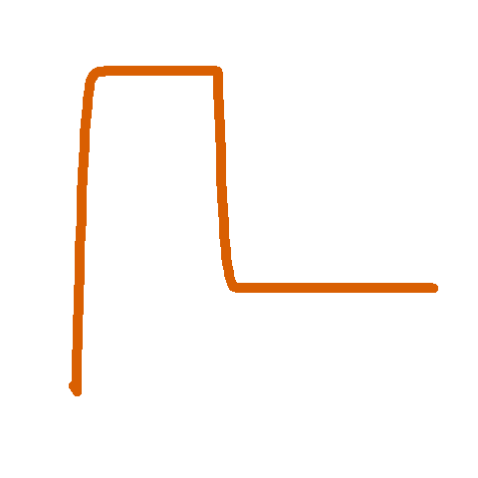

Baseline steady state
Juvenile harvest steady state

Slide 4

