Slide 1
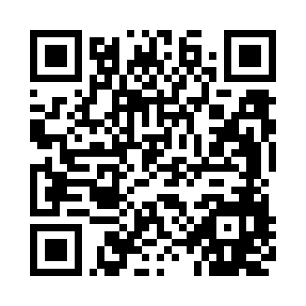
Behavioral Delta Risk
- Calibrated Attrition Scoring for Targeted Retention -
Stakeholder Brief
Geoffrey Bruder
https://github.com/geobruder/Zeta_WG_Repo
(No tracking - No redirects)
2026-05-06

Slide 2
Background
This project evaluates whether short‑term behavioral deltas improve attrition prediction beyond static demographic and credit features. The practical goal is a calibrated probability score suitable for a pilot retention campaign. This should serve as a valuable tool for retention management stakeholders who need a reliable prioritized list and probability thresholds to set outreach.

Slide 3
Motivation
Outreach is costly; prioritization must maximize ROI.
Short‑term behavioral deltas (recent drops in spend/count, fewer contacts) may signal imminent attrition.
Goal: produce calibrated probabilities for a pilot retention campaign.

Slide 4
Question, Hypothesis, Prediction
Question: Do short‑term behavioral deltas improve attrition prediction beyond static features?
Hypothesis: Negative deltas increase attrition risk after controlling for demographics/credit.
Prediction: Models with delta features → higher AUC and lower Brier.

Slide 5
Data at a glance
Dataset: anonymized BankChurners - (available at source/ in repo)
Rows in test set: 3039
Predictor count (approx): see pipeline
Key fields: demographics, credit metrics, transaction aggregates, quarter‑to‑quarter deltas.
Response: target_attrit (1 = attrited).
Note: PseudoID preserved; identifiers and flagged leakage columns removed.

Slide 6
Engineered features
Amt_Chg_Q4Q1 — relative change in transaction amount (Q4 vs Q1).
Ct_Chg_Q4Q1 — relative change in transaction count.
Large_Amt_Drop / Large_Ct_Drop — binary flags (threshold 0.7).
Recent_Contact_Reduction — contacts ≤ 1.

Slide 7
Preprocessing & leakage controls
Median imputation; rare‑level consolidation; dummy encoding; zero‑variance removal; winsorize outliers.
Targeted leakage audit removed model‑derived scores and identifiers (e.g., Naive_Bayes outputs, CLIENTNUM).
Transformations implemented in a reproducible recipe applied only on training data.
- Final leakage re‑audit required — audit performed; we recommend one more temporal leakage check before production.

Slide 8
Modeling overview
Baselines: static logistic. Enhanced: logistic + deltas.
Ensembles: Random Forest (tuned), XGBoost (direct xgboost CV fallback used).
Validation: stratified 70/30 train/test; repeated 5‑fold CV × 5 for tuning.
Metrics: AUC (discrimination), Brier (calibration), decision thresholds.
Implementation detail for reproducibility: Reconcile caret xgbTree behavior across environments — implemented direct xgboost CV fallback and documented divergence.

Slide 9
Key numeric results (holdout)
Selected model headline metrics:
XGBoost AUC: 0.9927
XGBoost Brier: 0.02282
Summary (from artifacts):
Logit Baseline: AUC 0.8724 | Brier 0.0941 Logit Enhanced: AUC 0.9148 | Brier 0.0739 Random Forest (tuned): AUC ≈ 0.9867 | Brier ≈ 0.03417 XGBoost (final, calibrated): AUC ≈ 0.9927 | Brier ≈ 0.02282

Slide 10
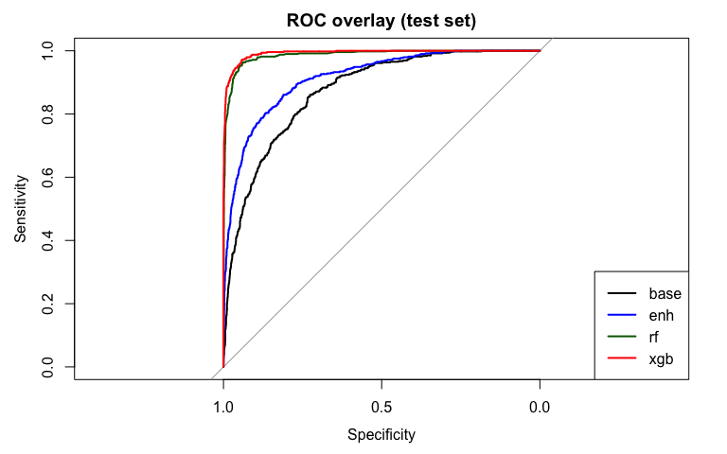
Visual diagnostics

Slide 11
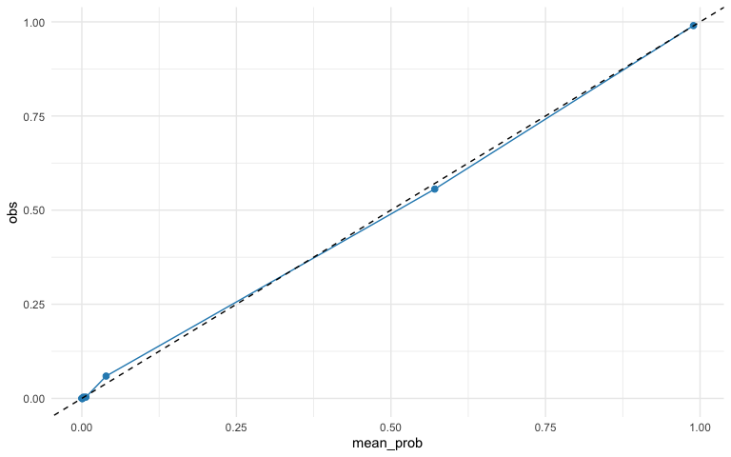
Calibration: Reliability diagram

Slide 12
Decision thresholds
(Test set)
threshold | TP | FP | TN | FN | Precision | Recall
0.01 | 487 | 458 | 2092 | 2 | 0.5153 | 0.9959
0.02 | 486 | 338 | 2212 | 3 | 0.5898 | 0.9939
0.05 | 479 | 213 | 2337 | 10 | 0.6922 | 0.9796
0.10 | 472 | 143 | 2407 | 17 | 0.7675 | 0.9652
0.20 | 462 | 96 | 2454 | 27 | 0.8280 | 0.9448
Pilot proposal:
Stage a conservative pilot using calibrated XGBoost at 0.10 threshold;
run A/B test measuring uplift vs control using operational LTV and outreach cost.

Slide 13
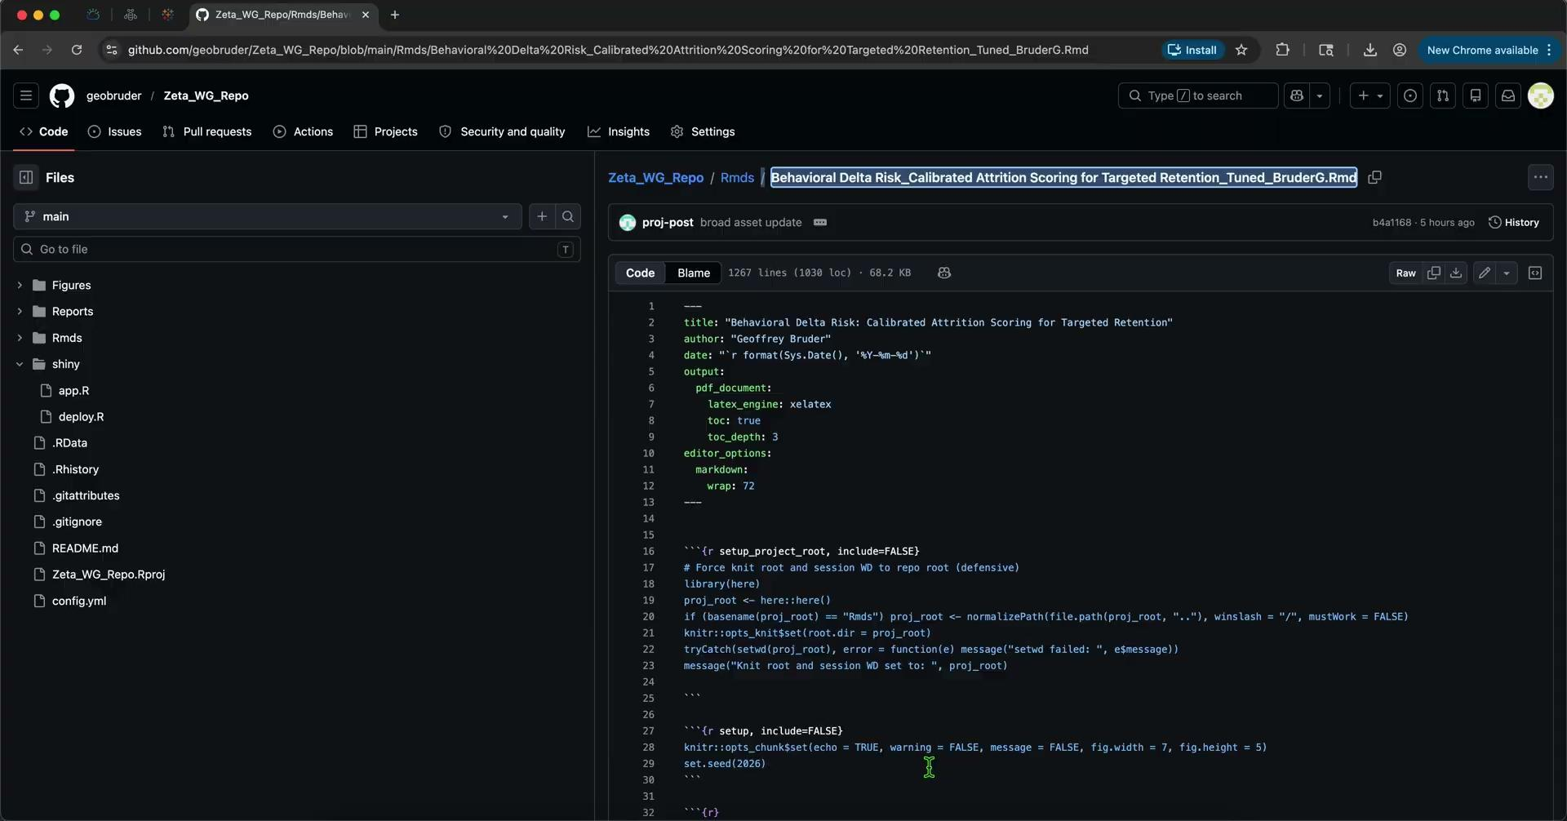
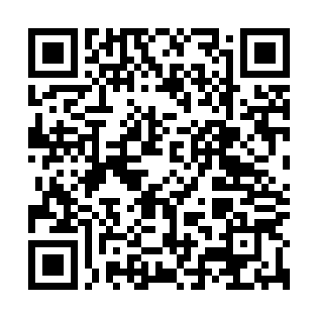
App Demo
Live demo will show:
1. Reload artifacts → confirm provenance and n_test.
2. Threshold slider → set to 0.10; show targeted list and ROI preview.
3. Decile filter → inspect top decile and drill to single customer.
4. Model insights → top predictors and local SHAP explanation.
Explore the app ar https://github.com/geobruder/Zeta_WG_Repo/blob/main/shiny/app.R

Slide 14
Limitations & cautions
Exceptionally high ensemble AUCs require final leakage re‑audit and temporal validation.
caret xgbTree inconsistency across environments — reconcile for reproducibility.
Calibration caution at highest decile — use conservative cutoffs for costly outreach.

Slide 15
Recommendations & next steps
Final leakage re‑audit and rolling origin validation.
Small pilot A/B test using calibrated probabilities and operational LTV/cost inputs. See pilot plan in repo.
Reconcile tuning across environments; document final hyper-parameters.
Deploy lightweight Shiny app for ops + publish Tableau dashboard; implement monitoring (weekly AUC, decile drift).

Slide 16
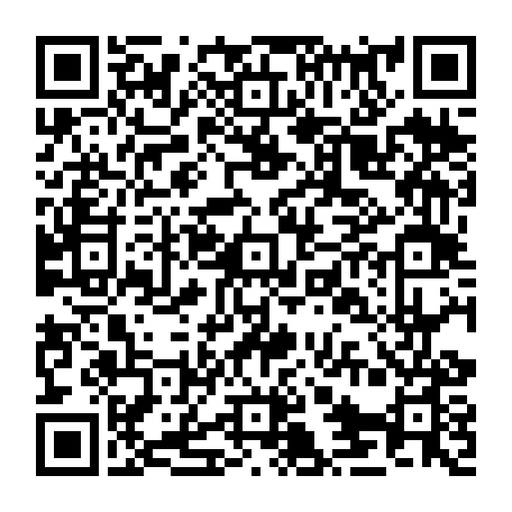
Appendix
Clone the repo at <https://github.com/geobruder/Zeta_WG_Repo>, ensure artifacts/project_artifacts.RData is in artifacts/, run the Shiny app (shiny::runApp("shiny_app") or open app.R), and explore the Threshold slider (set to 0.10), Decile filter (top decile), ROI preview, and customer drilldown with local explanations.
App includes built‑in A/B test scaffolding and monitoring hooks (artifacted model versions, timestamped runs, and weekly AUC/decile drift metrics) to support a staged pilot and ongoing performance tracking.
Tableau Dashboard (UC) is also available for future exploratory analysis and dashboarding of decile performance, cohort trends, and ROI scenarios; use it to supplement the live demo once finalized.
(https://public.tableau.com/app/profile/geoffrey.bruder/viz/BehavioralDeltaRisk_CalibratedAttritionScoringforTargetedRetention_GB/Dashboard1)
Shiny App Code
(@ Project Repo)
Project Repository
(view READ.me)
Future Tableau Dashboard
(UNDER CONSTRUCTION)

