Slide 1
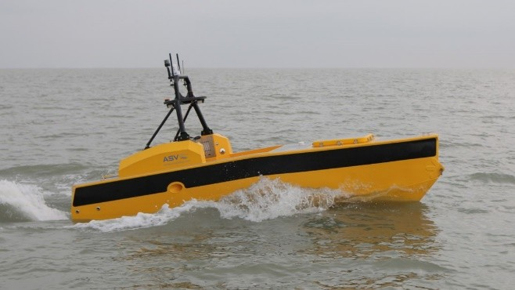
Unmanned Surface Vehicle for Autonomous Hypoxia Monitoring: Data Management

Slide 2
Integral Cloud Server
QARTOD QC and Repackage to GCOOS
GCOOS Server
GCOOS Public Server
ASV Data Collected
NCEI
Near real time data
Post-mission full data set
Enhanced QC data set
Unsure about path

Slide 3
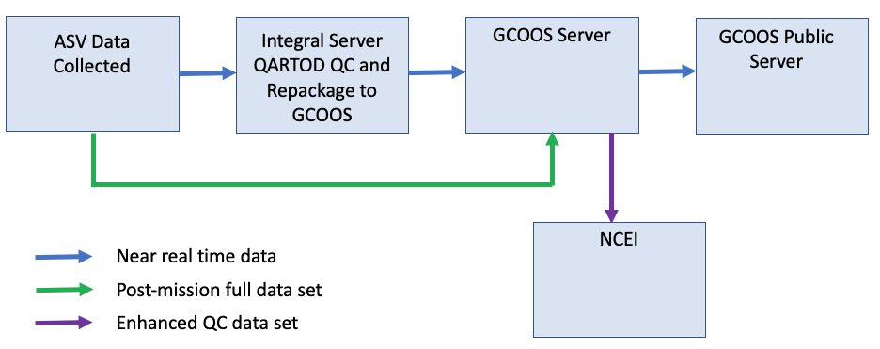
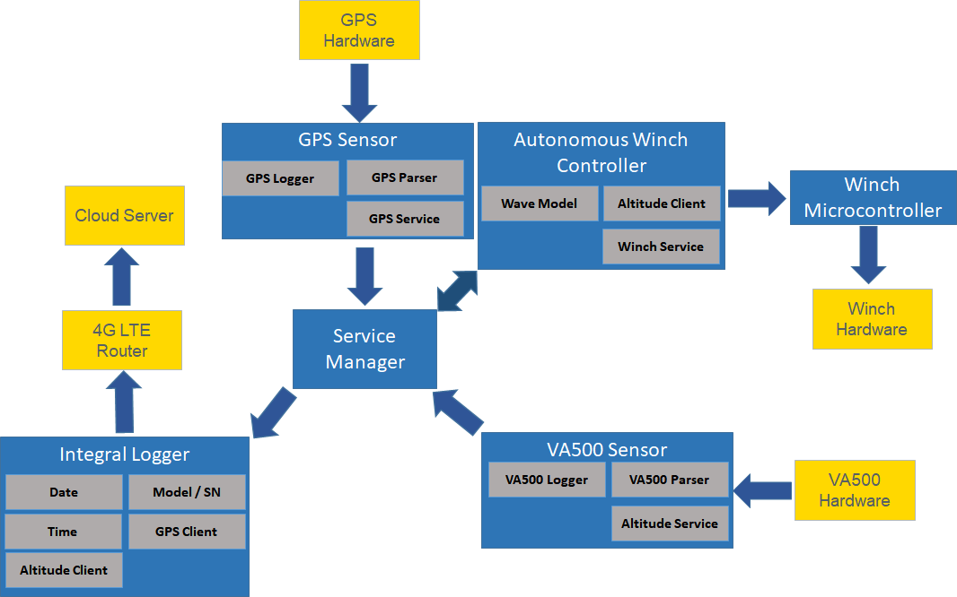
L3Harris/ASV Data Management
As shown in proposal
Tampnet 4G LTE, Iridium backup
SFTP

Slide 4
L3Harris/ASV Data Management
Files on C-Worker 5
Vessel log files
Navigation Files: time, lat, lon, heading, pitch, roll, speed over ground,
Vessel Performance Files
Winch Controller Files
Altimeter files
CTD files
DO files

Slide 5
Draft data file for sftp
Date / Time TURBIDITY;FTU PRESSURE;DBAR TEMPERATURE;C DISSOLVED OXYGEN;SAT% ALTITUDE;M CONDUCTIVITY;MS/CM FLUOROMETER (C);UG/L PH;PH Calc. SALINITY; PSU Calc. DEPTH;M LATITUDE;DEG LONGITUDE;DEG
13/07/2021 08:59:13.000 0.750 0000.625 0010.137 0023.343 0056.555 0000.000 0001.244 0000.813 0006.152 0001.197 0.01 30.186053 -91.985203
13/07/2021 08:59:14.000 0.750 0000.538 0010.137 0023.344 0056.570 0000.000 0001.244 0000.788 0006.192 0001.197 0.01 30.186053 -91.985203
13/07/2021 08:59:15.000 0.750 0000.613 0010.137 0023.344 0056.570 0000.000 0001.244 0000.788 0006.152 0001.197 0.01 30.186053 -91.985203
Add header with CTD, DO models and serial numbers and last cal date
Are we following ISO191 metadata standards?

Slide 6
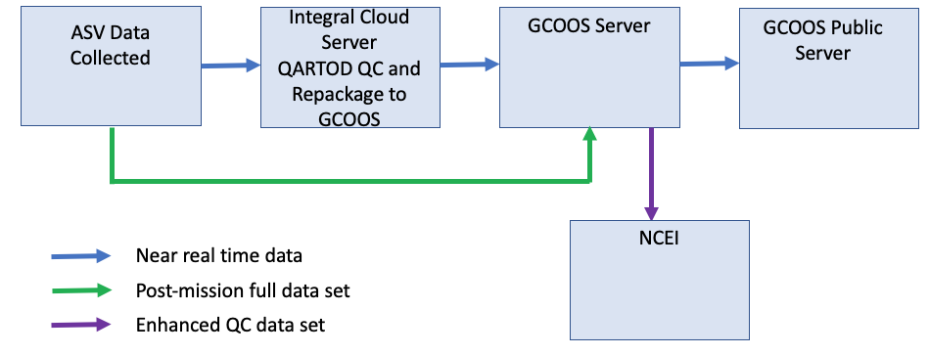
Integral Data Management
Ascii file
sftp over Tampnet 4G
Iridium Backup
Integral Cloud Server
QARTOD QC
NetCDF Files w QC flags
THREDDS
GCOOS
Integral Archive

Slide 7
Quality Assurance for Real-Time Oceanographic Data (QARTOD)
Required
Strongly Recommended
Suggested
Dissolved Oxygen
Test1: Gap Test-Check for arrival of data
Test2: Syntax Test-Expected data record received …
Test3: Location Tes -Reasonable geographic location
Test4: Gross Range Test-Does not exceed min/max
Test5: Climatology Test-Data fall within seasonal expectations
Test6: Spike test
Test7: Rate of change test
Test8: Flat line test
Test9: Multi-Variate Test
Test10: Attenuated Signal Test
Test11: Neighbor Test
Temperature and Salinity
Test1: Gap Test-Check for arrival of data
Test2: Syntax Test-Expected data record received …
Test3: Location Test-Reasonable geographic location
Test4: Gross Range Test-Does not exceed min/max
Test5: Climatology Test-Data fall within seasonal expectations
Test6: Spike Test
Test7: Rate of Change Test
Test8: Flat Line Test
Test9: Multi-Variate Test
Test10: Attenuated Signal Test
Test11: Neighbor Test
Test12: TS Curve/Space Test
Test13: Density Inversion Test
Add pH and Fluorometer
Add test on winch speed via pressure time derivative to ensure response time ok?
Add bathy test?

Slide 8
GCOOS Data Management
Post-mission files
NetCDF Files w QC flags
Integral Cloud Server
GCOOS Data Server
Enhanced QC and metadata (ISO191)
NCEI
GCOOS Data Portal: Near-Real-Time Profiles
Mapping
GCOOS Data Portal : Near-Real-Time Maps

Slide 9
Michael Kim set up sftp server
NetCDF files
Ugw UGO community surface vehicle standardized data
Valeport response time
Bathy QC
ERDAP and THREEDS Server

Slide 10
Adding a depth column before the vehicle parameters.
Date / Time TURBIDITY;FTU PRESSURE;DBAR TEMPERATURE;C DISSOLVED OXYGEN;SAT% ALTITUDE;M CONDUCTIVITY;MS/CM FLUOROMETER (C);UG/L PH;PH Calc. SALINITY; PSU Calc. DEPTH;M LATITUDE;DEG LONGITUDE;DEG
13/07/2021 08:59:13.000 0.750 0000.625 0010.137 0023.343 0056.555 0000.00 0001.244 0000.813 0006.152 0001.197 0.01 30.186053 -91.985203
13/07/2021 08:59:14.000 0.750 0000.538 0010.137 0023.344 0056.570 0000.000 0001.244 0000.788 0006.192 0001.197 0.01 30.186053 -91.985203
13/07/2021 08:59:15.000 0.750 0000.613 0010.137 0023.344 0056.570 0000.000 0001.244 0000.788 0006.152 0001.197 0.01 30.186053 -91.985203

