Slide 1
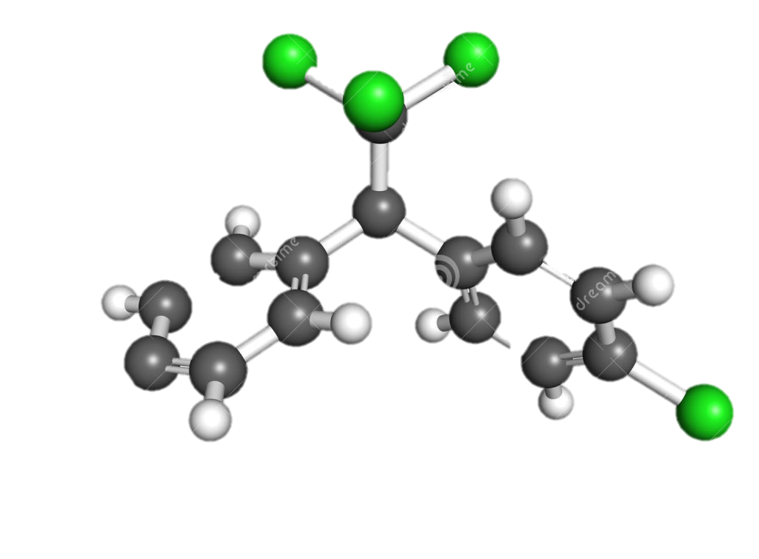
Detection Limits Demystified
Craig Hutchings
October 2015

Slide 2
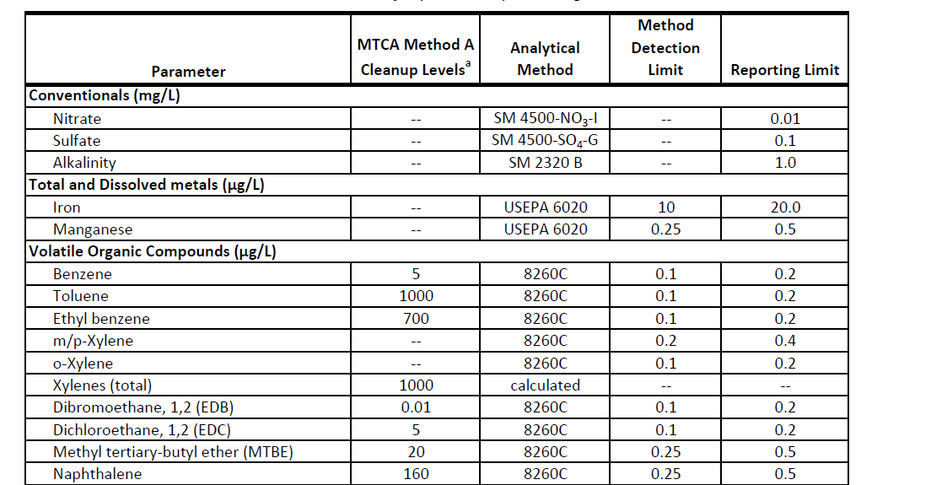
Why Are Detection Limits Important

Slide 3
Detection Limits Affect Data Interpretation

Slide 4
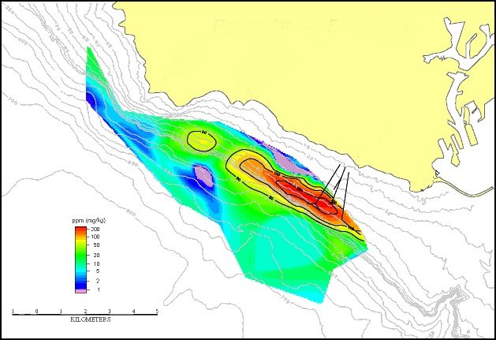
Nondetects May Lurk in Data Set

Slide 5

Terminology Can Be Confusing
Detected
MDL
LOD
SDL
EDL
IDL
Measured
MRL
RL
CRDL
CRQL
PQL
LLQ
QL
LOQ
Other
EMPC

Slide 6
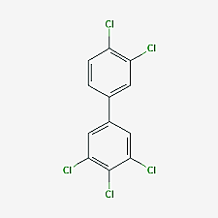
What is the detection limit for PCBs?
Aroclors or congeners?
Water, sediment, tissue, something else?
Is the site contaminated or pristine?
What will the data be used for?
Waste disposal
Screening
Regulatory review
Risk assessment

Slide 7
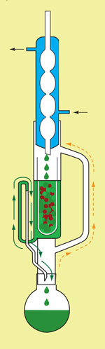
What Affects Detection Limits
Sample size
Concentration of other constituents
Sample clean-up
Methodology
Lab performance
Experience
Extraction technique
Instrument type and maintenance

Slide 8
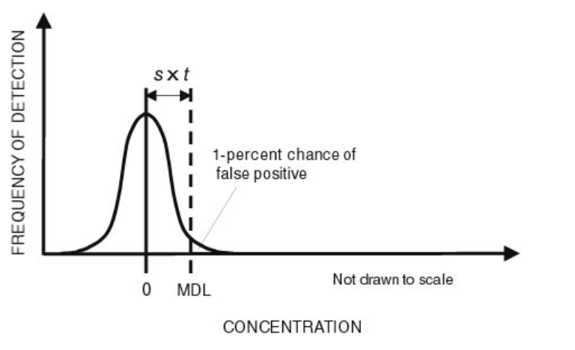
Method Detection Limit - MDL
Statistically determined
The minimum concentration that can be measured with 99% confidence that the concentration is greater than zero
Concentrations near MDL are estimates
Laboratory, instrument, matrix, method, & analyte specific

Slide 9
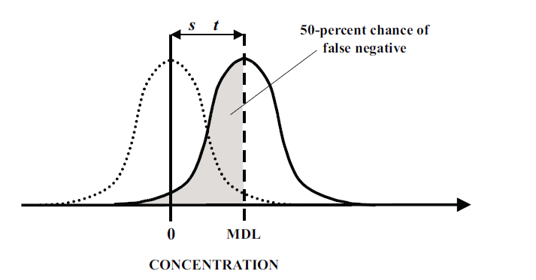
MDL continued
Concentrations at MDL expected to be a false positive 1% of the time, but false negatives 50% of the time

Slide 10
Method Reporting Limit - MRL
May also be referred to as QL (quantitation limit), sample quantitation limit, or just RL (reporting limit)
Determined by the lowest point of the calibration
Not as specific as MDL, labs can adust
Concentrations at MRL can be reliably quantified
MRL > MDL
Also laboratory, instrument, matrix, method, & analyte specific

Slide 11
Relationship of MDL to MRL
Increasing Concentration
Method Reporting Limit
Method Detection Limit
Notes:
Add slide about calibrations

Slide 12

Other Types of Detection Limits
PQL – Multiple definitions
Considered to be lowest concentration that can be reliably quantified by a method
For DOD work you may see
Limit of Detection (LOD) - Lowest concentration that can be detected with a 1% false negative rate.
Generally 2x to 3X MDL
Limit of Quantitation (LOQ) – similar to MRL

Slide 13
Other Types of Detection Limits
Estimated Quantitation Limit (EQL)
Estimated Detection Limit (EDL)
Sample Detection Limit (SDL)
PCDD/F specific, but frequently applied to PCB congeners, PBDEs, etc.
2.5 times signal to noise

Slide 14

EMPC
Estimated Maximum Possible Concentration (EMPC)
Peak present but not all of the identification criteria is met
Always greater than MDL, may be greater than MRL
Generally treated a non-detect in TEQ calculations
EMPCs can present data management difficulties and need to be reviewed in QC checks

Slide 15
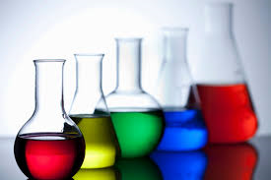
Which Limit Should You Use?
MDL ?
½ MDL ?
MRL ?
Project specific
Consult with regulators

Slide 16

Questions?

