Slide 1
PromptStudio

Slide 2
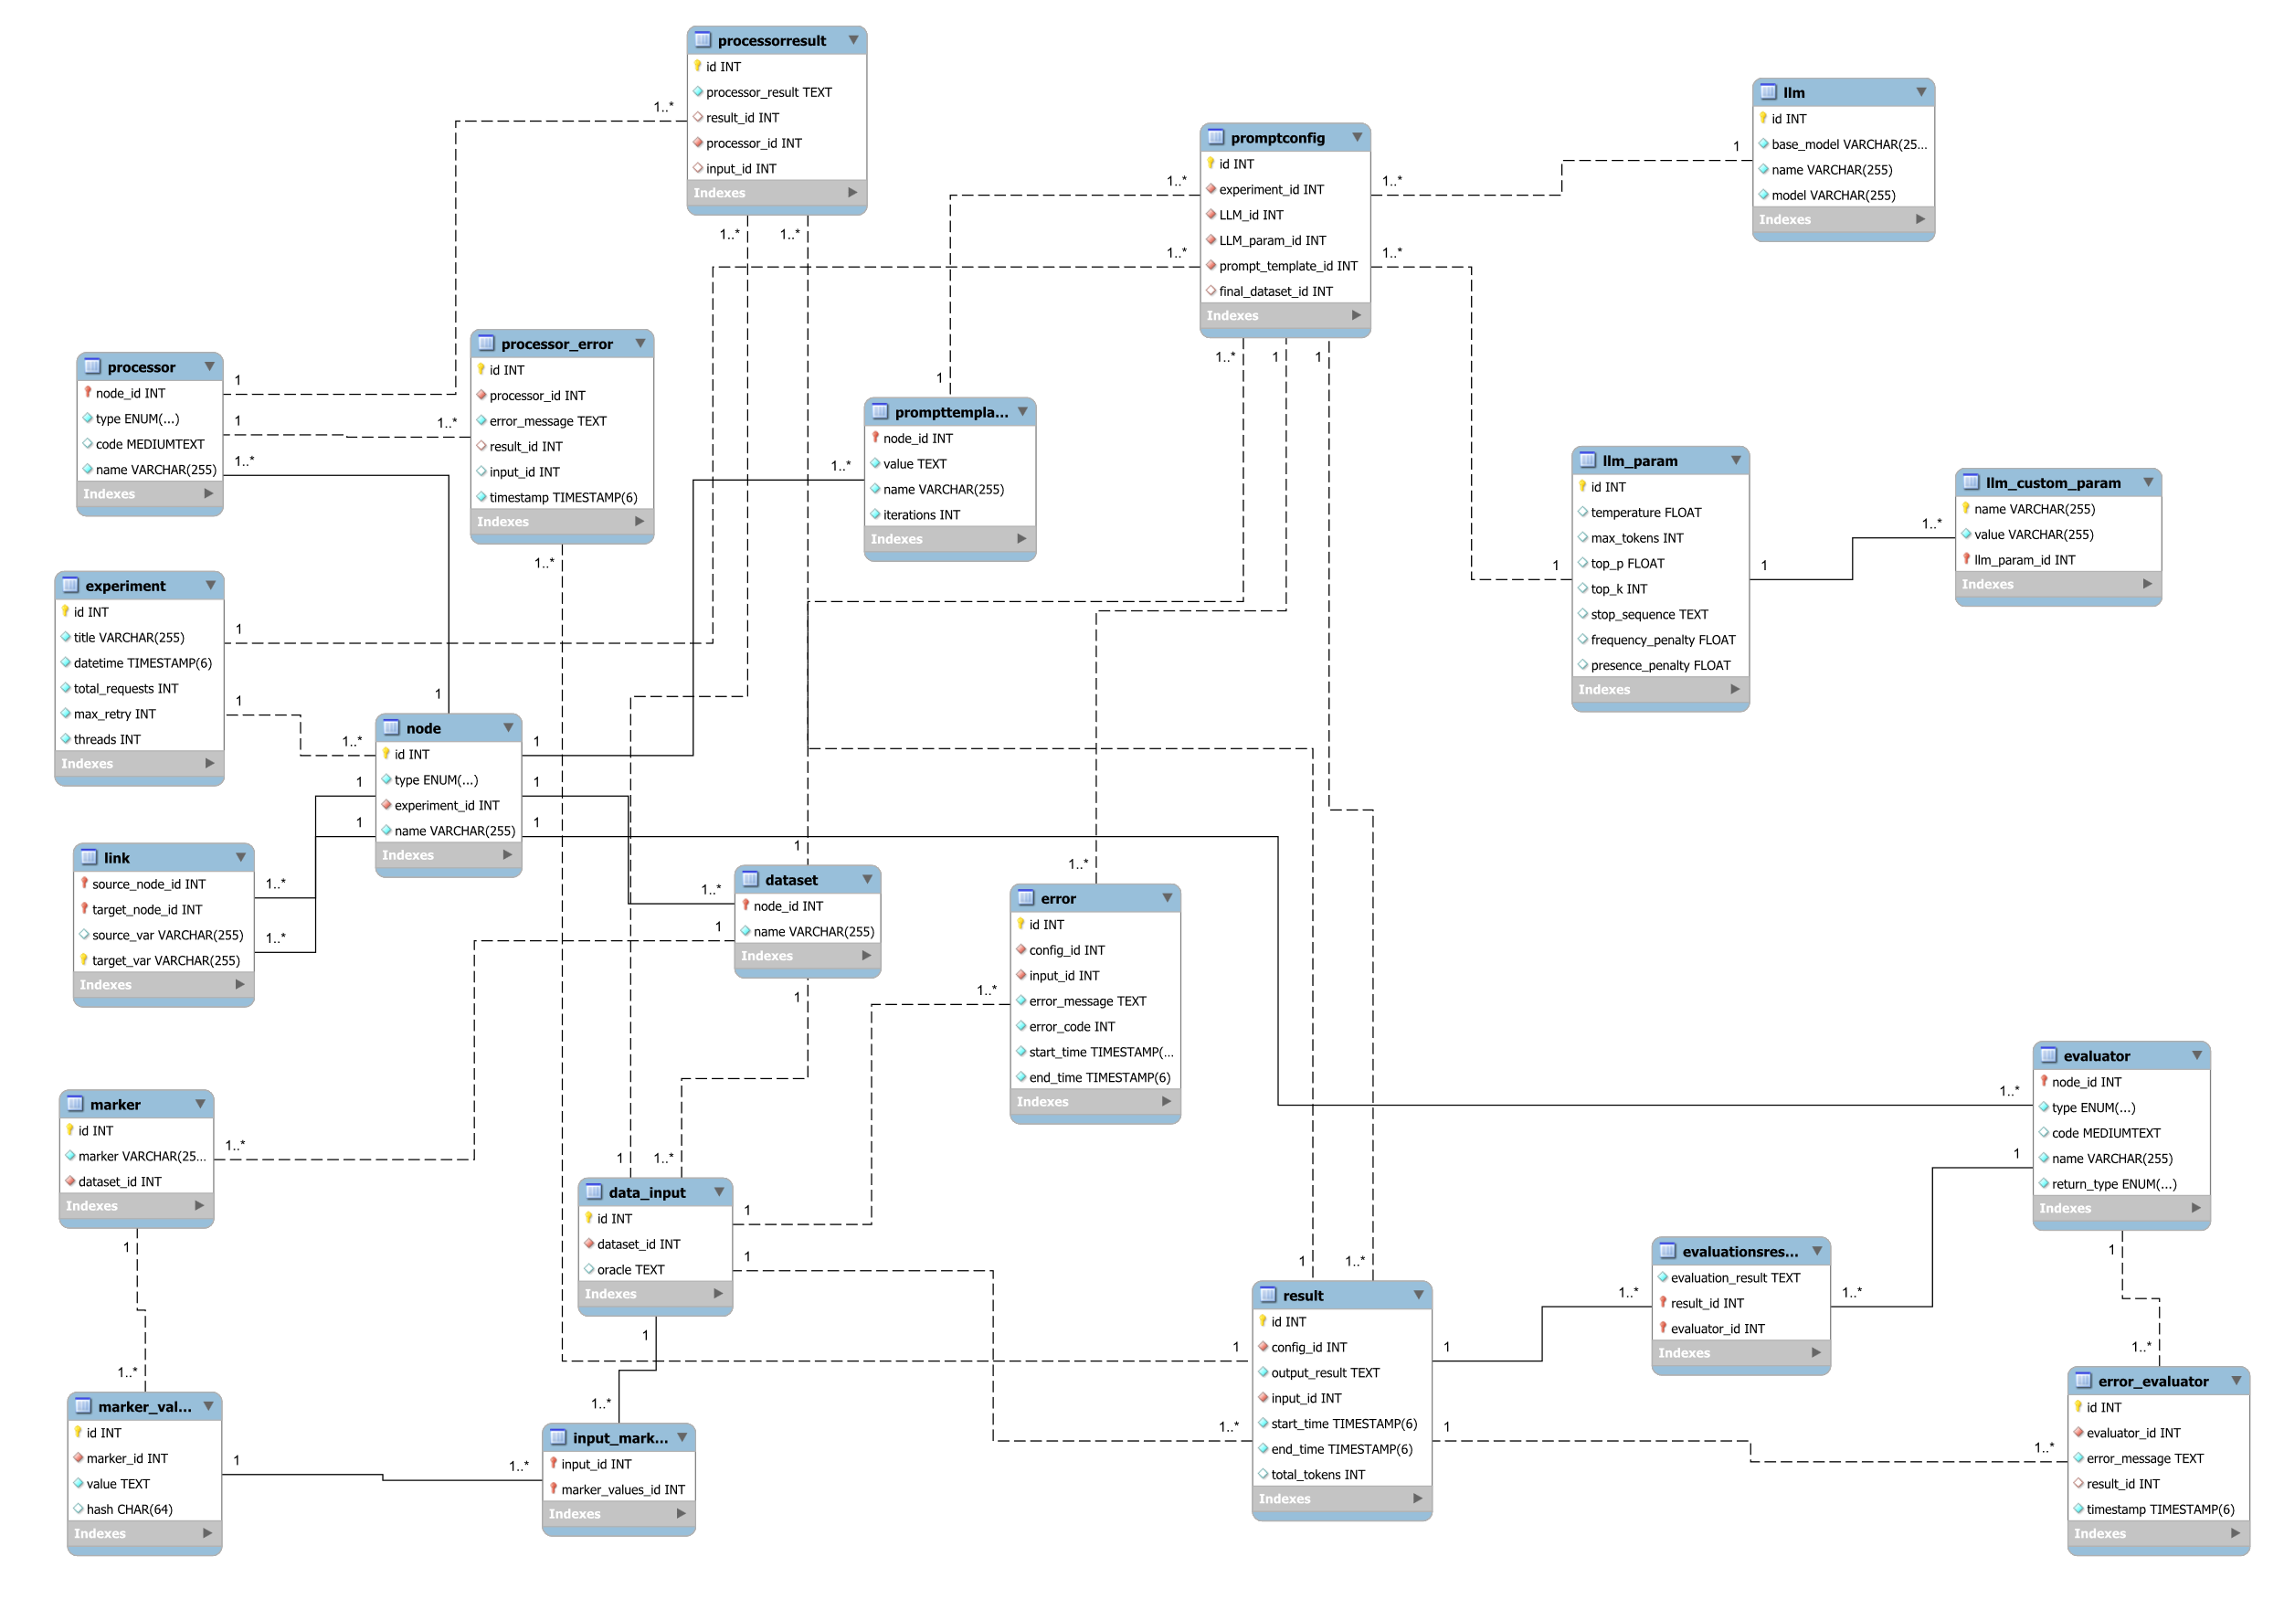
Database model
Using mysql

Slide 3
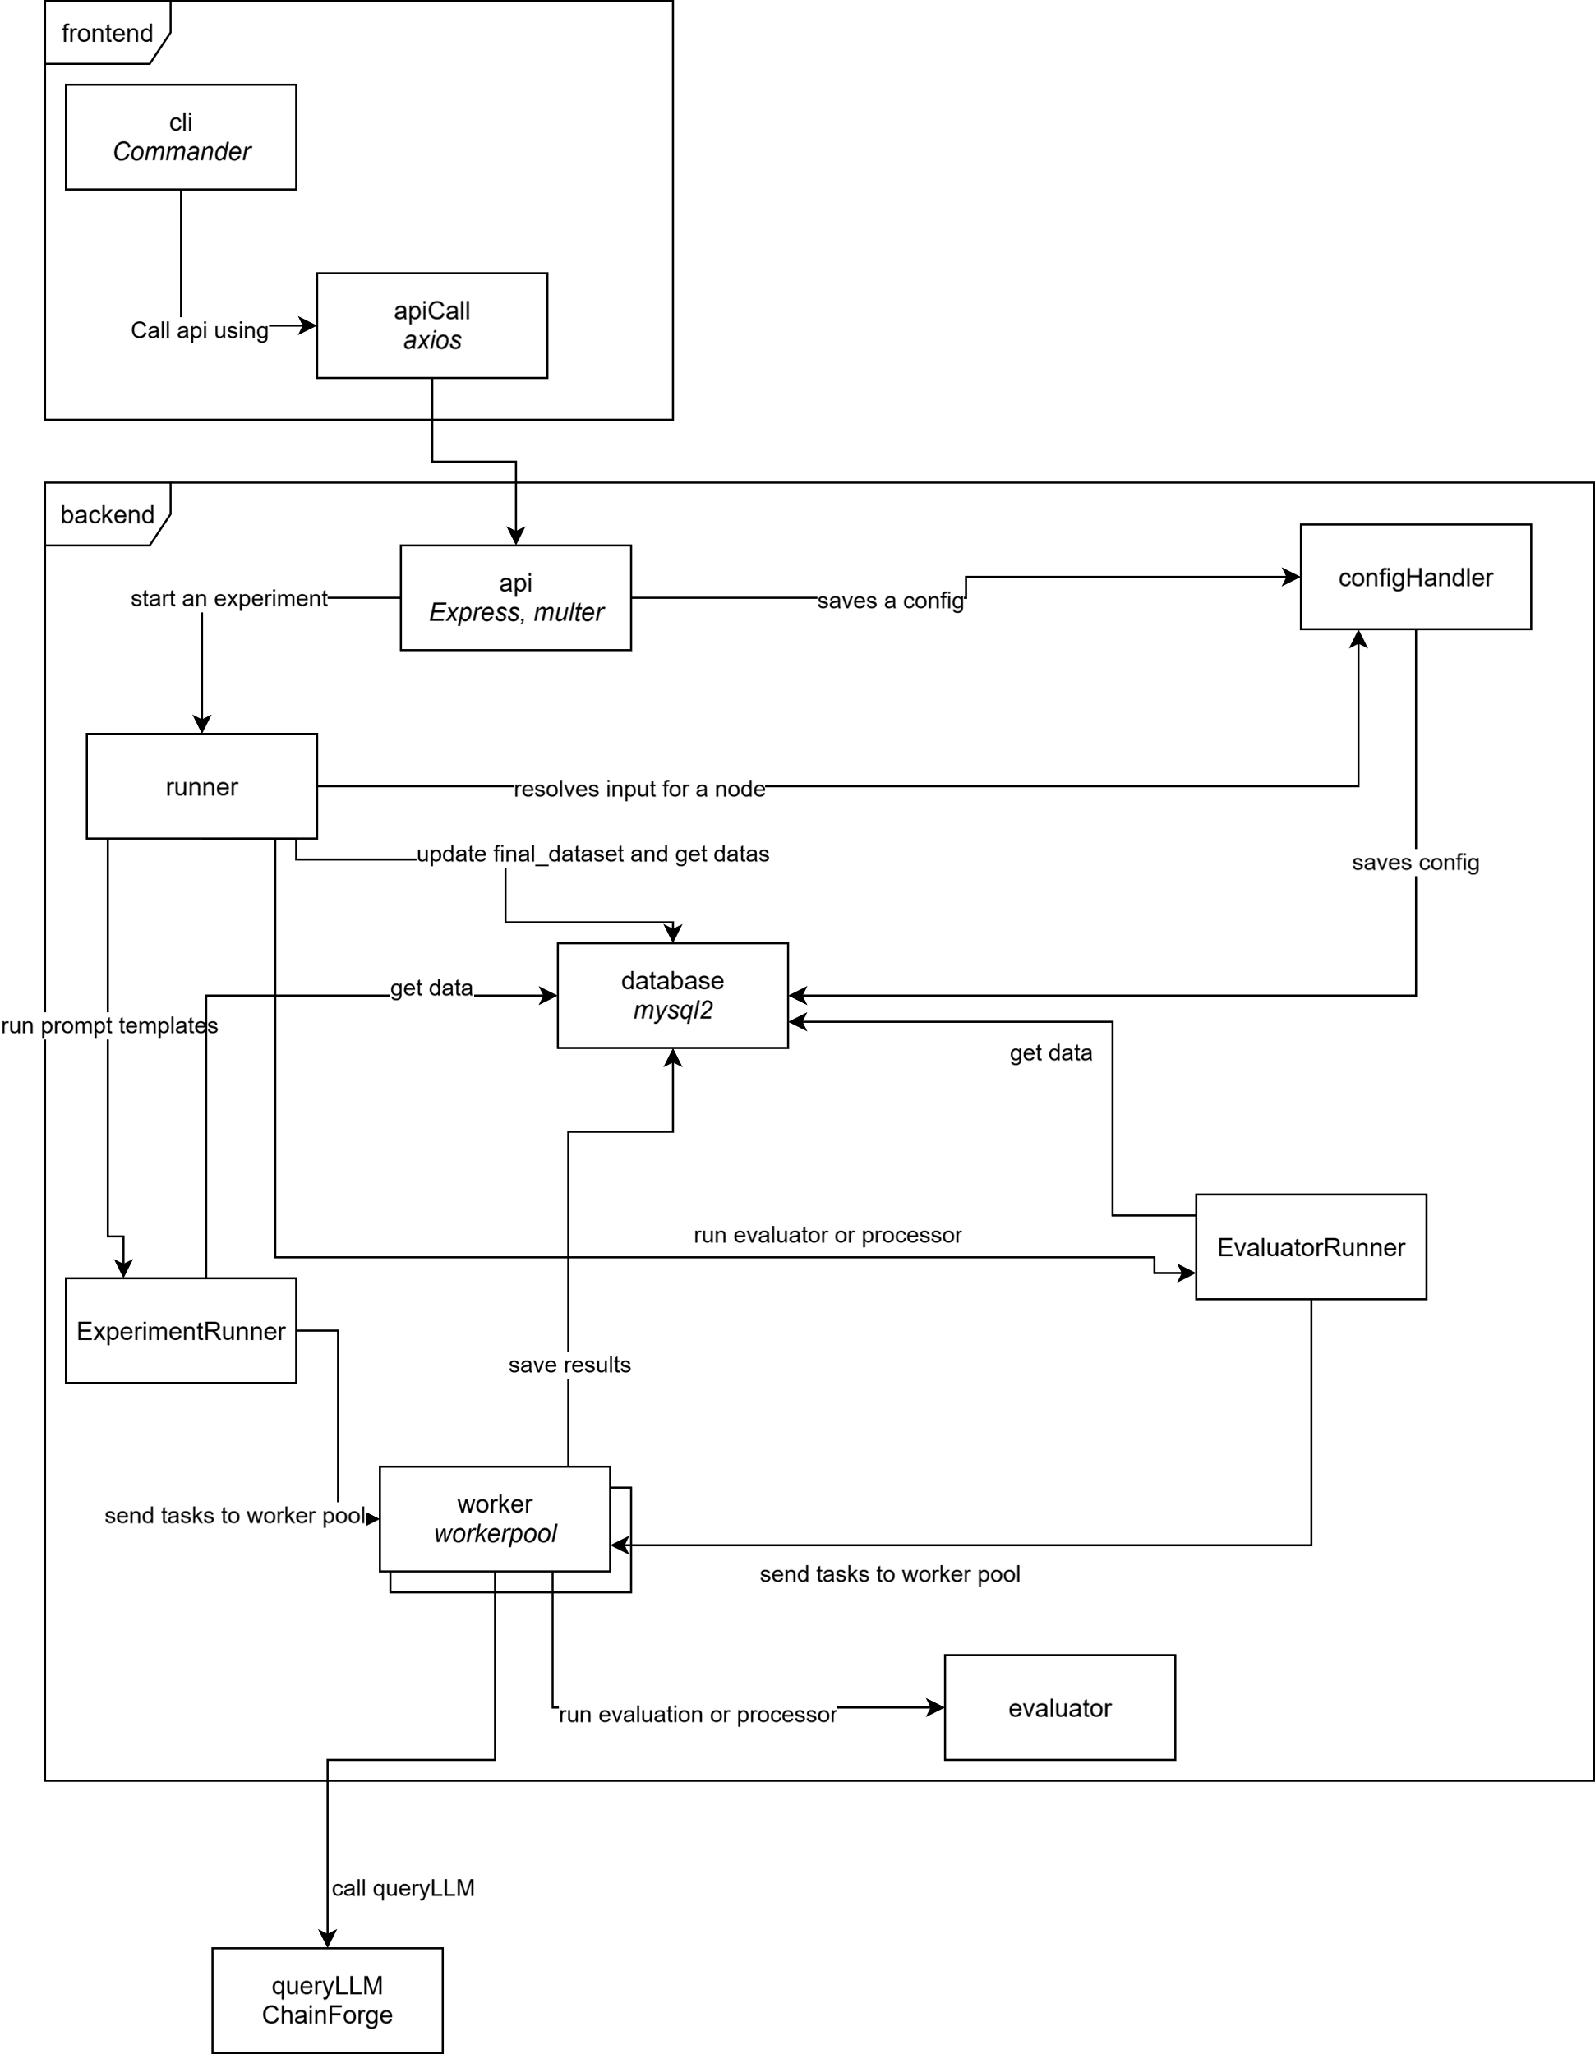
Architecture

Slide 4
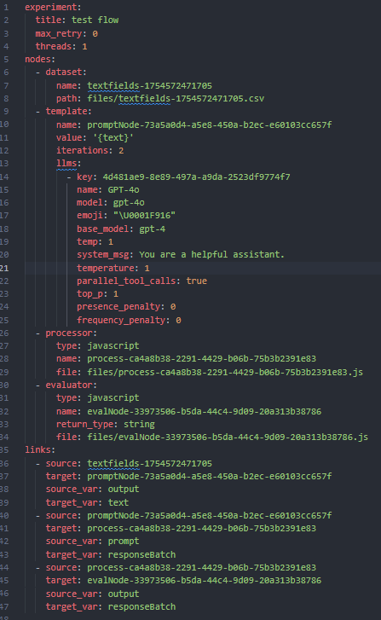
Structure of the yml config file
It follows the export format of ChainForge
There is the list of nodes and there is the list of links between nodes
Each dataset, and code are exported in their own file

Slide 5
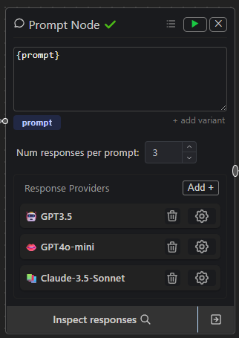
Prompt config
Prompt template
1 LLM + parameters
Contains 1 prompt template
Contains 1 final dataset
3 differents prompt configs with each 1 llm and parameters

Slide 6
Datasets
Any Prompt config is using 1 final dataset
Any final dataset is the dataset we got by doing the cartesian product of datasets, dependents prompt templates and processors
We iterate through the final dataset and call queryLLM on each input
When a template has a dependency to another template or processor, it looks for new results and only add those results to the existing dataset (with cartesian product with other dependencies and base datasets)
Each dataset are exported as a csv file and used in the yml config

Slide 7
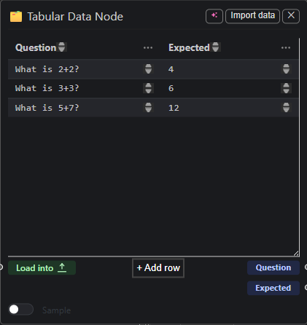
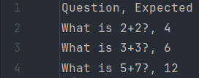
Tabular data to dataset

Slide 8
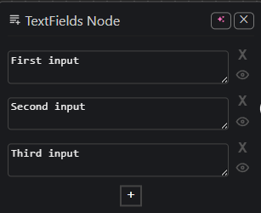

Text field to dataset

Slide 9
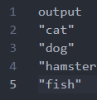
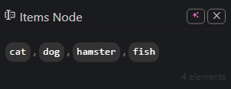
Items node to dataset

Slide 10
Global flow
The first step is it saves the yml config into the database
It saves each node one by one and then it saves every link one by one
It then run the experiment by doing a topological sort of the nodes, run the nodes one by one using multithreading

Slide 11
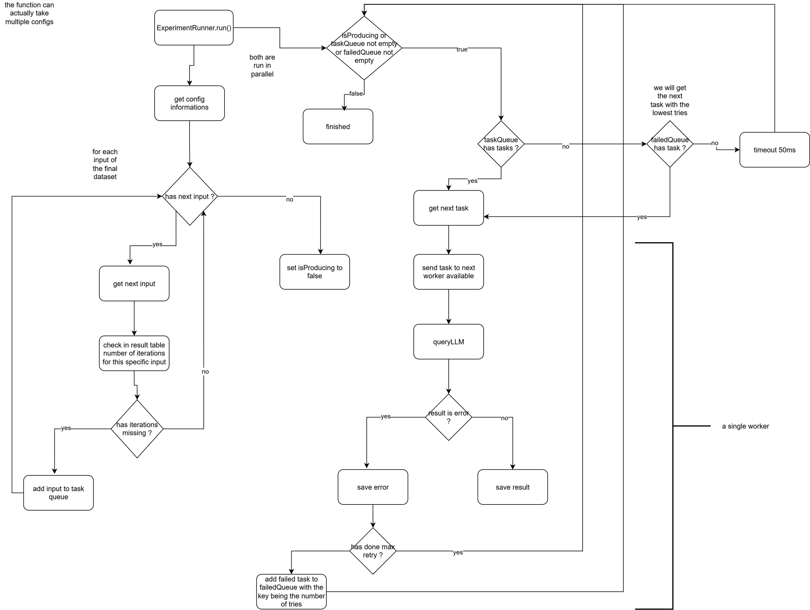
Run configs flow

Slide 12
Multithreading
Each nodes are being executed using parallellism with the workerpool library
It produces all the task and send them to the worker pool

Slide 13
What changed in chainforge
Removed caching because of browser dependencies
Removed uuid linked to caching to use datas directly

Slide 14

Running options
tsx cli.ts -c <Path_to_yml> save and run this config
tsx cli.ts -n <name of experiment> only re-run this config

Slide 15
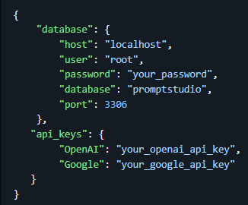
What we need to run the app
A yaml configuration file or a name of a saved experiment
An credentials.json file containing api keys and database credentials
The api must be running and the database must have been setup using the sql script
credentials.json

Slide 16
YML exporter
The yml exporter can be added directly on Chainforge
It reads the native json file and create the corresponding yml file, it also creates every input nodes as .csv files and every code as file (.js or .py)
Then it downloads the zip file with all those file
We can then use the yml config to run the app

Slide 17
What’s missing
Real time monitoring of the advancement of an experiment using sockets
Tokens monitoring when we exceed any of the tokens limit
Update tokens calculations before running because it’s not working currently
Add python evaluators and processors
Add ChainForge defaults evaluators and processors

