Slide 1
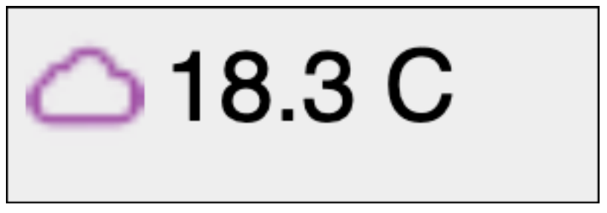
image,pos:nw,dx:10,dy:10-ch,width:60,height:60
NW position of the image=
Origin.x+10
Origin.y+10-canvas height (ch)
label,pos:nw,dx:80,dy:-ch+20
NW position of the label =
Origin.x+80
Origin.y-canvas height (ch) + 20
Canvas height: 100
Origin: 0,0
Canvas width: 300

Slide 2
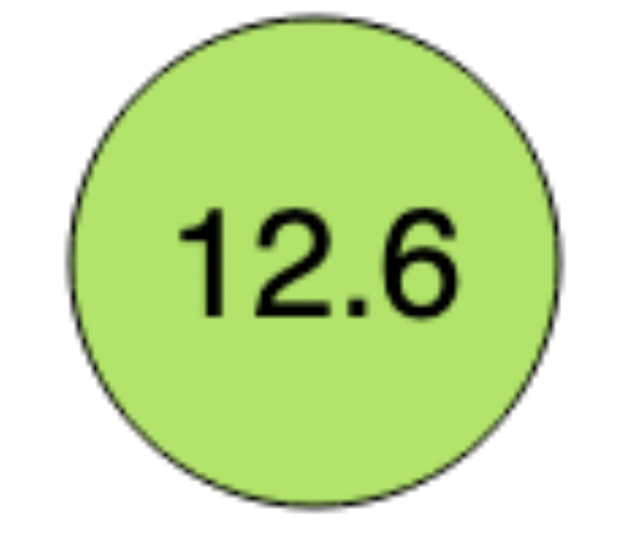
circle,width:cw-10,height:ch,pos:c,dx:cw2,dy:-ch2
Dimension of circle=canvas width-10, canvas height
Center of circle:
x = origin.x+ canvas width/2
Y = -canvas height/2
label,pos:c,dx:cw2,dy:-ch2
Center of label=
Origin.x+canvas width/2
Origin.y-canvas height/2
Canvas height=100
Origin: 0,0
Canvas width=100

Slide 3
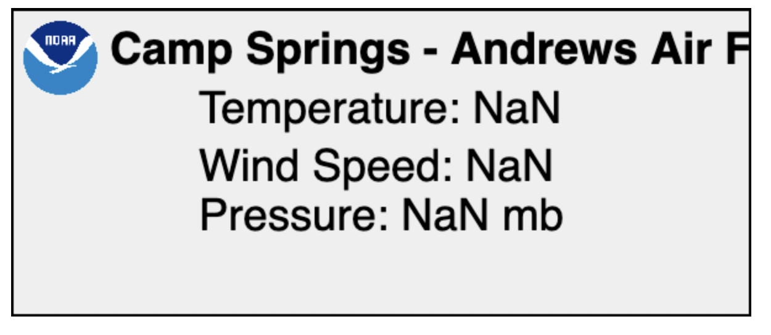
image,pos:nw,dx:10,dy:-ch+10
NW of image=
origin.x+10
origin.y=-canvas height+10
label,pos:nw,dx:80,dy:-ch+10
NW of label=
origin.x+80
origin.y-canvas height +10
Canvas width=250
label,pos:n,dx:cw2,dy:-ch+60
North=
origin.x+canvas width/2
origin.y-canvas height + 60
Canvas width=600

