Slide 1
Installing Tomcat 6 and RAMADDA under Fedora 14 Linux
Unidata 2011 Training Workshop
Unidata Program Center / UCAR
http://www.unidata.ucar.edu

Slide 2
Tomcat 6
RAMADDA is available at:
http://www.sourceforge.com/projects/ramadda
Steps performed as root:
Install Tomcat
yum -y install tomcat6
Copy RAMADDA war file to webapps directory:
cp repository.war /var/lib/tomcat6/webapps
Start Tomcat
chkconfig tomcat6 on
service tomcat6 start

Slide 3
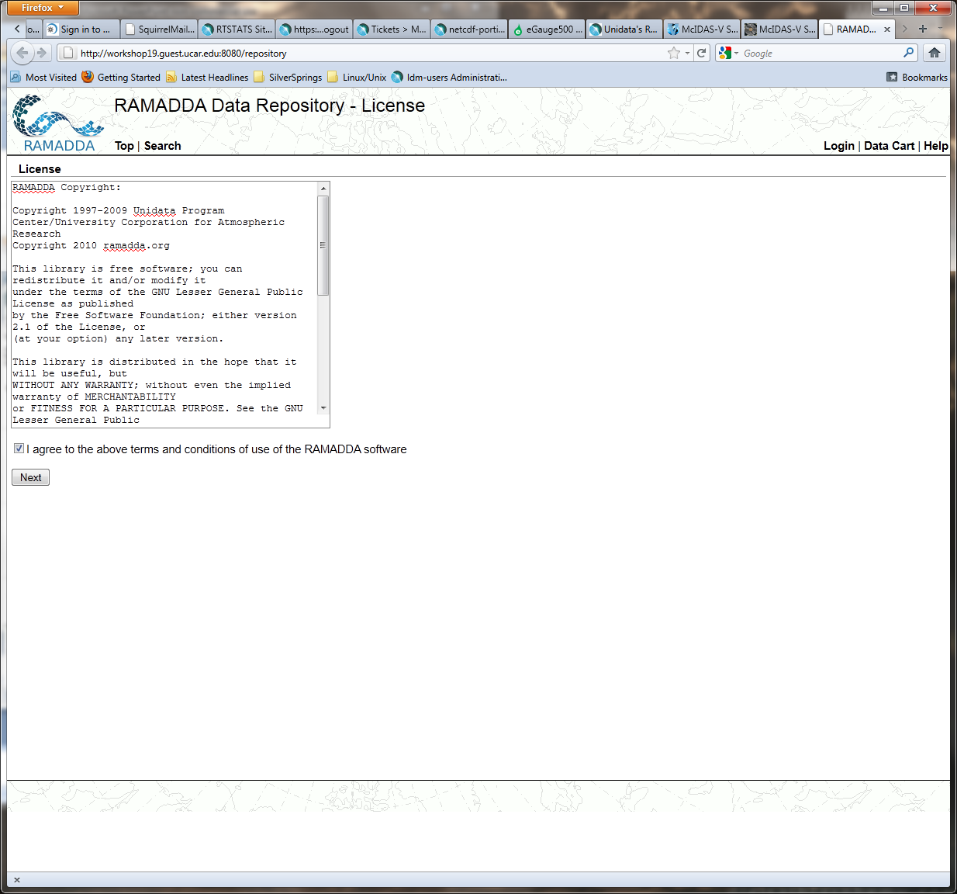
RAMADDA
Access RAMADDA installation from web browser as user
http://localhost:8080/repository

Slide 4
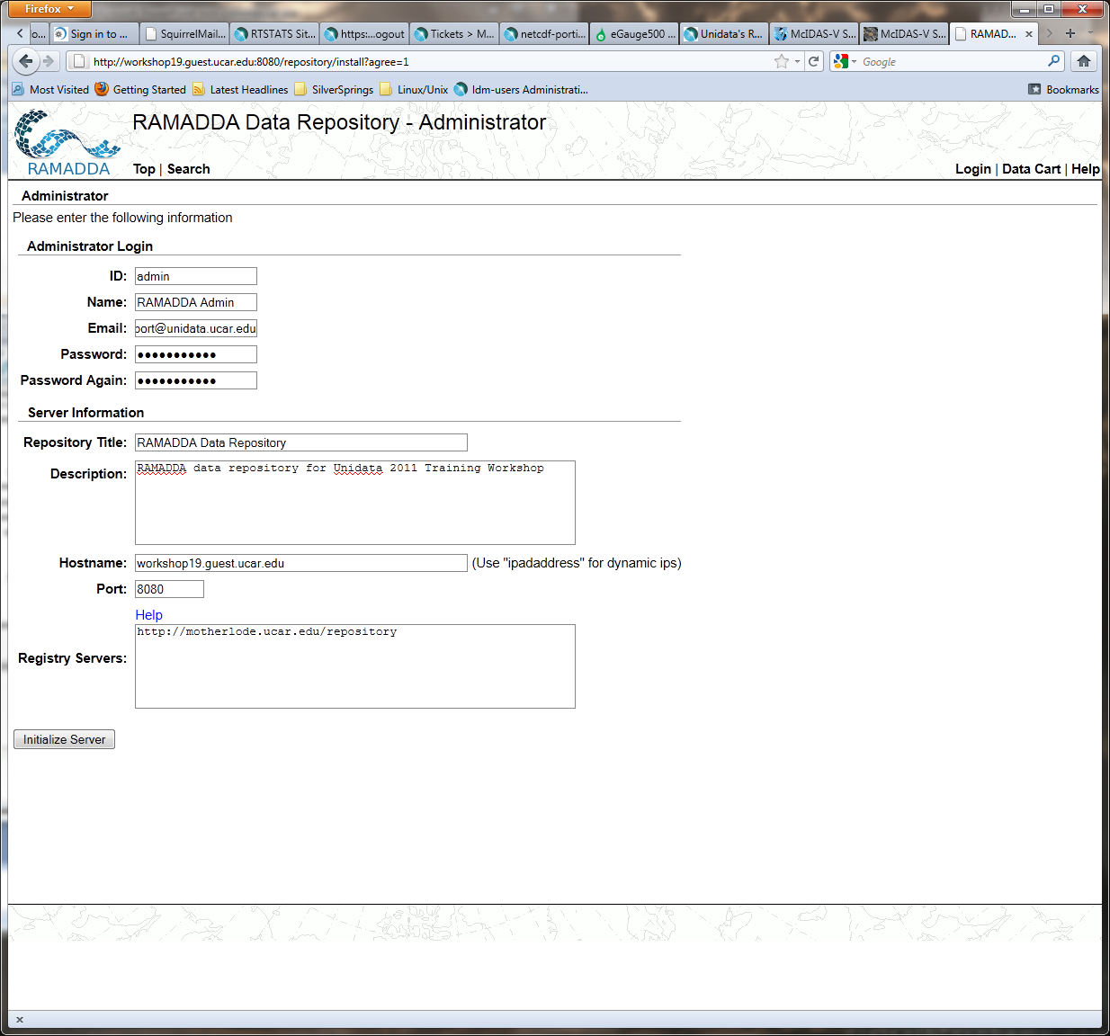
RAMADDA
Access RAMADDA installation from web browser as user
http://localhost:8080/repository

Slide 5
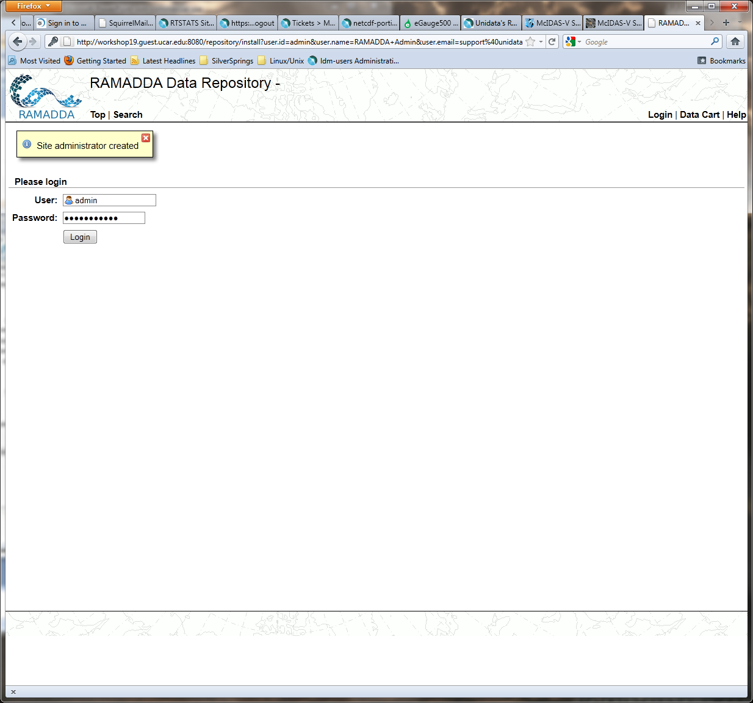
RAMADDA
Access RAMADDA installation from web browser as user
http://localhost:8080/repository

Slide 6
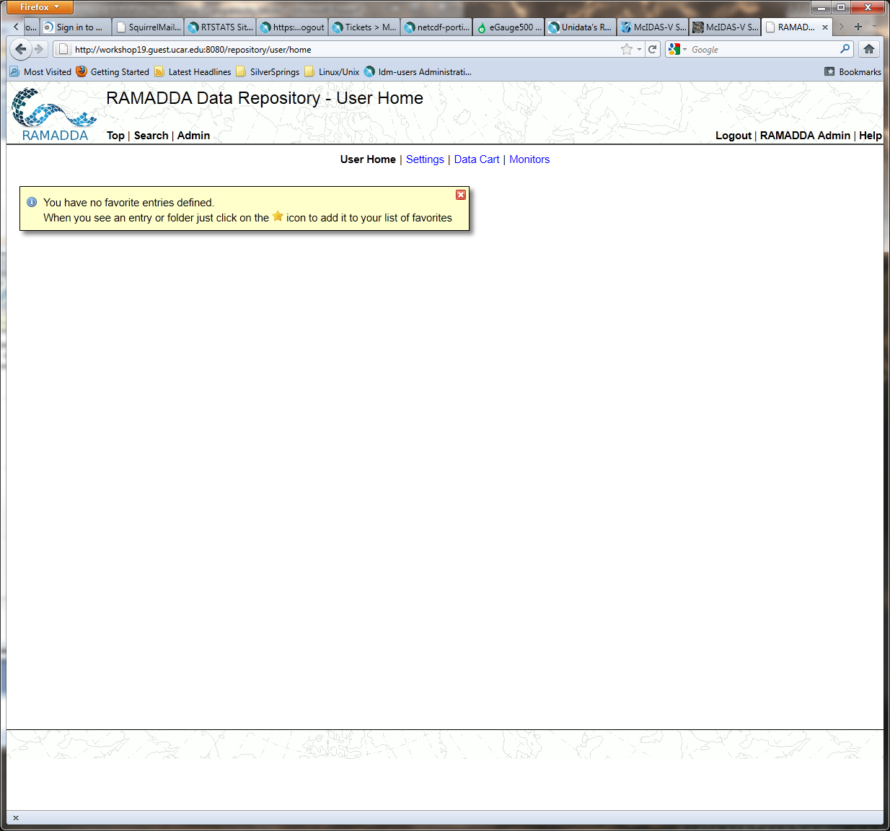
RAMADDA
http://localhost:8080/repository

Slide 7
RAMADDA
Steps performed as root:
Install RAMADDA Plugins
cp dataplugin.jar idvplugin.jar threddsplugin.jar /usr/share/tomcat/.ramadda/plugins
Restart Tomcat
service tomcat6 restart

Slide 8
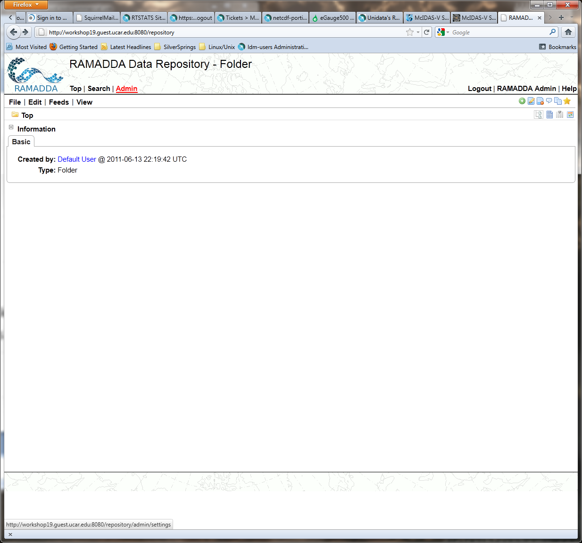
RAMADDA
Top
http://localhost:8080/repository

Slide 9
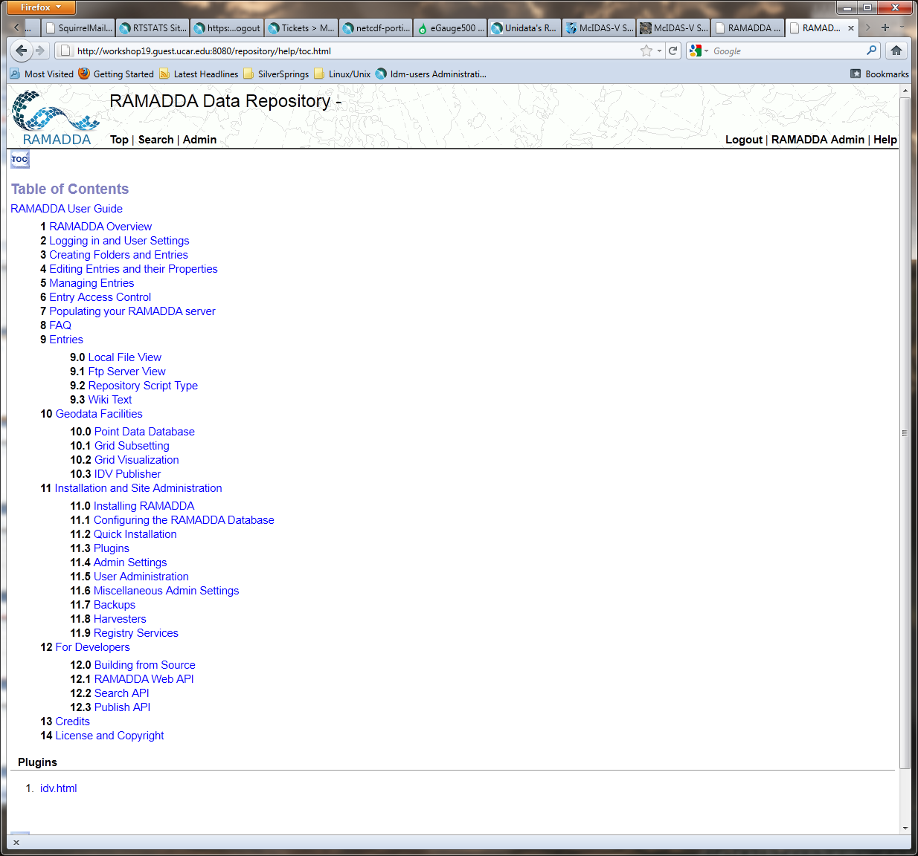
RAMADDA
Help
http://localhost:8080/repository

Slide 10
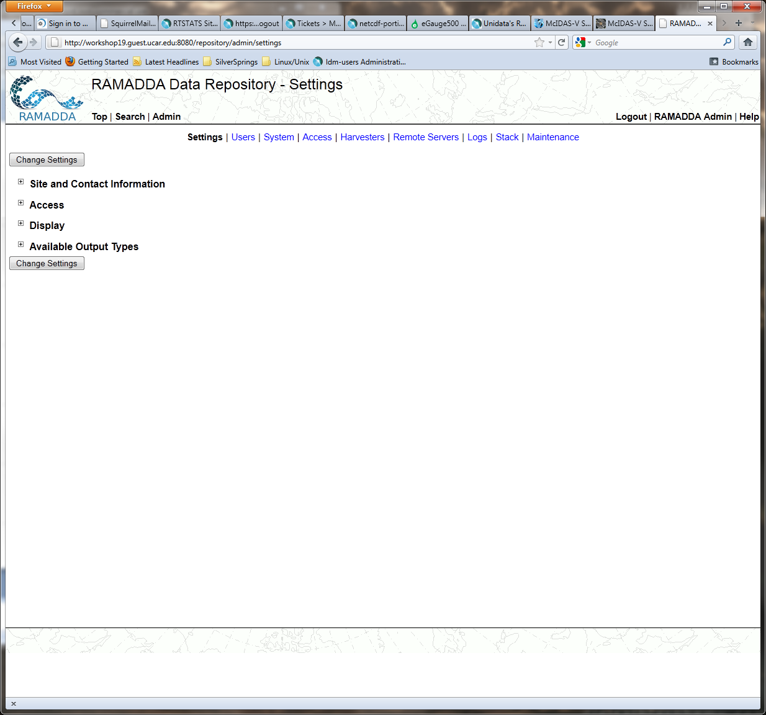
RAMADDA
Admin
http://localhost:8080/repository

Slide 11
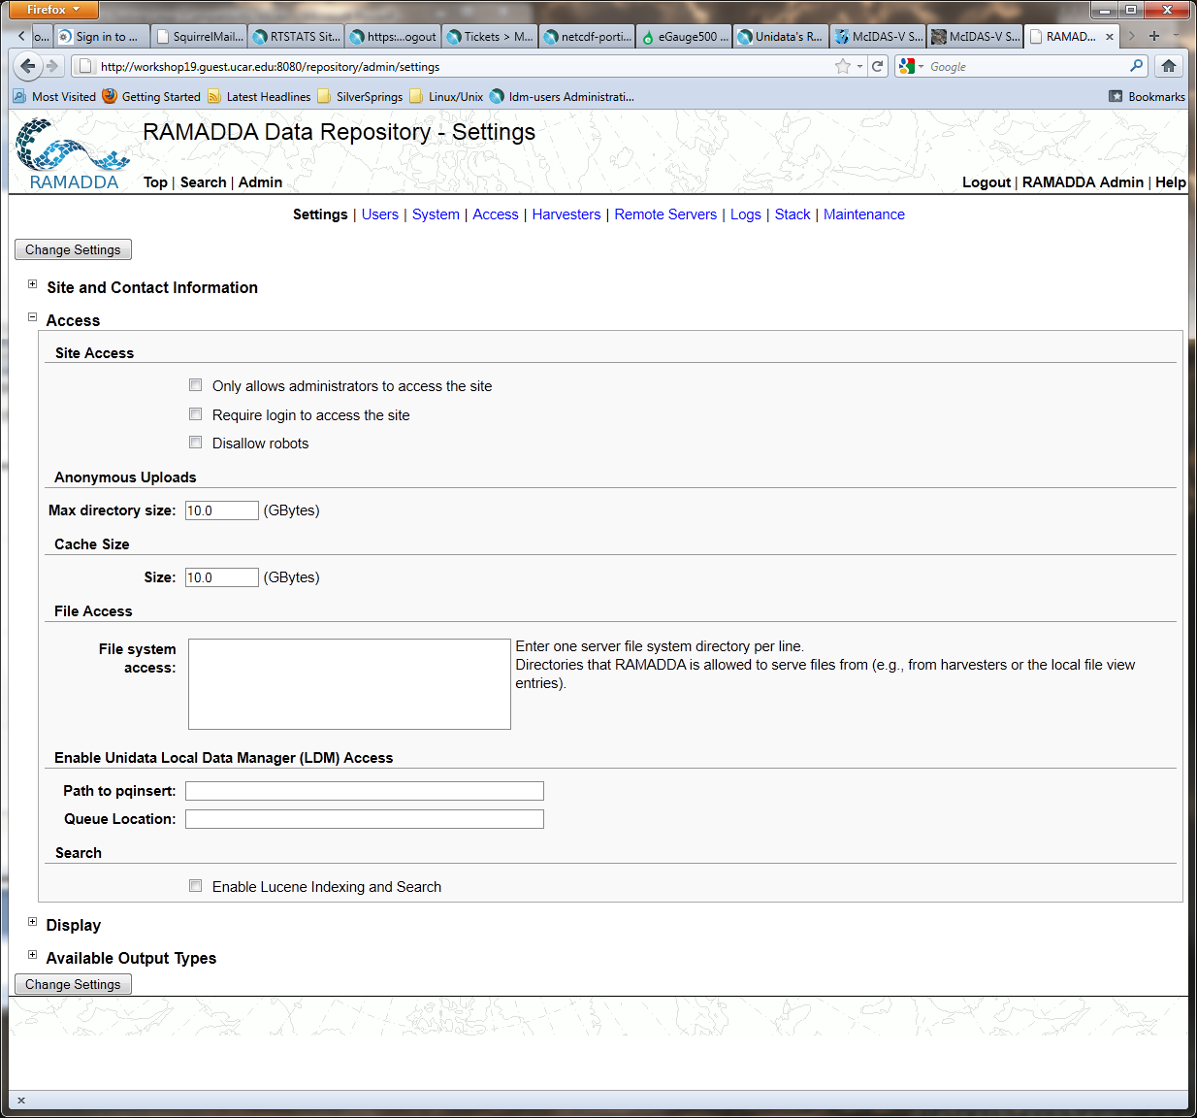
RAMADDA
Admin -> Access
http://localhost:8080/repository

Slide 12

RAMADDA
Admin -> Access ->
File system access
http://localhost:8080/repository

Slide 13
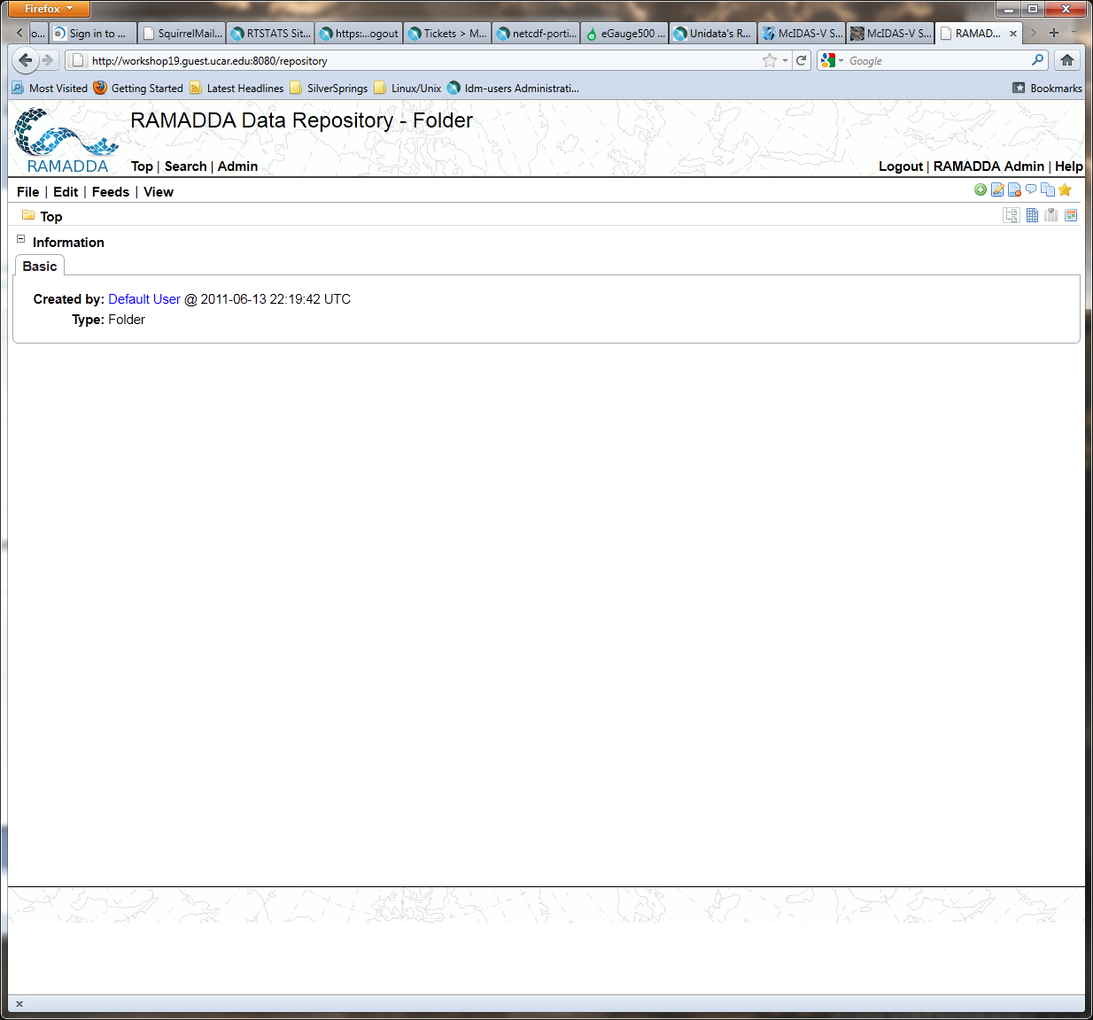
RAMADDA
Top -> File
http://localhost:8080/repository

Slide 14
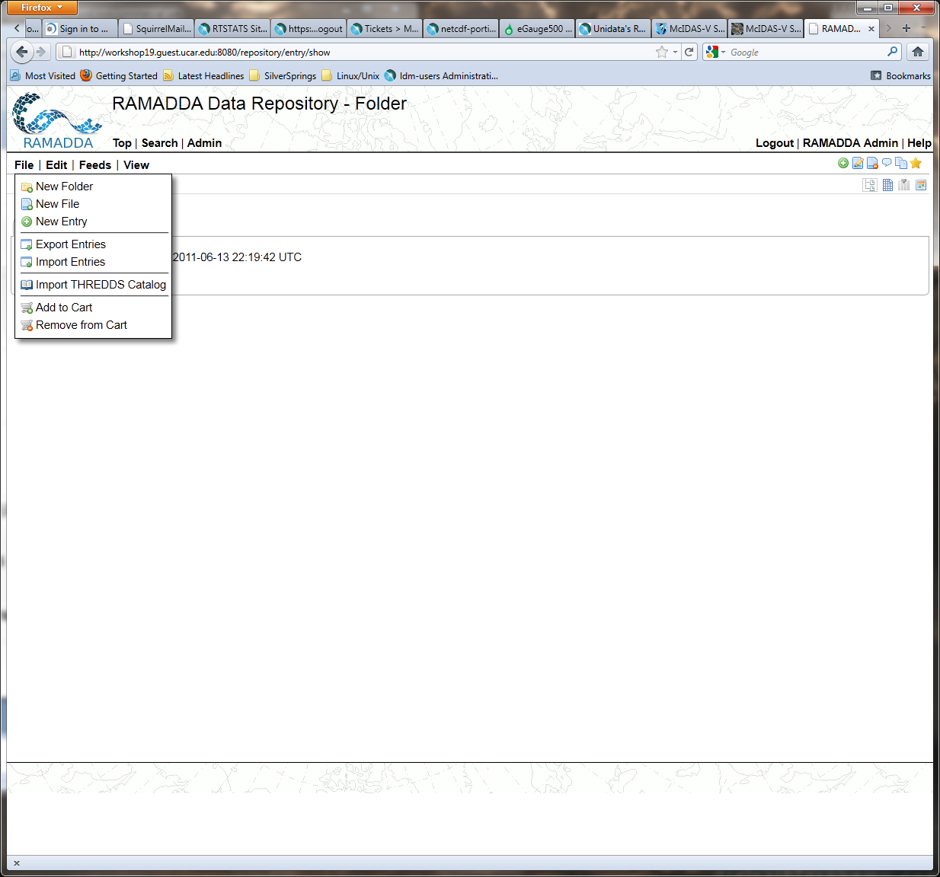
RAMADDA
New Entry
http://localhost:8080/repository

Slide 15
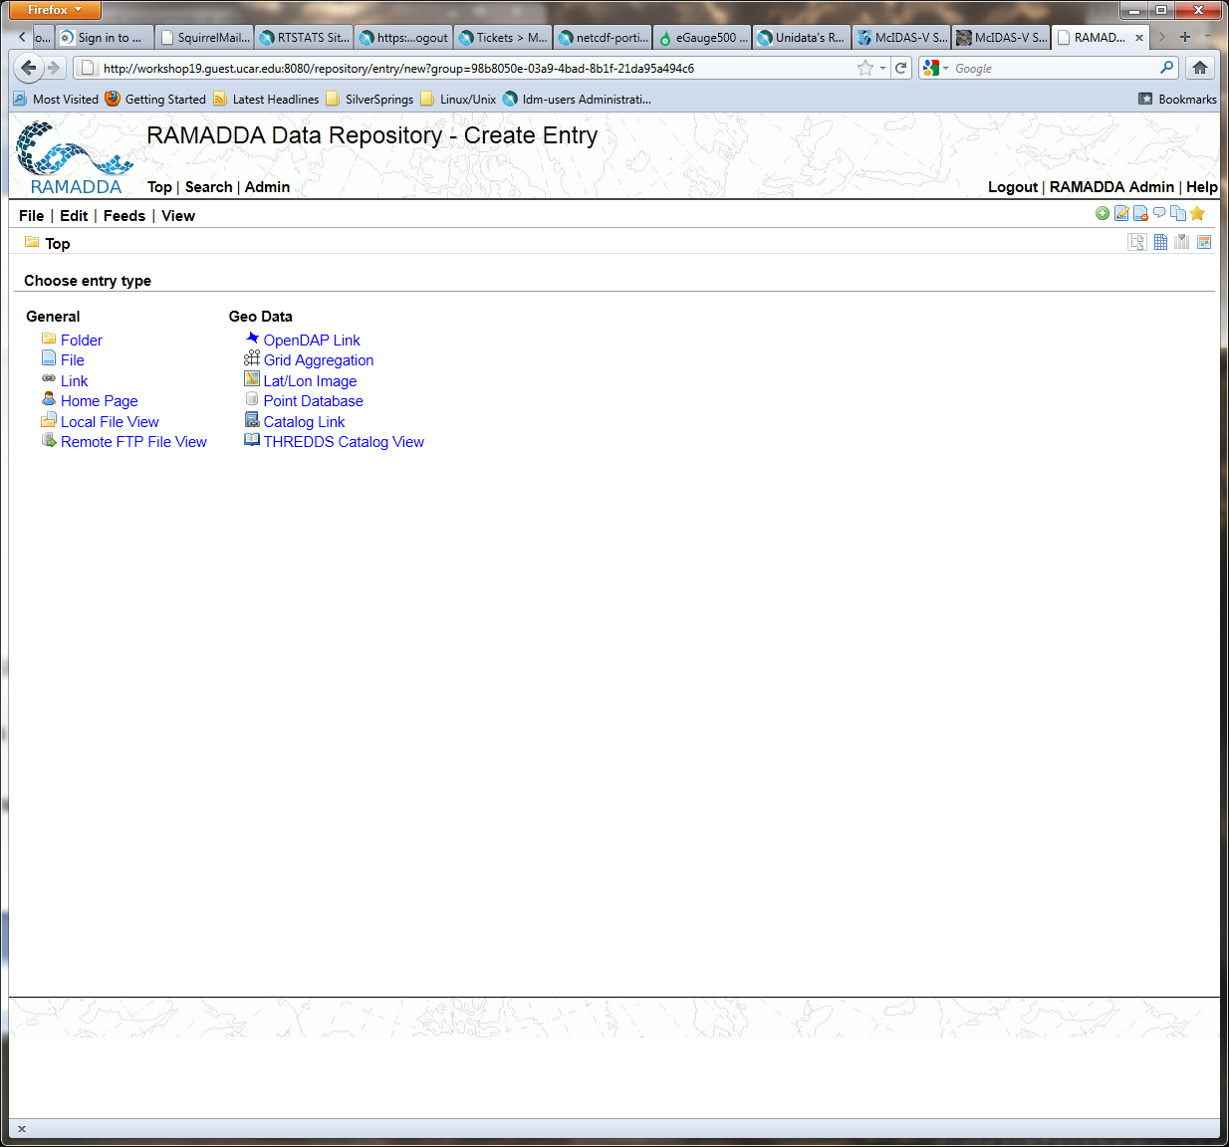
RAMADDA
Local File View
http://localhost:8080/repository

Slide 16
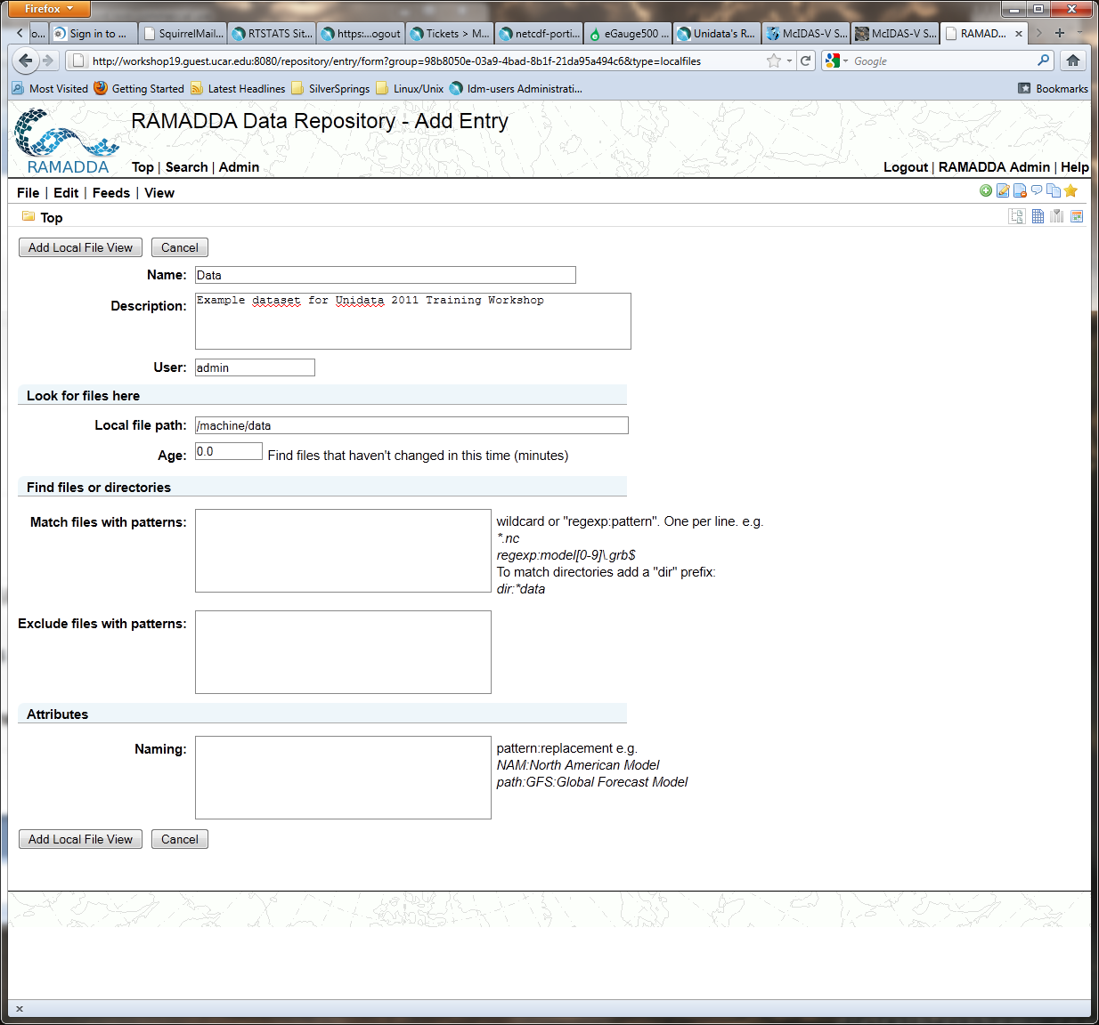
RAMADDA
Local File View
http://localhost:8080/repository

Slide 17
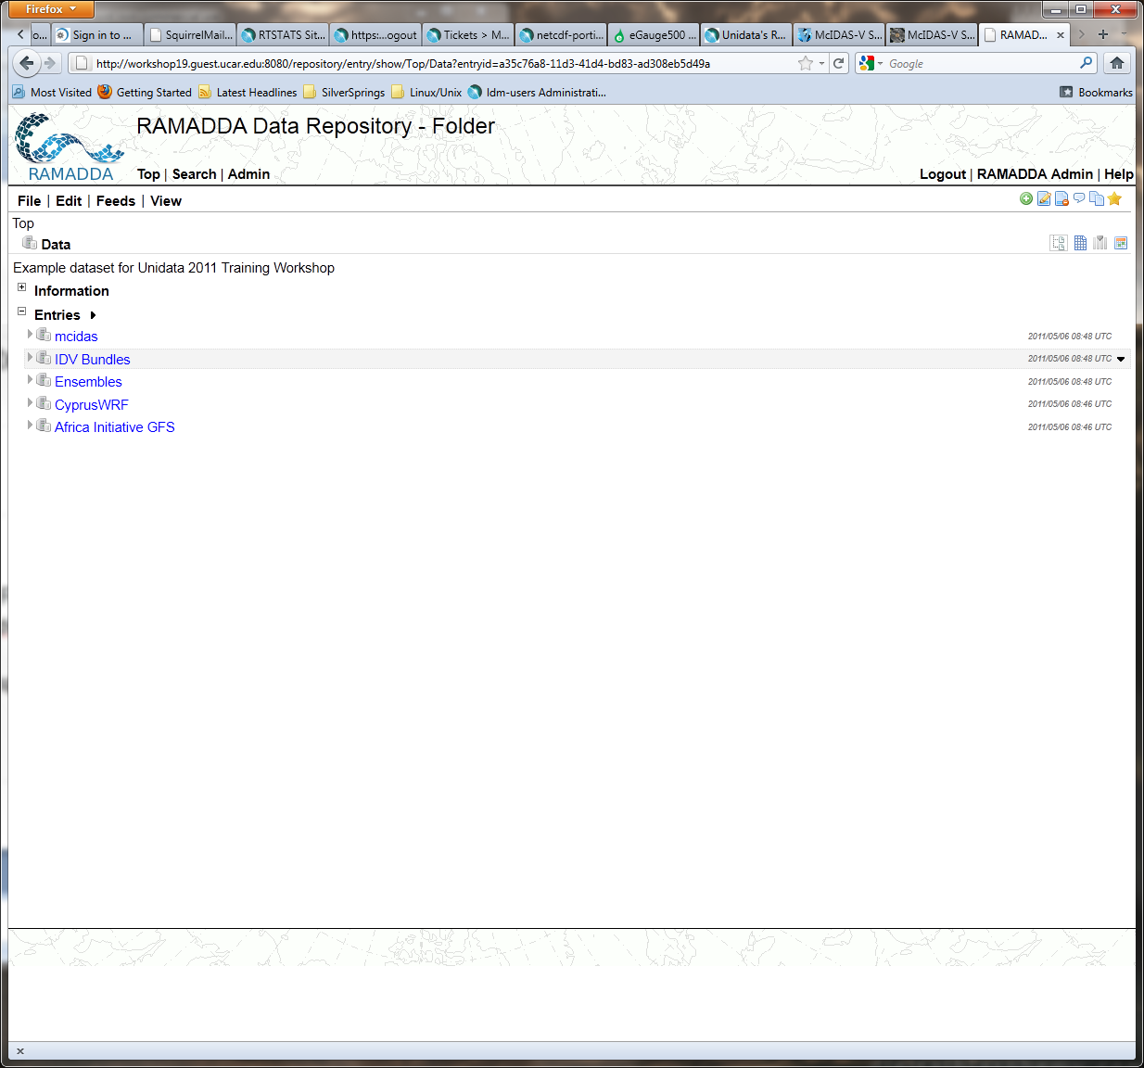
RAMADDA
Local File View
http://localhost:8080/repository

Slide 18
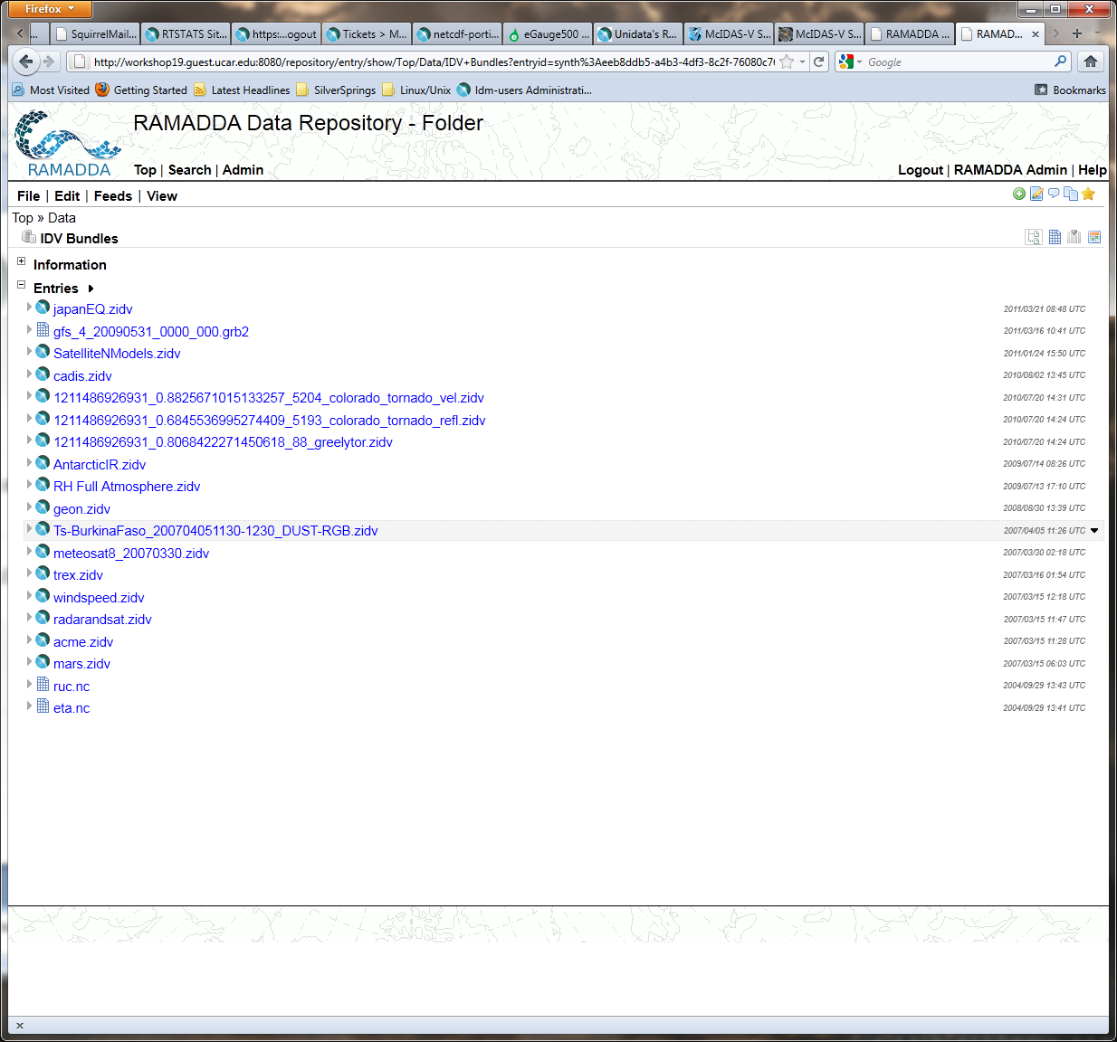
RAMADDA
Local File View
http://localhost:8080/repository

Slide 19
RAMADDA
Upload IDV zidv display to Derby database:
Top -> File
http://localhost:8080/repository

Slide 20
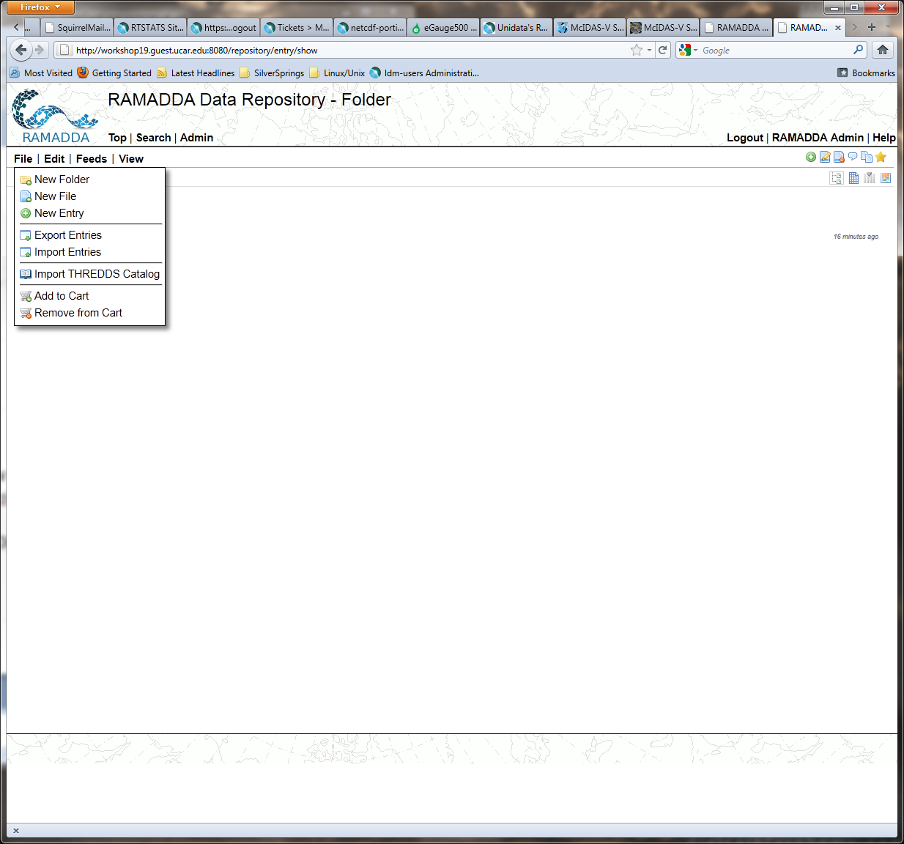
RAMADDA
Upload IDV zidv display to Derby database:
Top -> File -> New Folder
http://localhost:8080/repository

Slide 21
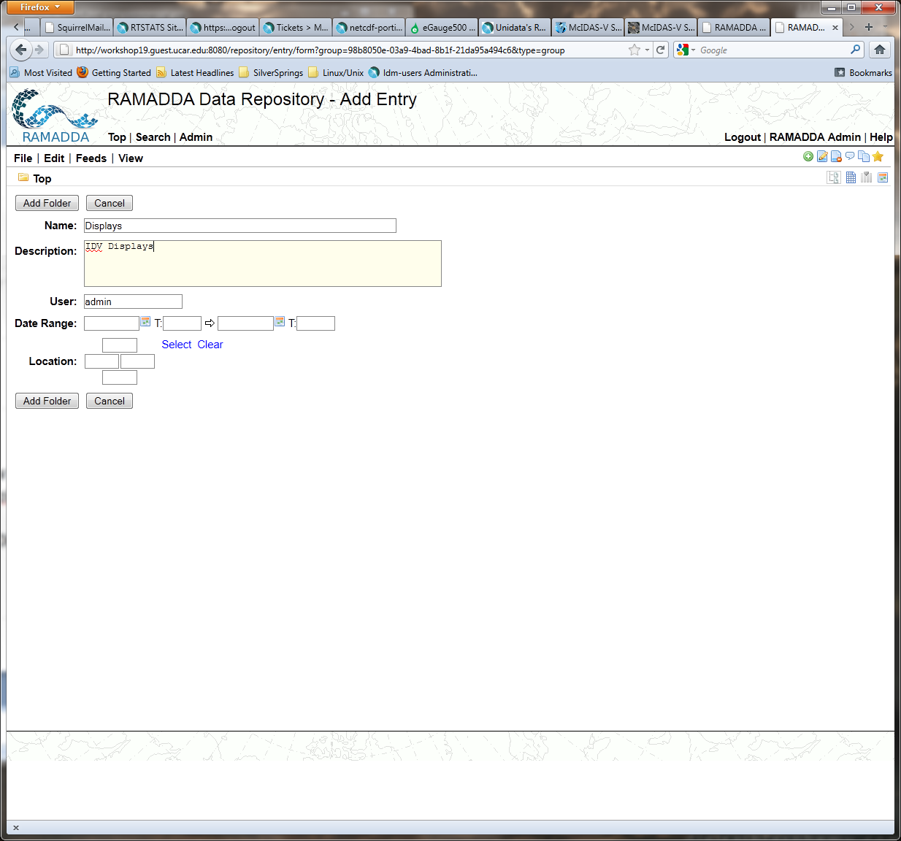
RAMADDA
Upload IDV zidv display to Derby database:
Top -> File -> New Folder ->
Add Folder
http://localhost:8080/repository

Slide 22
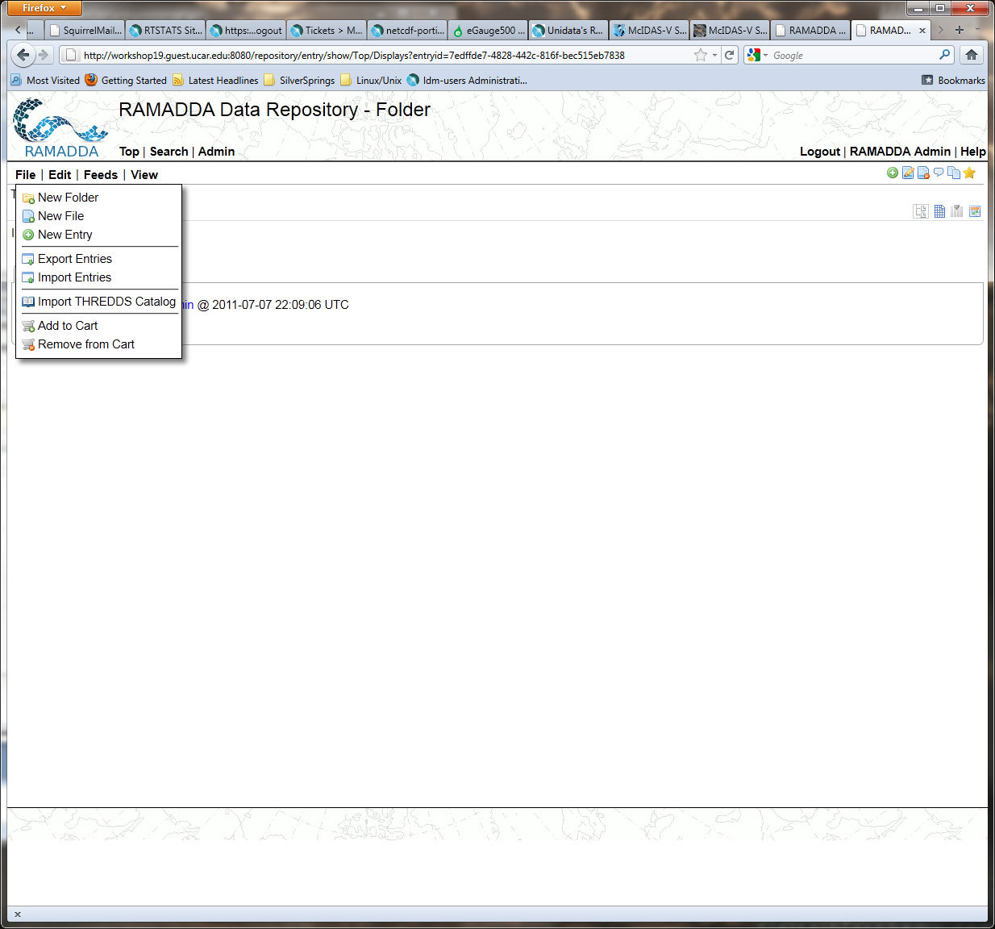
RAMADDA
Upload IDV zidv display to Derby database:
Top -> File -> New File
http://localhost:8080/repository

Slide 23
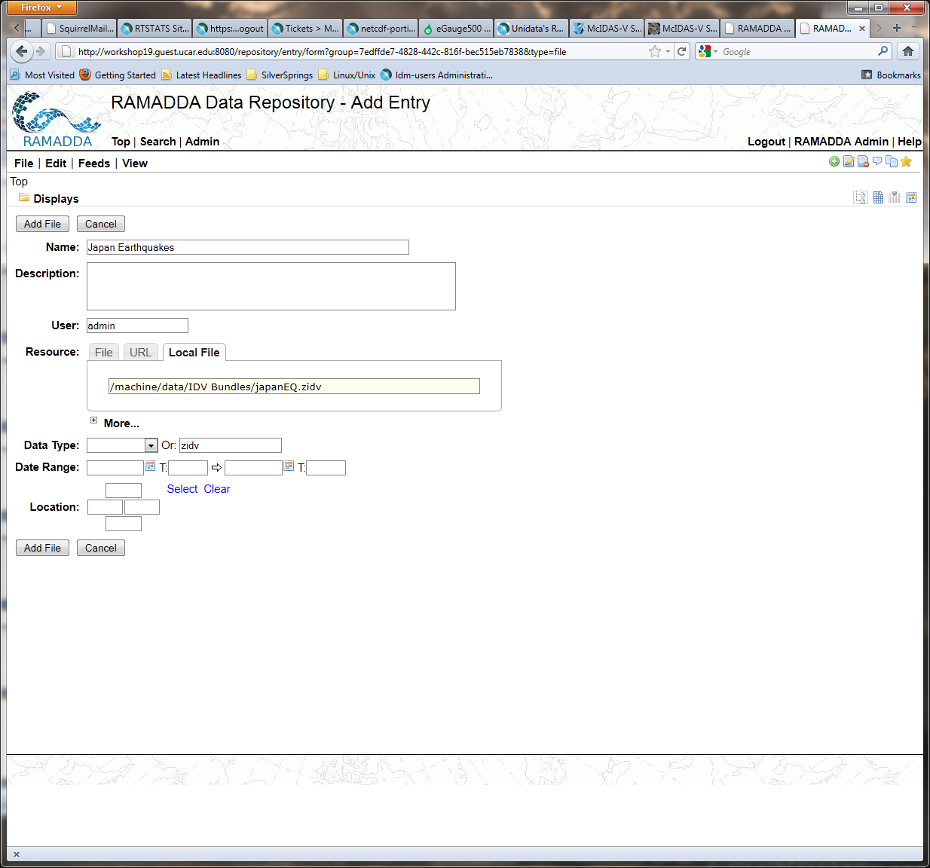
RAMADDA
Upload IDV zidv display to Derby database:
Top -> File -> New File ->
Add File
http://localhost:8080/repository

Slide 24
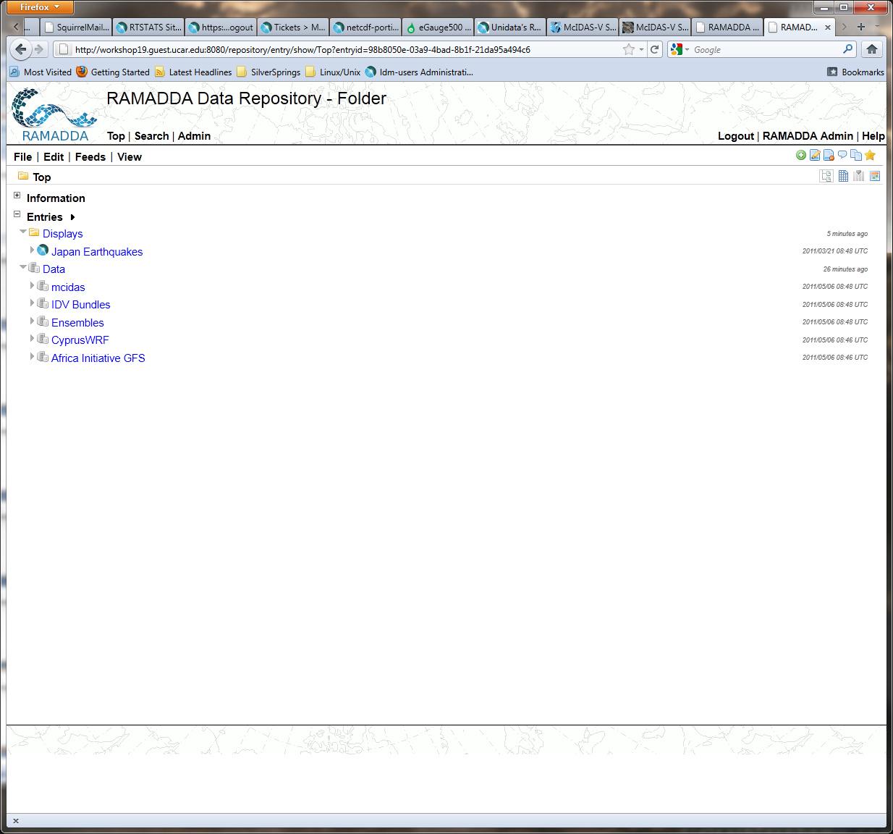
RAMADDA
Upload IDV zidv display to Derby database:
Top
Expand Displays
Expand Data
http://localhost:8080/repository

Slide 25
IDV + RAMADDA
Access Local RAMADDA from IDV
Data Choosers tab in Dashboard
General -> Catalogs
http://localhost:8080/repository?output=thredds.catalog <cr>
Access Remote RAMADDA from IDV
Data Choosers tab in Dashboard
General -> Catalogs
http://workshop<nn>.guest.ucar.edu:8080/repository?output=thredds.catalog <cr>

