Slide 1
Top
Tag
Folder 1
Folder 2
File 1
Project
File 1
File 1

Slide 2
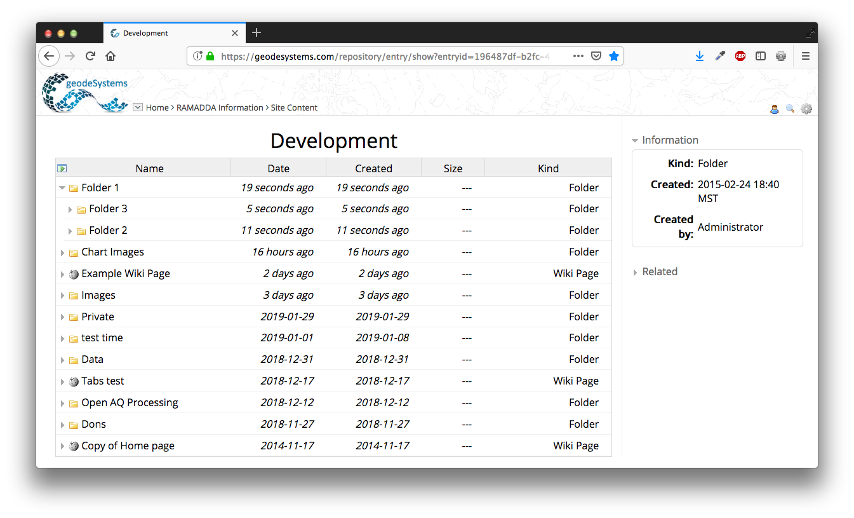
Entries are organized hierarchically
You are always viewing an entry. Here is a folder called Development
Click on the arrow to open the folder
Click on the link to view the folder

Slide 3
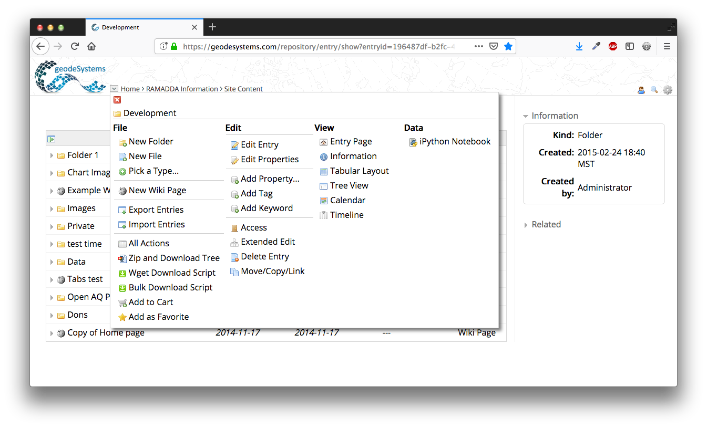
Click on the down arrow to show the actions and views available for this entry

Slide 4
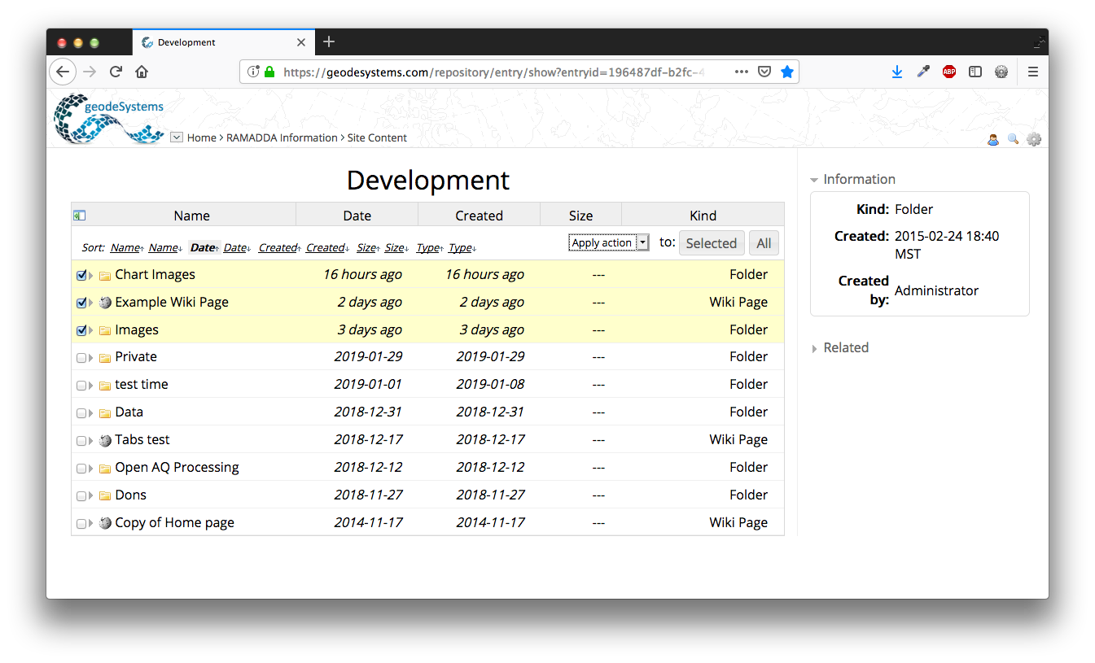
1) Click on the link to open the top form
3) Choose an action
4) Either the selected or all entries
2) Select entries

Slide 5
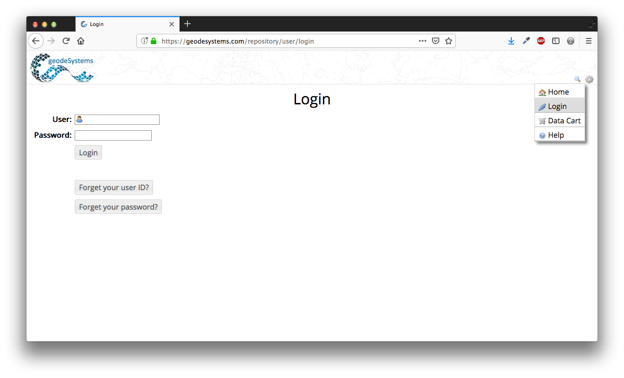
Login link
If your RAMADDA is configured to send email these reminder actions are available

Slide 6
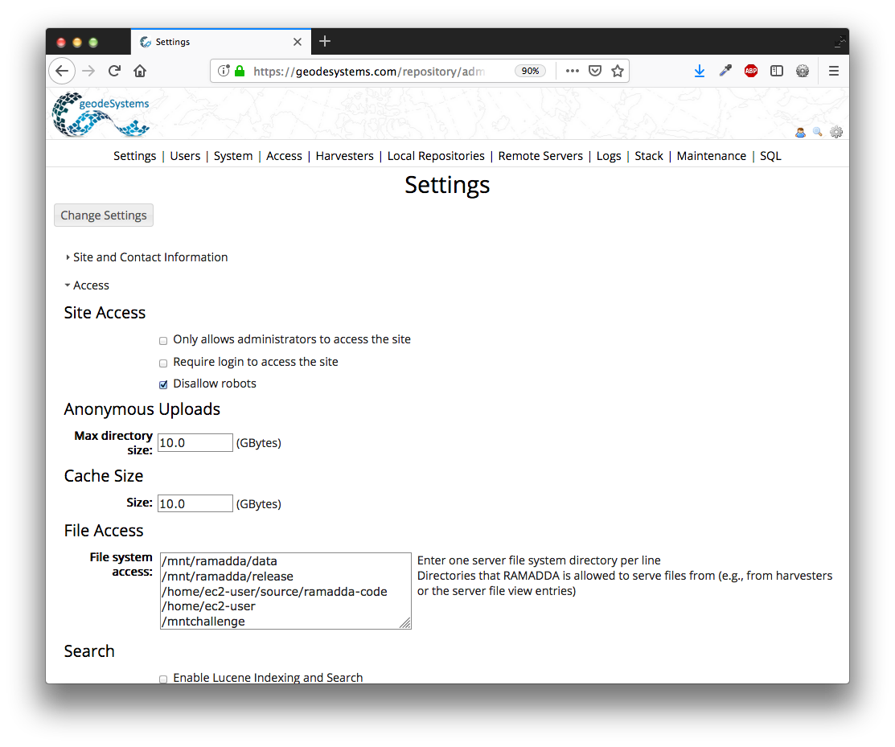
Enter one of more file system directories here

Slide 7
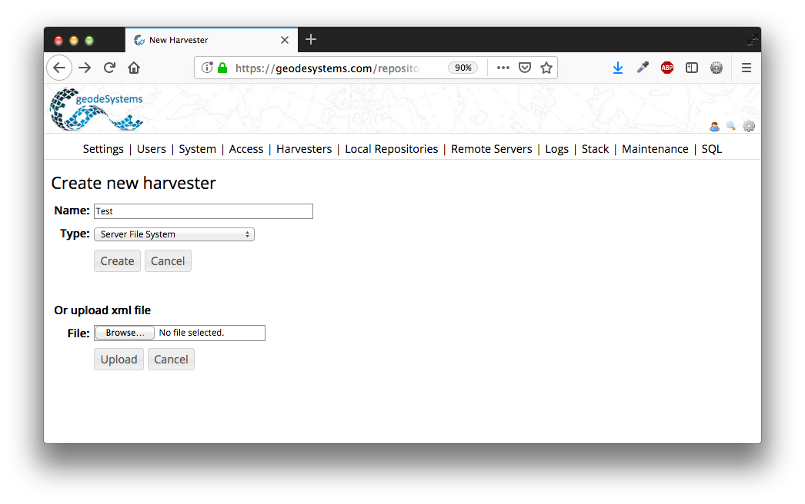
Create a Server File System harvester and give it some name

Slide 8
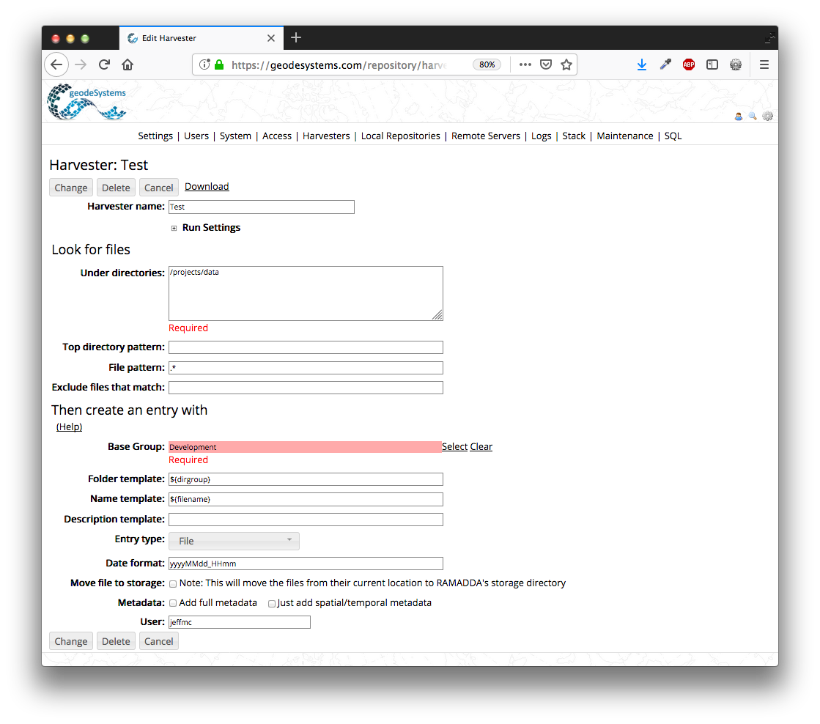
Specify the file system directory(s)
Specify the RAMADDA to
put the new entries

