Slide 1
PLL Trainer-API
George Downe - QA Consulting

Slide 2
Contents
Overview
Demonstration
Structure
Review
Conclusion
Notes:
We are going to start with an overview of the project- what the task was, why I chose to do a PLL trainer and what I had in mind in terms of functionality.
Then we will have a quick demonstration
Then discuss the structure and the tech used
Then review what went well what didn’t etc.
And conclude

Slide 3
The Project
Tasked with creating an API utilising a database, logic layer and front end.
CRUD
Create-ability to add database entries
Read-receive database entrants
Update-update database entrants
Delete-remove database entrants
A database with at least two tables

Slide 4
PLL trainer API
CFOP - Cross, F2L, OLL, PLL.
Permuting the Last Layer (PLL) – Essentially reshuffling the last layer pieces.
PLL requires over 20 algorithms to learn.
Not just about memorisation but speed.
Notes:
Algorithms are essentially a set of moves on the cube to achieve a desired movement of the pieces

Slide 5
Goal
Build an application to help increase recognition and speed of execution of the Algorithms.
An example of a user story I created when planning the API:
As a user
I want to store my solve times for given PLL case
So that I can see which Algorithms I need more practice on
Notes:
Would do this by presenting random scrambles which would give the user a special case of one of their algorithms
Trello

Slide 6
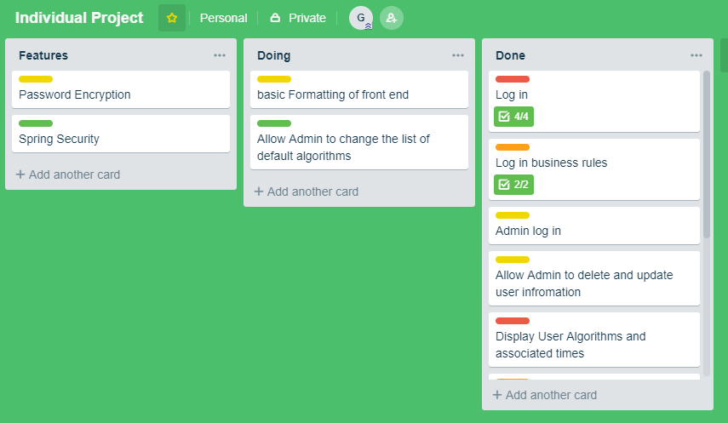

Slide 7
Demonstration
Quick demonstration
http://35.189.86.19:8080/

Slide 8
Structure
Database included the following entities all related by foreign keys
User – one User has many Algorithms.
Algorithm – one Algorithm has many TimeLogs.
TimeLog.
Logic included
Creation of the entities
All of the CRUD methods for interacting with the data and presentation layer
Business rules
Front end

Slide 9
Data Layer – Structure Query Language
Originally H2 database - very easy to use and had used it in the past during API building at QA
Switched to SQL as it actually persists the data between sessions.
Also gained experience with SQL during the week four technical skills week at QA
Note: H2 database was used for the demonstration as it is easier to setup on the cloud

Slide 10
Logic Layer – Spring Boot
Originally the logic layer was Java EE
Had gained lots experience during week 5 of my training at QA making it easy to build my API using Java EE
Decided to switch to Spring Boot
Circumvented CORS issue
Good to build on spring experience already gained at QA
Easy to implement
At the cost of abstraction
Notes:
Java EE – Had gained lots of experience building APIs with Java EE during the time at QA
Springboot
Springboot – felt like it would be good to build on springboot that I had learnt whilst at QA good technology more abstraction but easy to use and also to stop cors issue
Abstraction helped by my knowledge of Java EE

Slide 11
Presentation Layer - React
React is a very powerful technology which leads to fast responsive front ends.
At QA we learned how to create front end websites using HTML and JavaScript .
This made it a lot easier to use react which is a rather unintuitive technology at first.

Slide 12
Review
What did not go well
What went well
For the future

Slide 13
Review – what didn't go well
React Planning – Dived straight in.
React Synchronicity issue – initially struggled with concept and forced me to adjust structure of my React code.
CORS Issues – spent a lot of time tackling the issue.
Initial testing of JPA repository void methods

Slide 14
Review –What went well
Planning of the actual functionality of the API
Transition from Java EE to Spring Boot – Very quick and smooth.
Entities planned out very well- knew exactly how I wanted the foreign keys to work.
Over 70% testing coverage

Slide 15
For the future
Selenium testing for the front end.
Better planning on the front end overall .
Addition of features that were not yet implemented such as password encryption and Spring security.
Deploy on the cloud with SQL capabilities

Slide 16
Conclusion
Reflection
I believe that the API I created turned out to be very useful
Formatting is nowhere near perfect
Functionality is at a standard I would of hoped
good base to build on in the future
Lessons learned
Technical skills
Time management
Planning
Notes:
Learned not just technical skills

Slide 17
Thankyou for your time. Any questions? George Downe - QA Consulting

