Slide 1
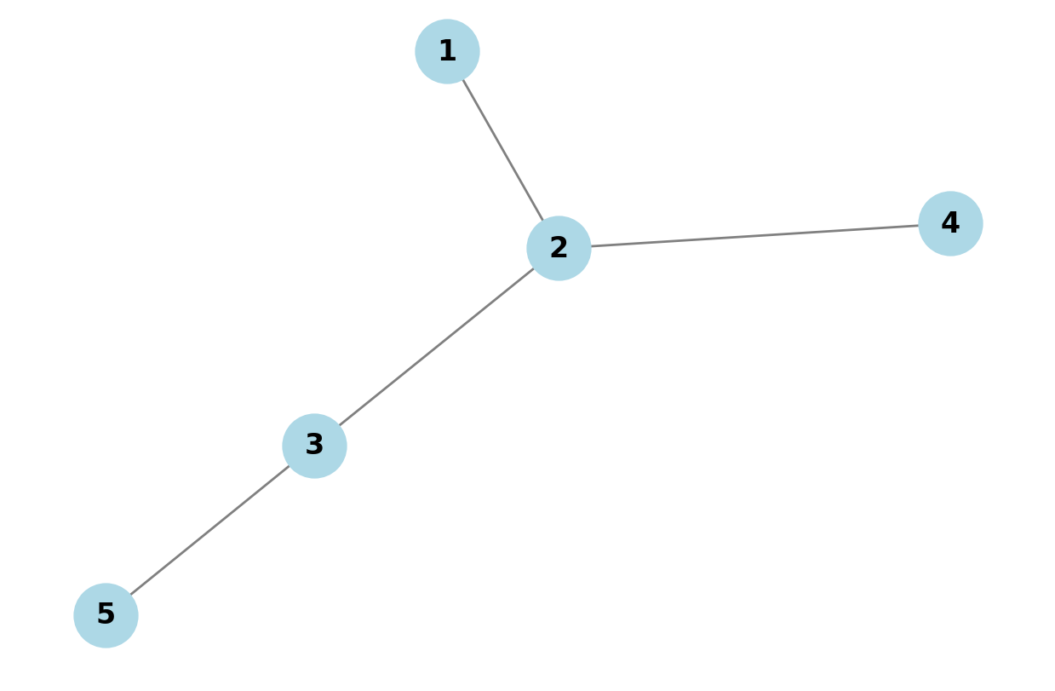





$$e_{4}$$
$$e_{5}$$
$$e_{3}$$
$$e_{1}$$
$$e_{2}$$

Slide 2
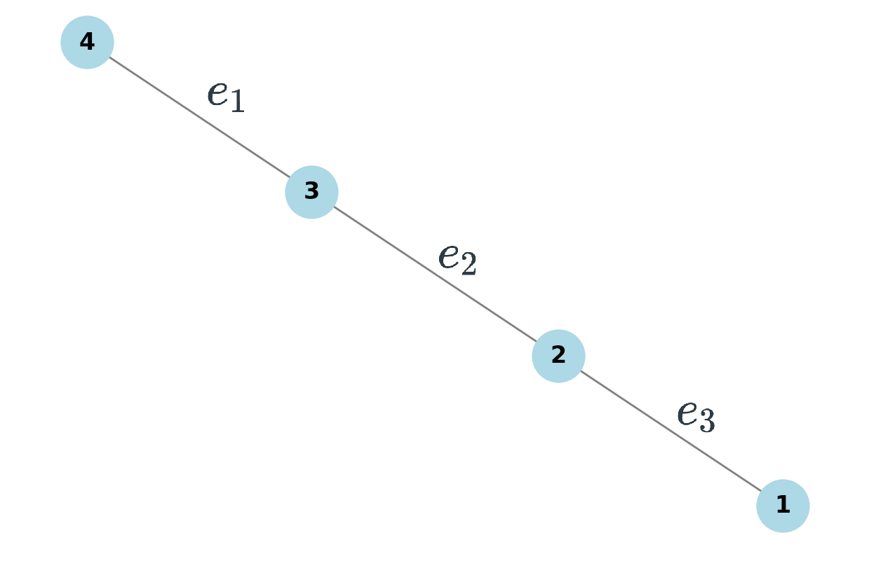

$$e_{4}$$

Slide 3
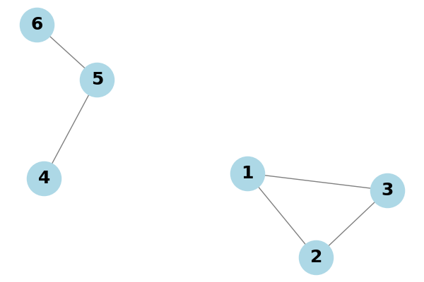





$$e_{4}$$
$$e_{5}$$
$$e_{1}$$
$$e_{2}$$
$$e_{3}$$

Slide 4
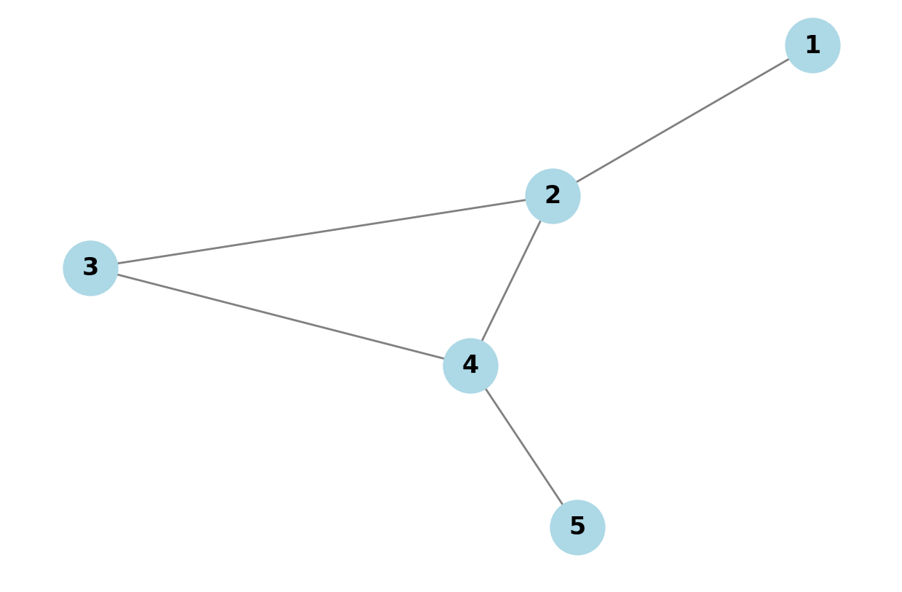





$$e_{1}$$
$$e_{2}$$
$$e_{3}$$
$$e_{4}$$
$$e_{5}$$

