Slide 1
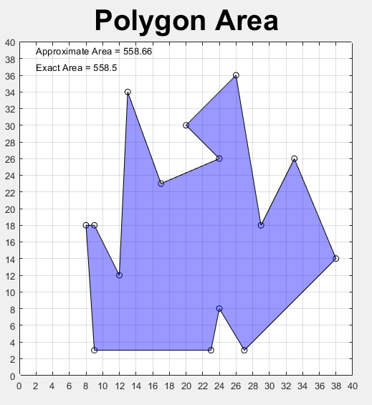
in
1

Slide 2
out
1
2

Slide 3
in
1
2
3

Slide 4
out
1
2
3
4

Slide 5






ray goes into
the polygon
$$v_{k+1}$$
$$y_{1}$$
edge 1
$$v_{k}$$
$$y_{0}$$
edge 2
$$y_{2}$$
$$v_{k−1}$$

Slide 6






ray does not go
into the polygon
$$v_{k}$$
$$y_{0}$$
edge 1
edge 2
$$v_{k+1}$$
$$y_{1}$$
$$v_{k−1}$$
$$y_{2}$$

