Slide 1
a
b

Slide 2
a+b
a
b

Slide 3
b
a+b
a

Slide 4
a
b
θ

Slide 5
a
|a|
b
θ

Slide 6
a
|a|
b
θ
|a| cosθ

Slide 7
a
|a|
b
θ
|a| cosθ
|b|

Slide 8

F
r
θ

Slide 9
F
r
θ
|F|cosθ
|r|

Slide 10
F
r
θ
|F|cosθ
Force
|r|
Distance

Slide 11
F
|F|sinθ
Displacement
r
θ
|F|cosθ
|r|
Distance
Force component
(in the direction of r)

Slide 12


Slide 13
a
|a|
b
θ
|b|

Slide 14
a
|a| sinθ
|a|
b
θ
|a| cosθ
|b|

Slide 15
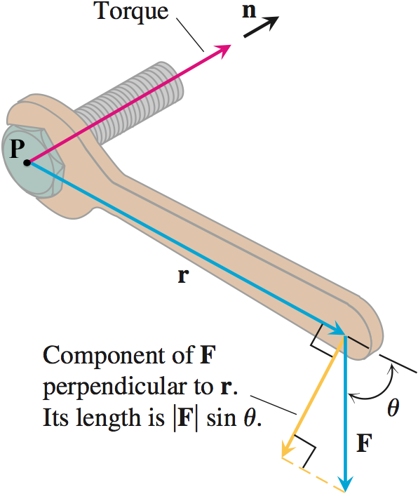
Line of
Action

Slide 16
z
y
x

Slide 17
z
S_{z+}
S_{x-}
S_{y-}
S_{y+}
S_{x+}
y
S_{z-}
x

Slide 18
z
T
y
x

Slide 19
Inflow
Outflow
dz
P
dx
dy
Divergence at P ~ Net flow through a
“small” box around P

Slide 20
z
5
y
5
2
x

Slide 21
z
(0,3,5)
5
y
3
x

Slide 22
z
2
y
2
3
x

Slide 23
z
y
x

Slide 24
z
y
x

Slide 25
z
y
x

Slide 26
π
-2π
-π
π
2π
x
-π

Slide 27
z
y
x

Slide 29
1
-2
-1
1
2
-1

Slide 30
π
-2π
-π
π
2π
x
-π

Slide 31
