Slide 1
A Programmer’s Perspective on Reverse Engineering
It’s Not Only For Security Research!

Slide 2
Kernel-Mode Exposure
Lower
boot data
policies (TPM, Secure Boot, code integrity)
Shim Database (SDB) for drivers
API Set Schema
I/O interpreted in kernel mode for kernel-mode use
file-system metadata
registry hives
I/O interpreted in kernel mode to help user mode
font files!
Notes:
Ad lib on this for as long as seems suitable. Boot data is both less of a problem as boot-time security gets pushed ever closer to the firmware, yet becomes more important and gets more attention. NTFS.SYS must have some of the most banged-on code that has ever been written. Joke about everyone knowing the trouble Windows (still) has with font files.

Slide 3
Kernel-Mode Exposure
Upper
calls from user mode to kernel (requests for service)
parameter validation and privilege checks
calls to user mode from the kernel (notifications)
not supposed to happen!
called code may re-enter kernel
no certainty that called code will return
kernel-mode reading of data shared with user mode
KUSER_SHARED_DATA at fixed address
kernel-mode fs:[18h] and gs:[30h] point to user-mode TEB
Notes:
Privilege checks built in from start. Parameter validation also, and progressively strengthened, even before there was a security industry, e.g., for Windows NT 4.0 SP4. But there was for a long time a long way to go. Picked over pretty thoroughly by now, you’d think.

Slide 4
System Services
int 2Eh
historically
generally, but with other interrupts for special cases
sysenter
32-bit Windows (i386)
syscall
64-bit Windows (amd64)
i386 in early Windows XP for some processors
Notes:
Most bugs that can be initiated from user mode at least start with a system service.

Slide 5
NtCreateProfile NtStartProfile KeProfileInterruptWithSource
One Buffer Overflow
Two Causes
One Original, One New
One Needs Mischief, One Not
One for Security Researchers, One for Programmers
Notes:
Bug spread over three functions. NtCreateProfile and NtStartProfile are system services. They are original, i.e., from version 3.10. They are undocumented. Unusually for system services, there are no higher-level functions, e.g., in KERNEL32, that “map” to them.
KeProfileInterruptWithSource is a kernel export for private use by the HAL.

Slide 6
Profiling
ancient diagnostics technique
long pre-dates Windows (even DOS had it)
architecture fully formed in Windows NT 3.1
it’s not debugging, it’s not tracing
statistical sampling of processor execution
generate recurring hardware interrupt
periodic, from timing device
processor event, e.g., every 1000th branch mis-prediction
build histogram of return addresses
Notes:
To go by the int 2Fh function numbers, PROF.COM dates from the very late 80s, after HIMEM.SYS, roughly concurrently with development of the 16-bit DOS extender for Windows/286, certainly before the DOSKEY tool in DOS 5.

Slide 7
Profile Parameters
What execution to profile?
address and size of profiled region, e.g.,
whole address space (including kernel mode)
single EXE or DLL, or even just code section
single routine
execution by specific process (or by all)
execution only on specific processors (or on any)
What source for recurring interrupt?
Where and how to build histogram?
address and size of buffer to receive execution counts
bucket size, i.e., bytes of profiled region per count
Notes:
Profiling of kernel-mode execution not allowed for “restricted callers” in 6.3 and higher. Can profile for all processes, if holding SeSystemProfilePrivilege. Can profile any single process, if opened handle with PROCESS_QUERY_INFORMATION permission.

Slide 8
Histogram Collection
NtCreateProfile describes what’s wanted
NtStartProfile begins collection
maps output buffer into locked system memory
page-granular
unlimited
asks HAL to start recurring interrupt
KeProfileInterruptWithSource fills buffer
called by HAL on each interrupt
computes which bucket contains interrupted execution
increments corresponding execution counter

Slide 9
Parameter Validation
Regard profiled region as array of buckets
ProfileBase: address of profiled region
ProfileSize: size in bytes of profiled region
BucketSize: size in bytes of bucket (given as logarithm)
Buffer: address of output buffer
BufferSize: size in bytes of output buffer
Buffer receives one 4-byte count per bucket
If interrupt would return to address p such that
ProfileBase <= p && p < (PVOID) ((PBYTE) ProfileBase + ProfileSize)
then counter to increment is at
&((PBYTE) Buffer) [((PBYTE) p - (PBYTE) ProfileBase) >> BucketSize]

Slide 10
What Could Go Wrong?
Given ProfileSize and BucketSize, there’s a minimum BufferSize that’s safe.
BufferSize >= ((ProfileSize + (1 << BucketSize) – 1) >> BucketSize) * 4
one counter for each whole or partial bucket
Given BufferSize and BucketSize, there’s a maximum ProfileSize that’s safe.
ProfileSize <= (BufferSize / 4) << BucketSize
one bucket for each whole 4-byte counter
What does NtCreateProfile require?
ProfileSize <= BufferSize << (BucketSize – 2)
Notes:
Segue: for a given BufferSize and BucketSize, the difference in these simple computations allows ProfileSize to be as much as one byte less than a quarter of a bucket too big for safety.

Slide 11
Crash Kernel From User Mode (I)
Versions 3.10 to 10.0
give faulty parameters to NtCreateProfile
allows ProfileSize roughly a quarter of a bucket too big
call NtStartProfile
execute code in partial bucket at end
if (when) it gets interrupted
KeProfileSourceWithInterrupt increments counter immediately after the output buffer
if output buffer ends on page boundary
invalid address accessed in hardware interrupt handler makes brutal bug check
Notes:
Has this really never been seen!

Slide 12
Fuzzing?
Possible but improbable
different enough that few might think to do it
low chance of success without already understanding
In the usual fuzzing problem:
output comes from processing data
find bug by repeated input of corrupt or oversized data
For profiling:
output is caused by execution of code
find bug by repeated execution of code?

Slide 13
What Else Could Go Wrong?
Parameters validated when user calls NtCreateProfile
Buffer created when user calls NtStartProfile
Buffer written when execution gets interrupted and KeProfileInterruptWithSource determines execution meets conditions
Is interrupt in profiled region?
PVOID end = (PBYTE) Buffer + BufferSize;
Buffer <= p && p < end
Windows 8:
Buffer <= p && p <= end

Slide 14
Crash Kernel From User Mode (II)
Versions 6.2 to 10.0
give good parameters to NtCreateProfile
exact fit for ProfileSize, BucketSize and BufferSize
call NtStartProfile
execute instruction exactly at ProfileBase + ProfileSize
if (when) it gets interrupted
KeProfileSourceWithInterrupt increments counter immediately after the output buffer
if output buffer ends on page boundary
invalid address accessed in hardware interrupt handler makes brutal bug check

Slide 15
Contrasts
Original Bug
deliberately invalid parameters (mischief)
to programmers: at best a curiosity
no way you’d ever code it
to security researchers: is it exploitable?
not impossible, but difficult and unproductive
New Bug
valid, even optimal, parameters (ordinary use)
to programmers: vital
it could happen to you, not your fault, must know to avoid
to security researchers: less interesting
exposure to ordinary use decreases expected life

Slide 16
Perspective Difference
When writing code that depends on other software, programmers want to:
understand the software
preferably avoid any bugs
When studying software, security researchers want to:
find the bugs
preferably avoid understanding the software
Notes:
Segue: Even if I mean this only slightly provocatively, who am I to say such things? You won’t know me as a security researcher or malware analyst or whatever, because I’m not one. Some, including me, even doubt that I’m a programmer. So, my name is...

Slide 17
Geoff Chappell
started programming in 1989
started reverse engineering in 1989
contract to write DOS Internals in 1991
consultant since 1994
programming, e.g., Windows driver development
analysis, e.g., for lawyers suing Microsoft
research published only to website from 1997–2016
Windows (kernel, Win32 API, shell, browser)
programming tools for Windows (Visual C++)
Notes:
Picking up from preceding: I trained as a mathematician. If we don’t count the token amount of programming that mathematicians learn for numerical analysis, then I started programming in...

Slide 18
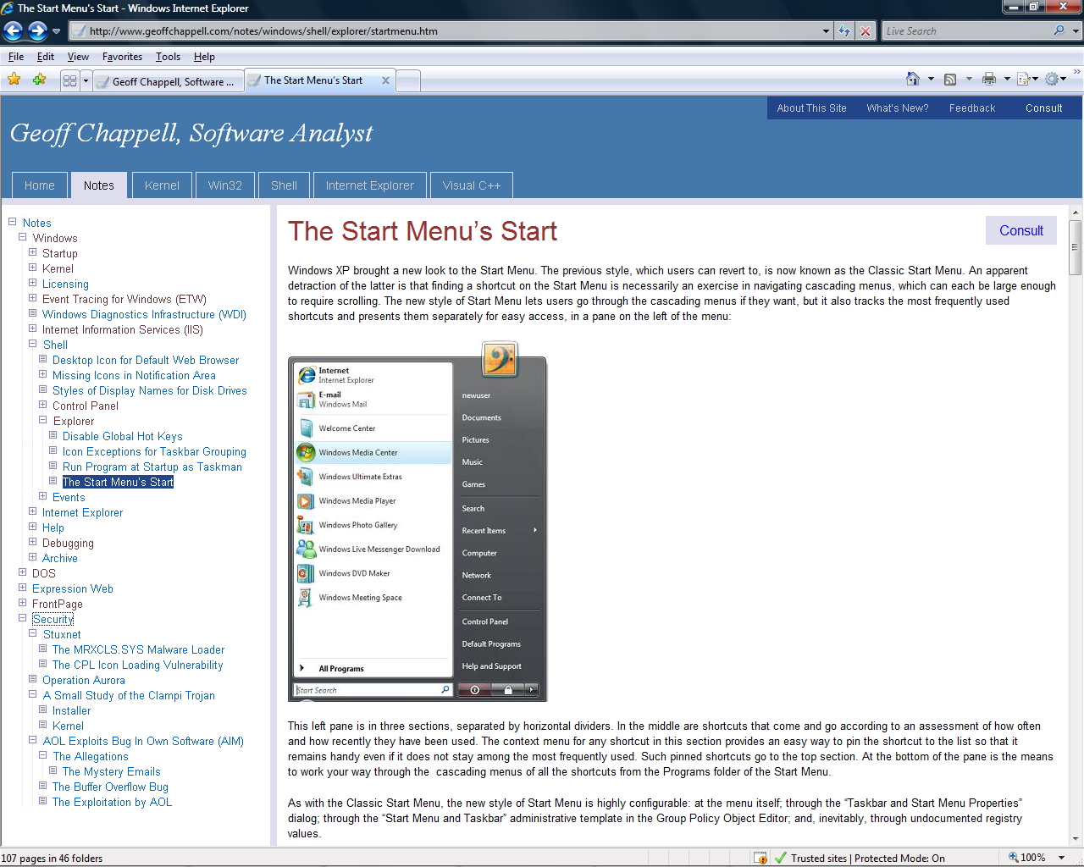
www.geoffchappell.com
Notes:
Quick write-up, incidental to exploration of programming functionality; information obtained by reverse engineering but not itself for either programming or security.

Slide 19
Why Reverse Engineer?
If Not For Security
check what software manufacturers claim
about their own software – they do lie!
AOL, which explicitly denied AIM buffer overflow
Microsoft, e.g., for browser integration
everyone (?) in disclosure of security vulnerabilities
about other software
patent infringement
Notes:
You may have no competition when developing undocumented functionality, but what you develop may have no market.

Slide 20
Why Reverse Engineer?
If Not For Security
become a better programmer
under-documented functionality
avoid quirks and errors - debugging in advance
develop better judgement - know how to get stuff (truly) working
undocumented functionality
improve on Microsoft’s own use, and have little competition
develop better judgement - know what’s better avoided
code generation
better debugging skills - seen it all before
develop better judgement - know how to write
Notes:
You may have no competition when developing undocumented functionality, but what you develop may have no market.

Slide 21
Security
AOL Exploits Bug In Own Software (1999)
a buffer overflow in AOL software used by AOL to distinguish their client from Microsoft’s imposter
A Small Study of the Clampi Trojan (2009)
ordinary banking spyware with p-code obfuscation technology said to be “almost impossible” to reverse engineer
Operation Aurora (2010)
Internet Explorer bug and fix described in detail before Microsoft published fix
Stuxnet (2010)
CPL execution via shortcut widely miscategorised as parsing error

Slide 22
Control Panel Items
Stuxnet gets code loaded just from browsing
shortcut to (supposed) Control Panel item
CVE-2010-2568
Microsoft: “Windows incorrectly parses shortcuts”
Me: parsed correctly, too trusting
CVE-2015-0096
defect in fix (found by Michael Heerklotz)
PoC||GTFO 14:08

Slide 23
Perspective Similarity
The everyday problems are self-contained.
Programmer writes a program that:
shifts data in, out and around;
calls towards operating system as magic.
Security researcher inspects such programs for:
mistakes in data-manipulation algorithms;
misunderstanding of the magic.
Mostly under control from both perspectives, technically and commercially

Slide 24
Perspective Similarity
Detail is hideously uneconomic!

Slide 25
Other People’s Software
The tricky problems are in the magic.
Different perspective
not looking down or in at system and hardware
looking up or out at “stack” of generality and arbitrariness
Not everyone is up to it.
Software industry mostly has it controlled
by moving most programming far up the stack
Security industry less so
perhaps seen as uncommercial
occasional errors and omissions

Slide 26
Windows Research
Sure to turn up things that everyone can use and may even need. So, please, fund it!

